Slide 1
Ear, Mind, or Brain?
Reflections on Musical Similarity
Eleanor Selfridge-Field
Stanford University

Slide 2
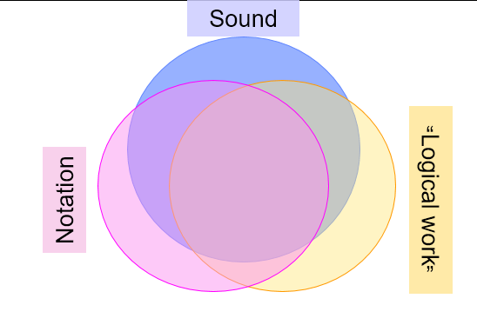
Music as sound
Timbre
Tempo
Dynamics

Slide 3
Human factors in assessments of similarity
  Artistic interpretations in performance
  Cognitive weights of feature-based comparisons
  Perceptual factors in the experience of “similarity”
  Cultural conditions

Slide 4
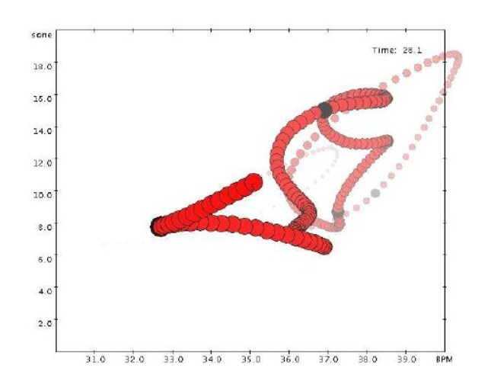
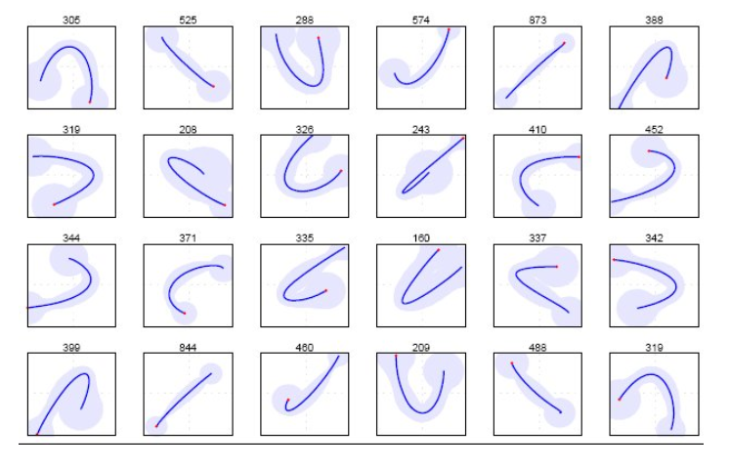
What is music?
Cognitive aspects of musical similarity
Performance worm
Beat-level tempo changes
Simon Dixon, Werner Goebel, Gerhard Widmer: Performance worms

Slide 5
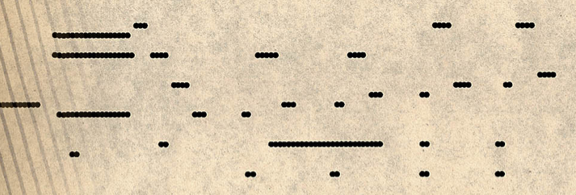

Differences issue from several domains
Music as sound
From SUPRA (Stanford U. Piano Roll Archive): supra.stanford.edu
Listening to performance differences (Pianola website)
“Five Foot Two”
Marg. Thomson, 1925
Superphone Label

Slide 6
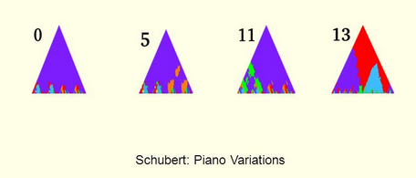
Cognitive aspects of musical similarity
Craig Sapp: Notation-based extrapolation
of harmonic similarity

Slide 7
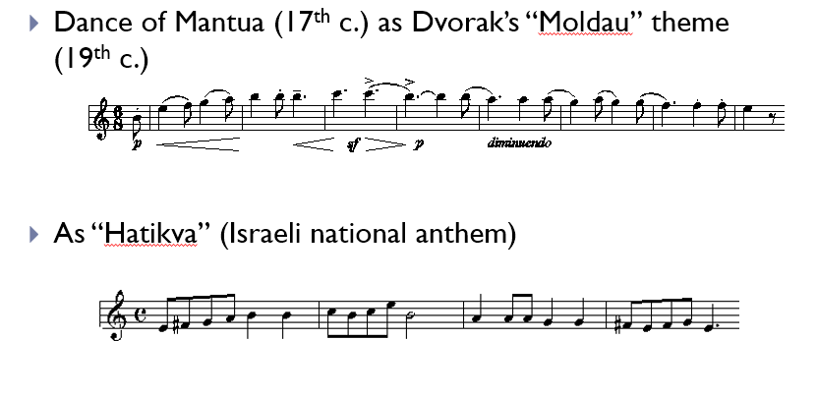
Social factors, cultural Interpretation
Cultural and social factors in musical similarity

Slide 8
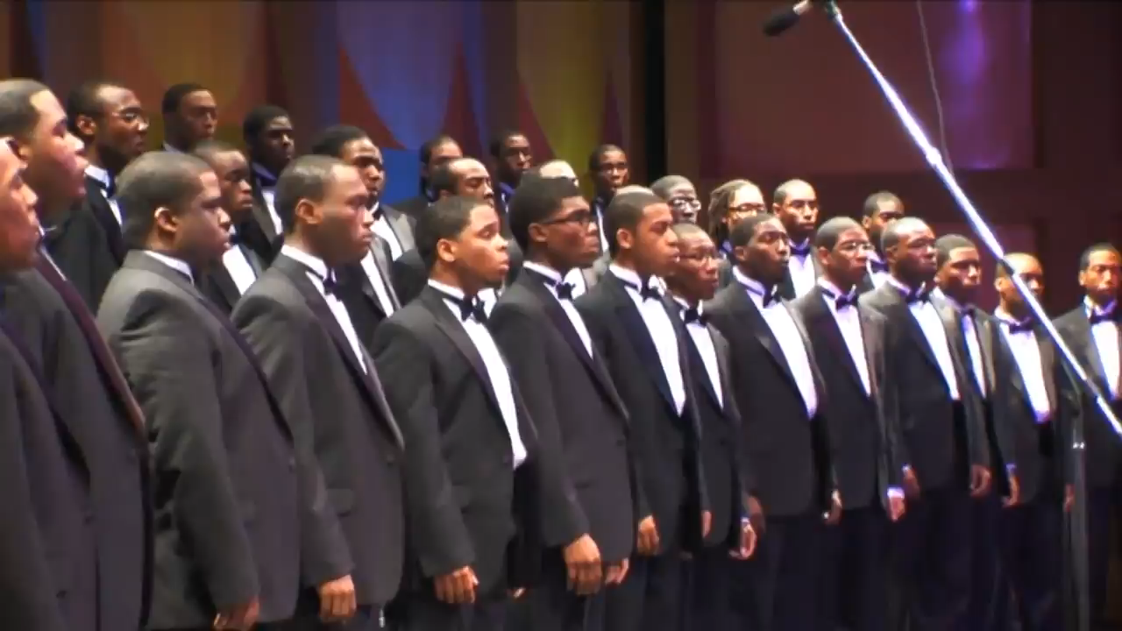
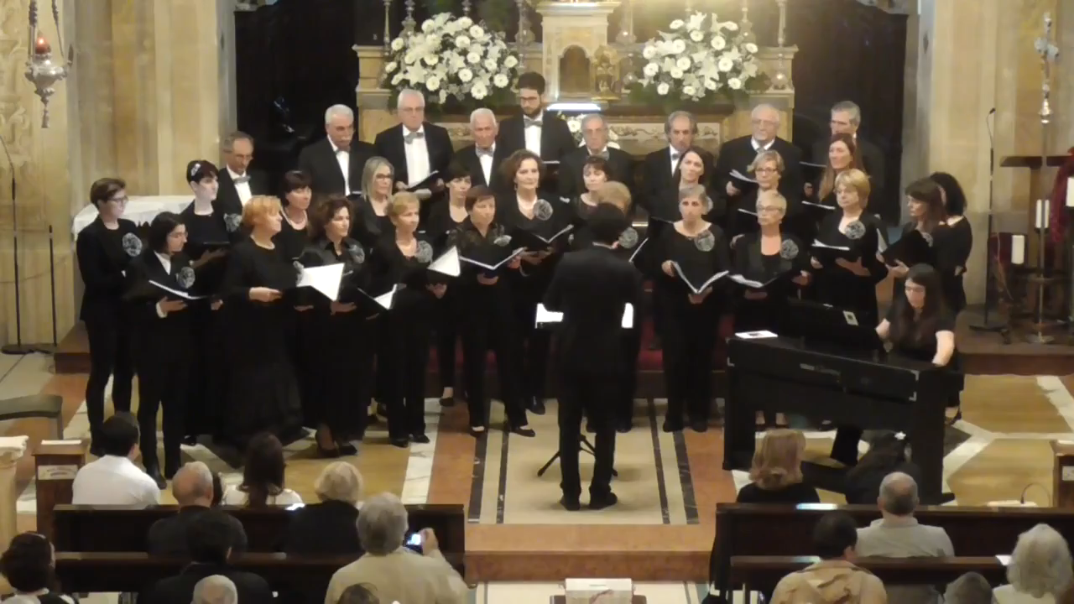
Cultural distance
We shall overcome
Morehouse College Glee Club 2009
[arr. Wendell P. Whalum]
O Sanctissima (Latin hymn,
18th century)
https://www.youtube.com/watch?v=Aor6-DkzBJ0
Coro Città di Castelarano, dir.
Marco Giudorizzi, 2017
https://www.youtube.com/watch?v=SGFcce-NfQ8

Slide 9
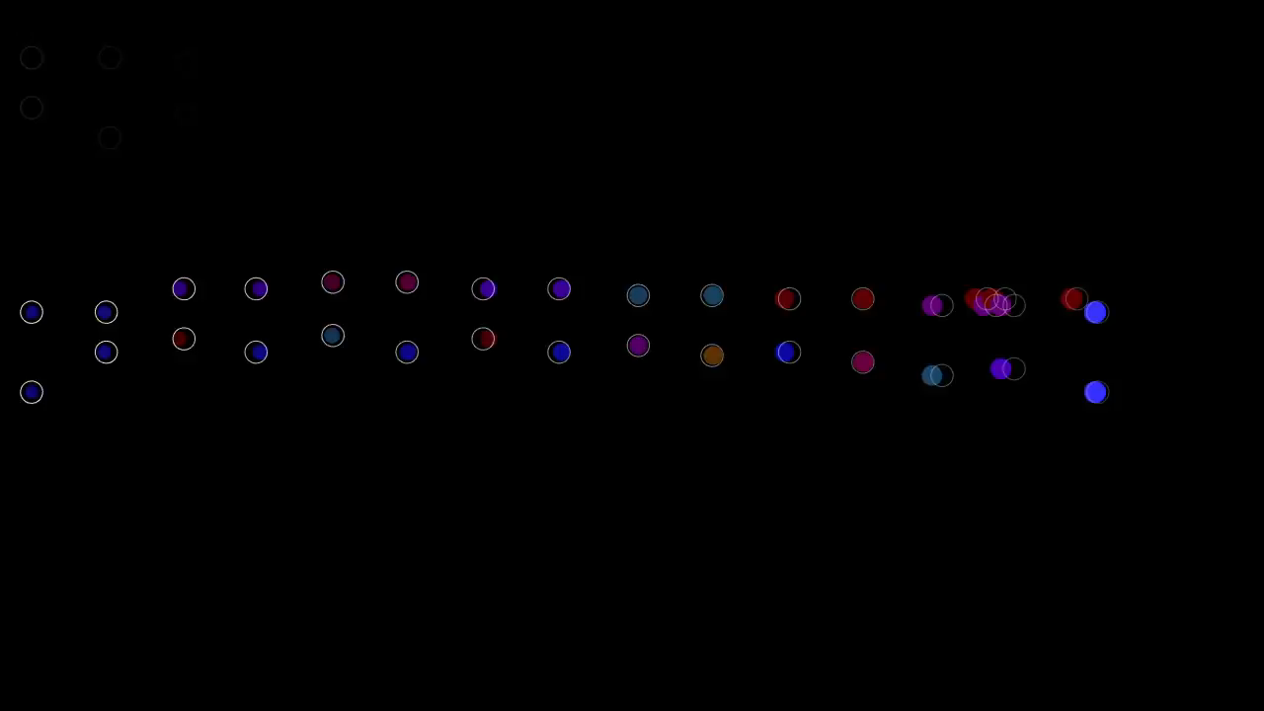
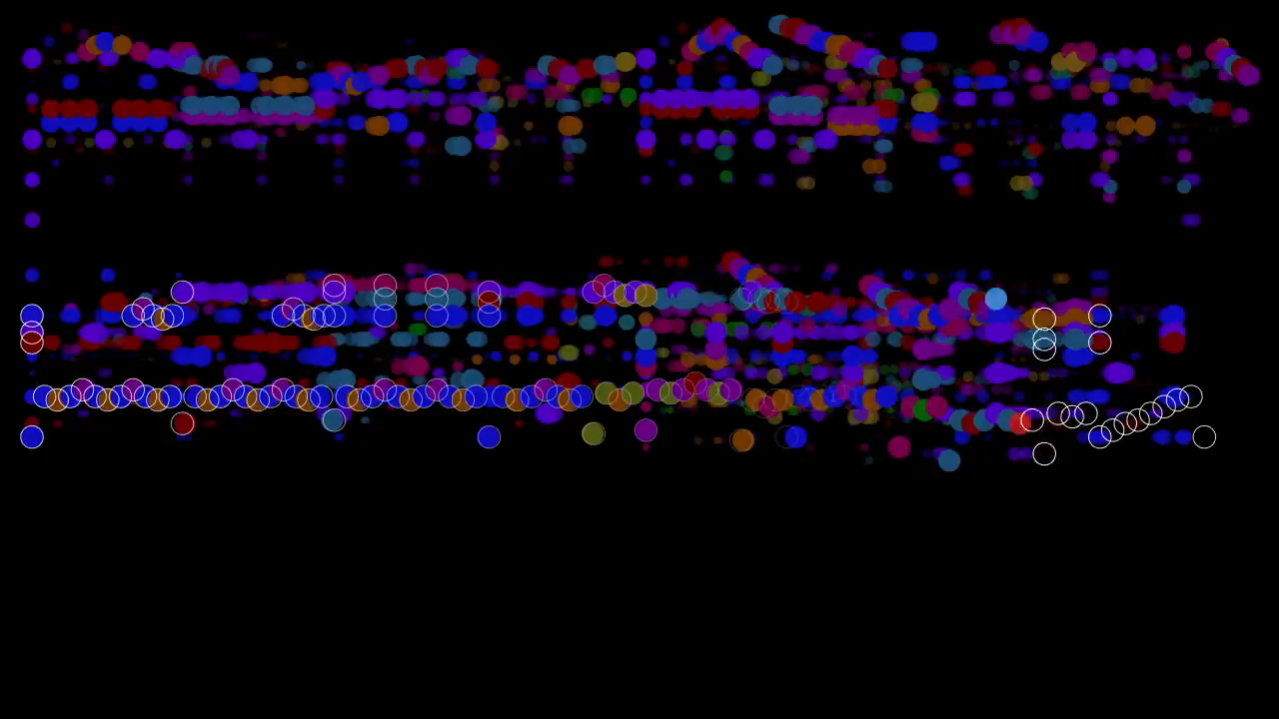
Perceptual Difference: Melodic elaboration in Mozart
Visual realizations by Stephen Malinowski, Music Animation Machine, after Mozart:
“Ah vous dirai-je Maman”, K. 265 (YouTube: Musam 2016)
Example 1:
Example 2:

Slide 10
Topic 2 of 2
Musical similarity in music-copyright infringement

Slide 11
Seminal cases
Arnstein vs. Porter (1946)
  establishes concept of substantial musical similarity (SMS)
  establishes idea of lay listener test
Gaye vs. Williams and Thicke (2013)
  Verdict on appeal—March 2018
  Provisionally prohibits similarity of style in protected work
Skidmore vs Zeppelin (2020) “Taurus” vs “Stairway to Heaven”
  Dispute concerns only introductory descending sequence

Slide 12
Ira Arnstein and the concept of substantial musical similarity
Arnstein vs. Porter (1946)
Long series of cases (1940…) in which Arnstein was the plaintiff. (He always lost.)
1946 ruling by Jerome Frank established two principles:
  Similarity must be “substantial”
  Likeness must be determined by “lay listeners”

Slide 13
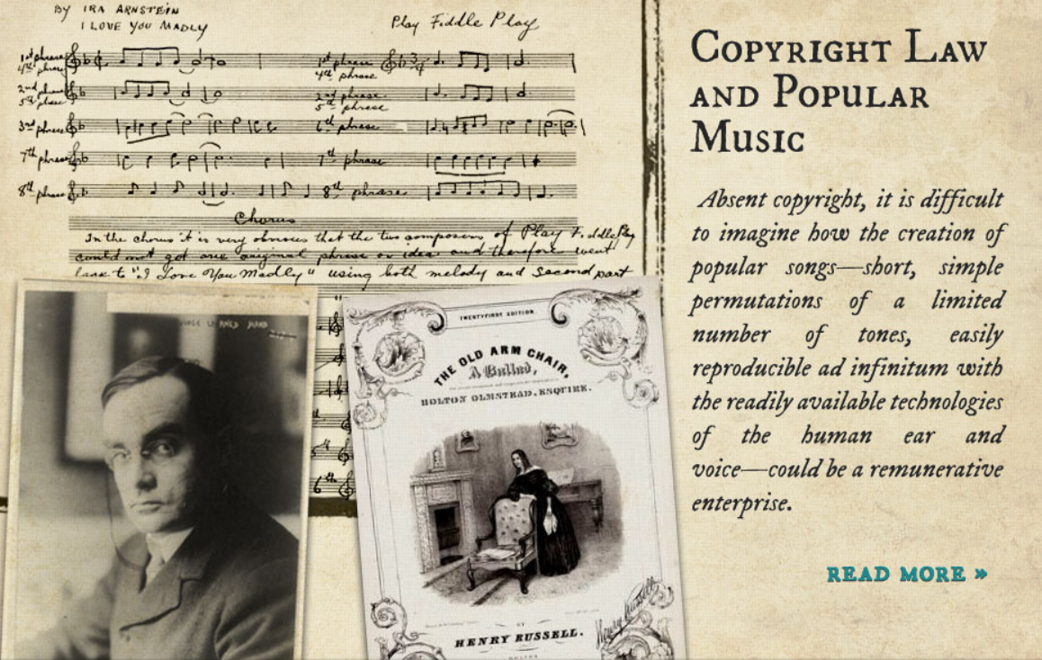
Sardonic view of music copyright

Slide 14
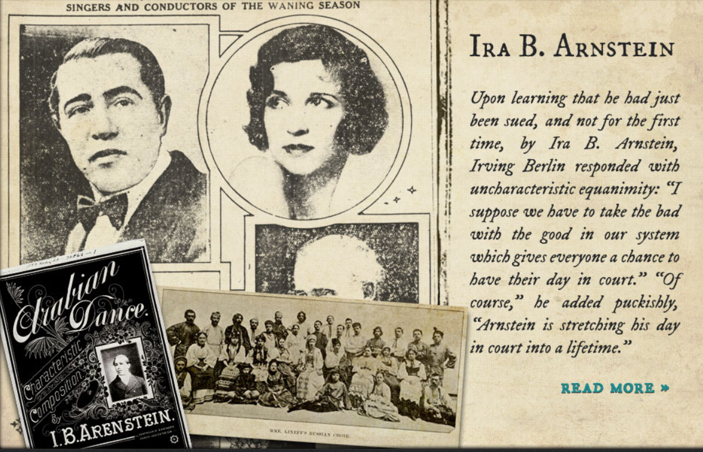
Irving Berlin’s opinion of Arnstein

Slide 15
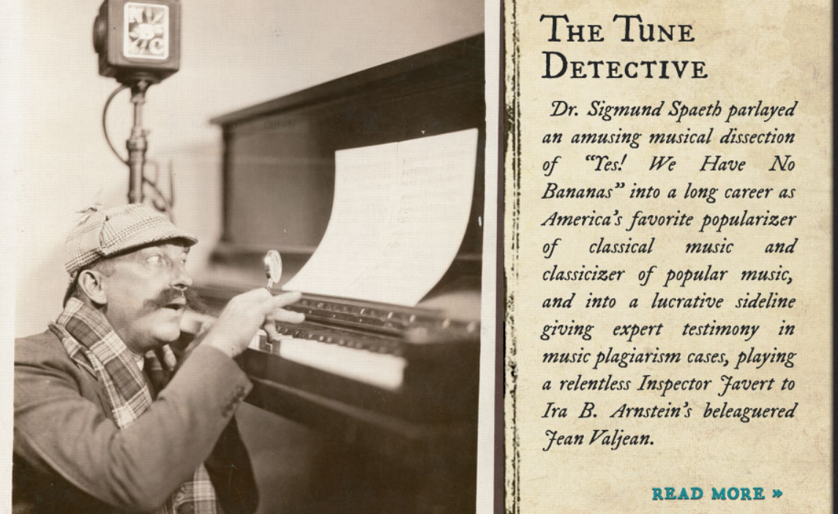
Detectives investigate musical similarity

Slide 16
Similarity of which features?
1946: Notation base
Main parameters
Melody
Harmony
Rhythm
2013: Audio/video base
Main parameters
Timbre
Tempo
Dynamics

Slide 17
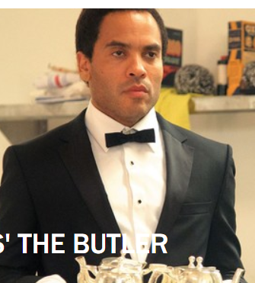
Contractual disagreements
We shall overcome (2015)
Audio-visual synchronization rights: $100,000 [film = The Butler, Lee Daniels, 2013]

Slide 18

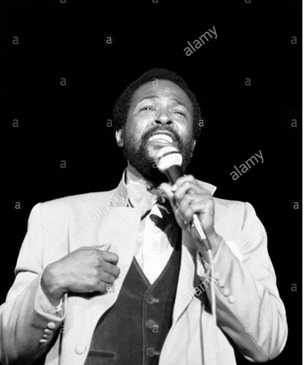
Gaye (L) vs Williams, Thicke (R)
(2013; appeal, 2015; Gaye prevailed, 2018)
Estate of Marvin Gaye RE: “Got to Give it Up (1976/1977). This photo: Birmingham, UK 1976
Pharrell Williams and Robin Thicke (2013).

Slide 19
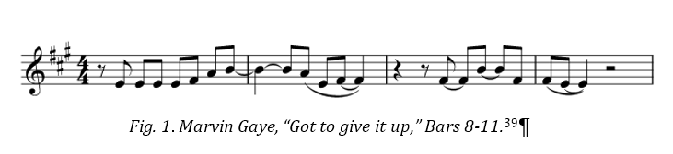
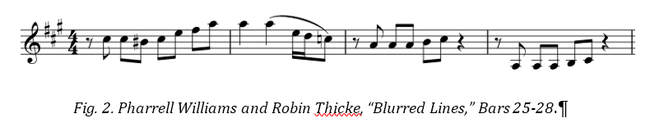
Melodic comparison (involves slipping positions)
Timbre
Tempo
Dynamics
Note position,
Scale degrees

Slide 20
What is a substantial melody?
Timbre
Tempo
Dynamics
Note position,
Scale degrees

Slide 21
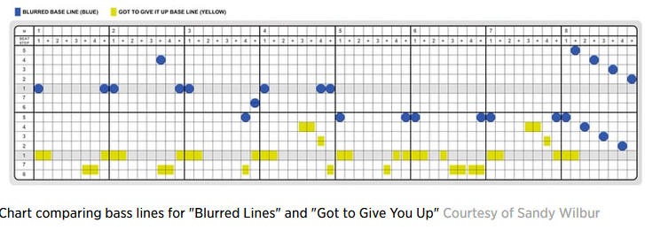
Notated vs. performed music in copyright litigation
Sandi Wilbur’s diagram
of rhythmic activity

Slide 22
Gaye estate vs Williams and Thicke; Williams et al vs Gaye estate*
2013 (copyright), 2015 (suit), 2018 (appeal),
Standing judgment:
*Musical style is a protectable element

Slide 23
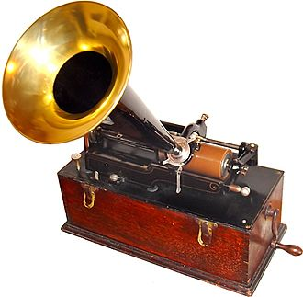
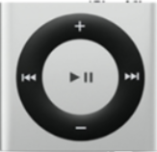
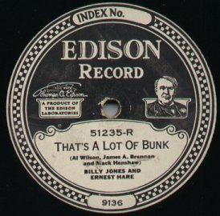

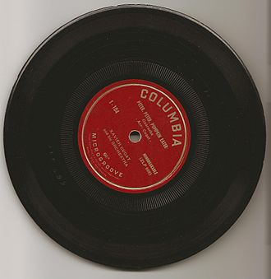
Changing music technology as pivot
  1999 Record sales peak
2009 Streaming music downloads peak
2015 Digital downloads = 90% of music sales
1900
2000
1920
2018
1950

Slide 24

“
Notated vs performed music in (US) copyright registrations, 1940-2017
Decade | Score only | Recording only | Score & recording | Music video/film | MIDI file
1940-49 | 2 | 3 | 7 | 2 | 0
1950-59 | 0 | 2 | 7 | 0 | 0
1960-69 | 1 | 0 | 5 | 0 | 1
1970-79 | 1 | 0 | 4 | 2 | 1
1980-89 | 2 | 4 | 3 | 3 | 3
1990-99 | 2 | 9 | 5 | 1 | 2
2000-09 | 0 | 25 | 0 | 0 | 1
2010-17 | 0 | 21 | 1 | 0 | 0
Source: Charles Cronin’s

Slide 25
Drift in registration media (1940-2017)

Slide 26
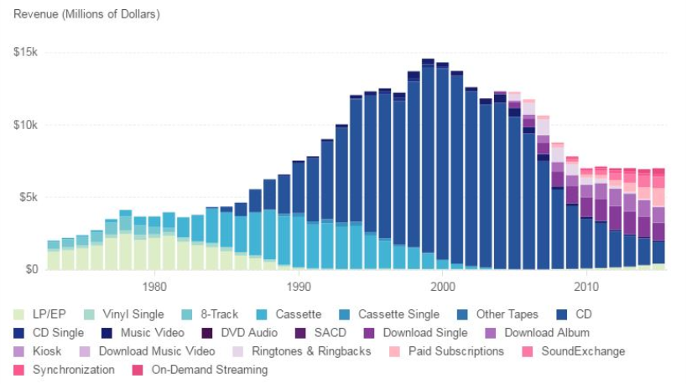
RIAA revenue by delivery medium (2016)

Slide 27
Controversial points ( “Blurred Lines”)
Can a musical style be owned by one entity?
Should cases be argued on the basis of registered copies only?
See E. Selfrdge-Field, “Substantial Musical Similarity in Sound and Notation”, Colorado Journal of Law and Technology (2018) in HeinOnline (legal aggregation) via Stanford logon

Slide 28
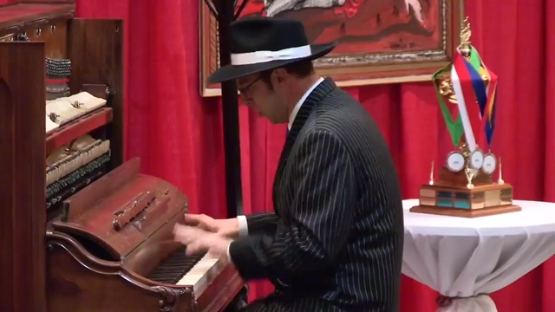
Should every “style” be exclusive to its own creator?
Improvisatory pastiche (18th/20th centuries)
Ethan Uslan, 2012
(parody)

