Slide 1
Playing by ear beyond 100
ICMPC San Francisco 2016
Eleanor Selfridge-Field (esfield@stanford.edu)

Slide 2
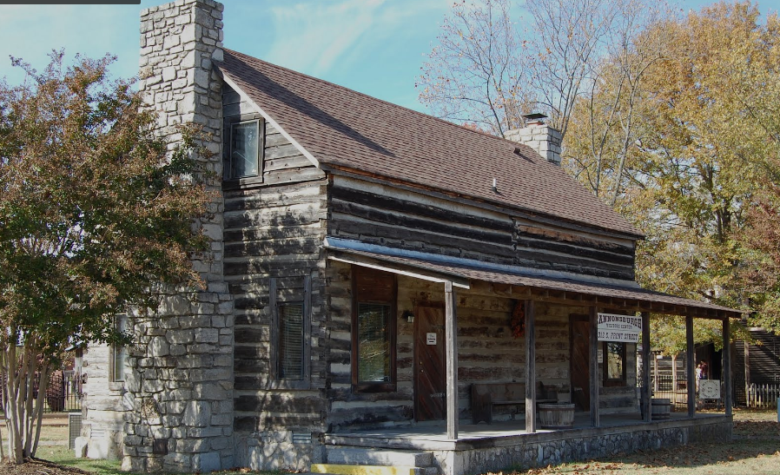
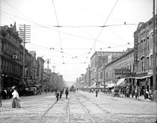
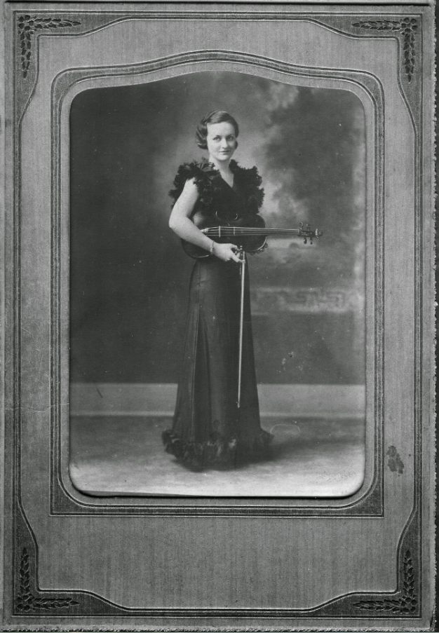
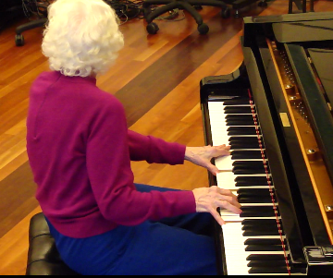
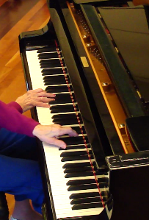
2010
ICMC 11

Slide 3
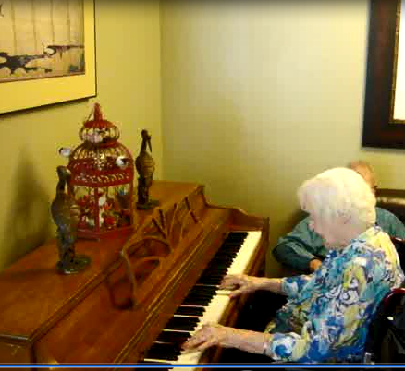
Updates, 2010-2016
Now 101.9 yrs
Still playing
Areas of change:
Simpler arrangements
Some loss of digital dexterity
More focus on content:
Scope of repertory
Scope of harmonic vocabulary, rhythmic articulation

Slide 4
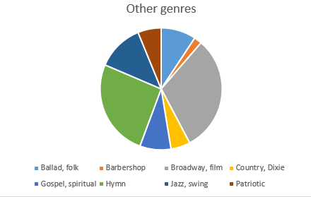
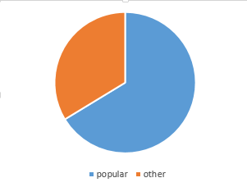
Repertory: Genre
Central points:
Genre ambiguity
Arbitrariness of genre-classification systems
Basis = 365 identified items
Unidentified (omitted) = 33

Slide 5
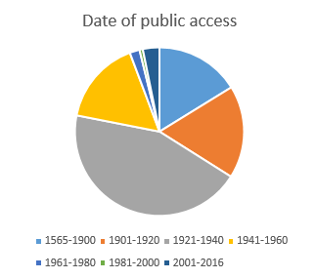
Repertory: Learning window
Central points:
Read clockwise from noon
Peak = school, early adult years (grey, 4:00-9:30)
Learning improved by performance over past decade (blue serge, 11:30-12:00)
Caveats:
Based on copyright records
Many works were re-popularized at one-generation intervals
N = 315
Not classified = 83

Slide 6
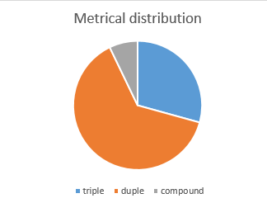
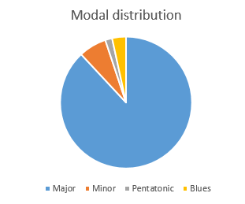
Repertory: meter and mode
N = 315 (mode)
N = 280 (meter)
Central points:
Beware of cultural artifacts
Music pre-1920 leaned heavily to triple meter, major mode
1920-1940: emergence of Broadway, jazz, and blues (complex rhythmic patterns)
1940-1980: strong influence of film music

Slide 7
Musically significant features of performance
Harmonic richness
Inventory of chord types in own composition = 18*
Melodic and harmonic inventiveness
Intermediate and final cadences filled with much improvised activity
Exploitation of register to vary verse repetitions
*Chord varieties in C Major = I, I#5-7, I7, I9, II, II#3, II7dim, ii9, II#3#7, IV, IV9, V, V7, V#5-7, v, VI#3, VI7, VIdim7. Composition date = 2005

Slide 8
Same/different features of performance
Stability of tempo: consistent but not identical from from one repetition to the next
Arrangement ability: gradual tendency to shorten, without significant loss of inventiveness (probably caused by physical, not cognitive, disability)
Tonal orientation: intact but moot
(plays in C Major/A minor unless directed otherwise)
Timbre recognition: intact (20-timbre test)
Adaptability in ensembles: intact (accommodates to duos, trios, vocal accompaniment)

Slide 9
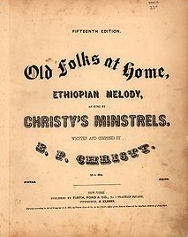
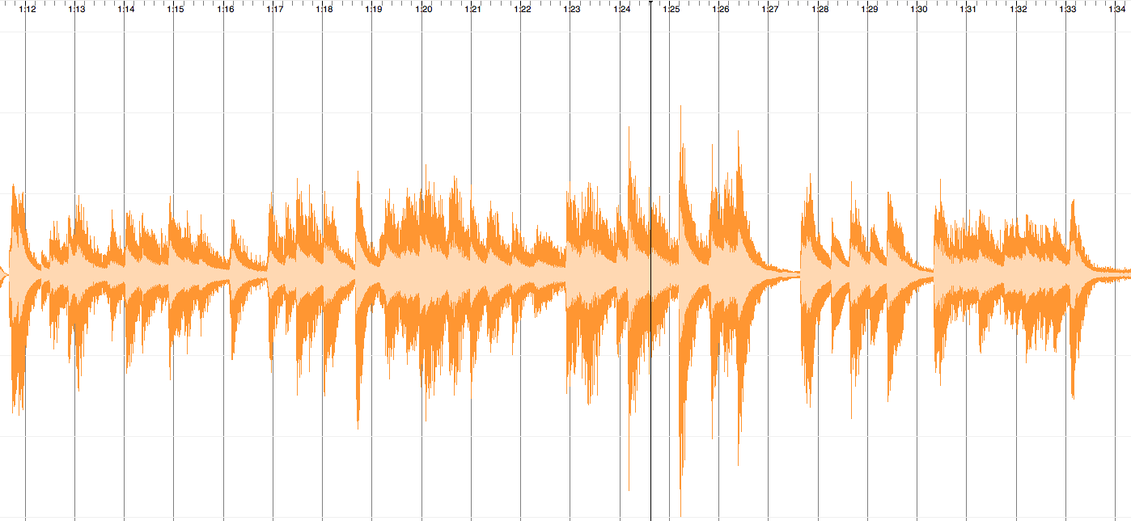
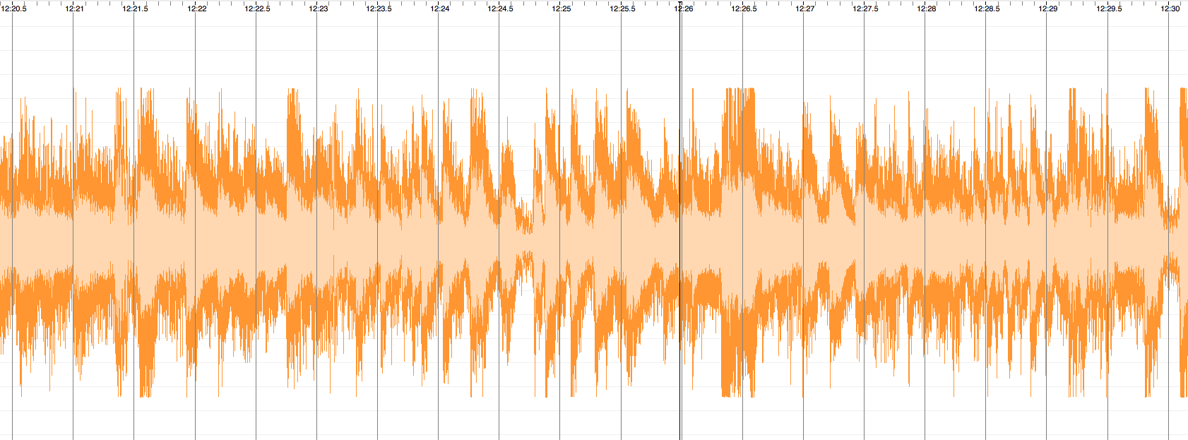
Performance visualizations: Swanee
Swanee 2009
(MIDI)
Swanee 2014
(recording with background noise, sw artifacts)
“Old Folks at Home”, Stephen Foster, 1851

Slide 10
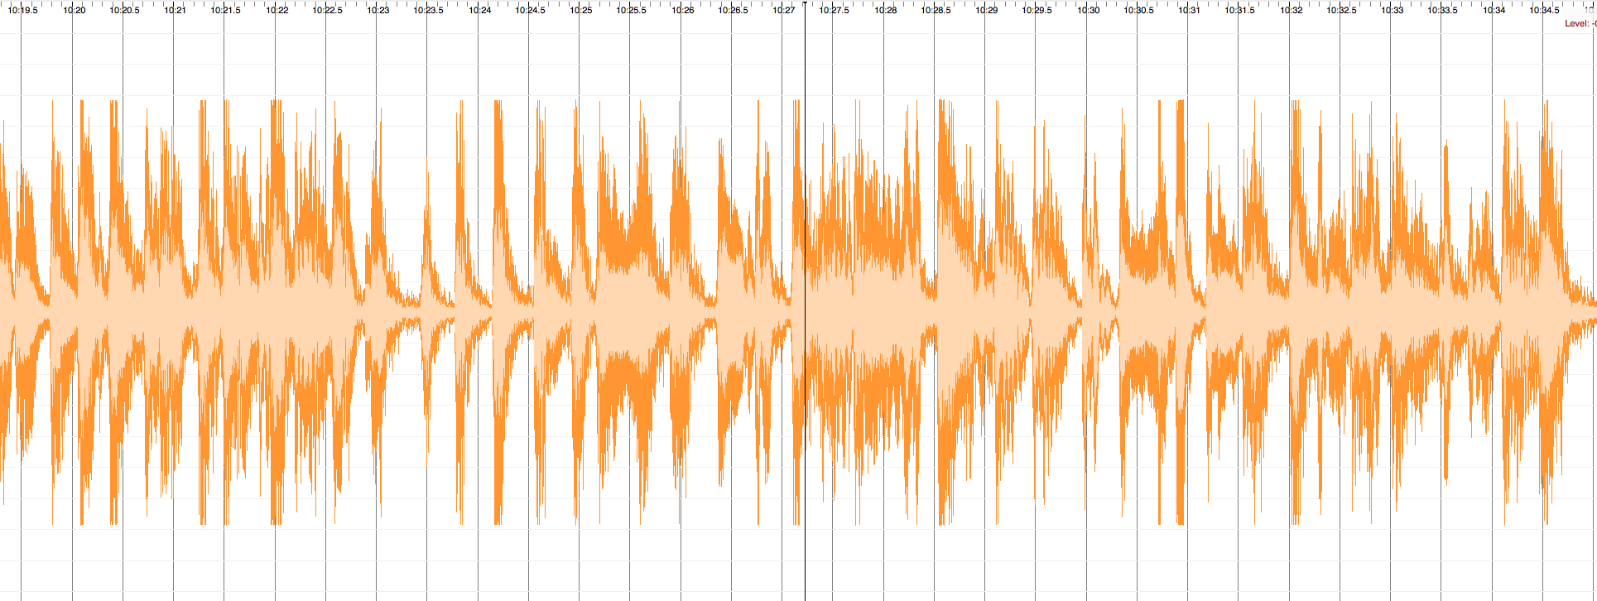
Performance visualizations
St. Louis Blues (2013)

Slide 11
A life in (and out of) music (1914--)
Credits:
Family of ME
Petr Janata
Julene Johnson
Rose Lily
Caroline Palmer
Craig Sapp
San Jose Met. Band

