Slide 1
When is a dissonance a dissonance?

Slide 2
1. Consonance and Dissonance

Slide 3
Pre-staff notation
Cheironomic (Byzantine)
Neumatic (Roman)

Slide 4
Monophony
Windsor Epiphany chant

Slide 5
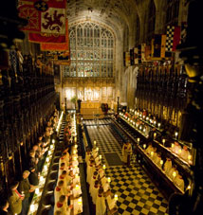
Monophony
St. George’s chapel,
Windsor Castle
Points of note
Windsor Epiphany chant
Illumination of initials
Four-line staff
Square notation (neumes)
Emphasis of text, not music
Architectural space suited to antiphony

Slide 6
Tetrachords, tuning, and music: Guido and Hucbald (1)
10th-11th centuries

Slide 7
Tone-semitone schemes described by Hucbald
Tetrachords, tuning, and music: Hucbald (2)

Slide 8
Elaboration of tetrachords into extended systems of tonal relationships
Modal mapping
Octave mapping
Tetrachords, tuning, and music: Hucbald (3)

Slide 9
Hucbald’s staff notation
Differentiating whole and half steps

Slide 10
The Gamut and the Hexachord (1b)

Slide 11
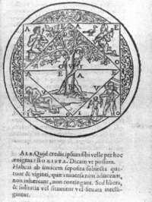
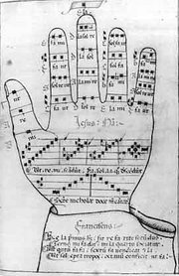
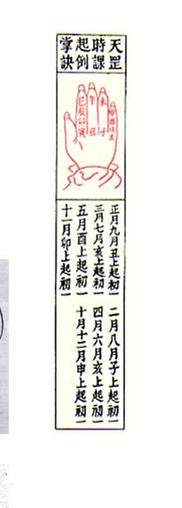
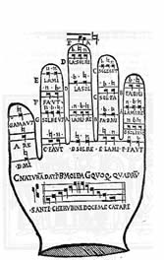
Mnemonic aids to memory
Guidonian and other “hands” (11th century onward)

Slide 12
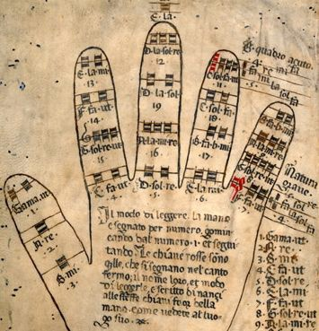
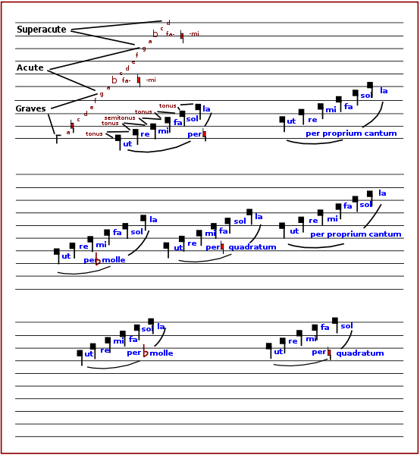
The Guidonian hand explained
The gamut was the “gamma ut” [the first ut]

Slide 13
Insert: tetrachord, hexachord

Slide 14
Rhythmic aspects of monophony and early polyphony

Slide 15
Iambs, Trochees et al. in neumatic notation
Quantitative accentuation: weak-STRONG

Slide 16
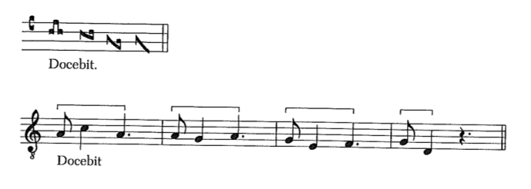
Anapestic foot in neumatic notation

Slide 17
Isorhythm

Slide 18
Magnus Liber Organi (Notre Dame organum)
Trans. NE Smith

Slide 19
Neumes (and feet) of variable length

Slide 20
Syllabic settings

Slide 21
From Monophony to Polyphony

Slide 22
“Late” monophony: Music as appendage to text
Machaut

Slide 23
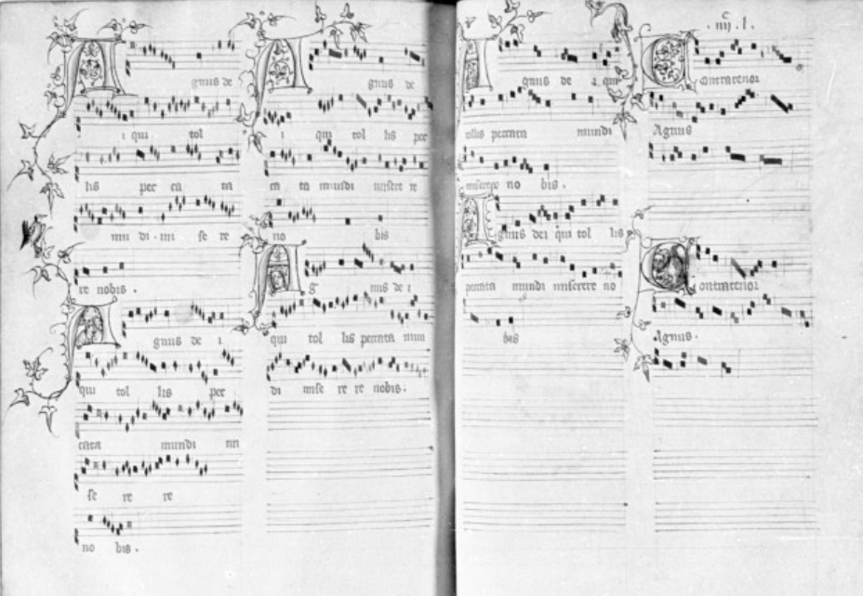
Machaut’s polyphony
Physical presentation (Agnus Dei a 4)

Slide 24
Machaut: The instrumental “tenor” part

Slide 25
Organum
Winchester troper (12th century)

Slide 26
Organum
Acquitanian florid polyphony

Slide 27
The ballata
Relatively homphonic, with musica ficta considerations

Slide 28
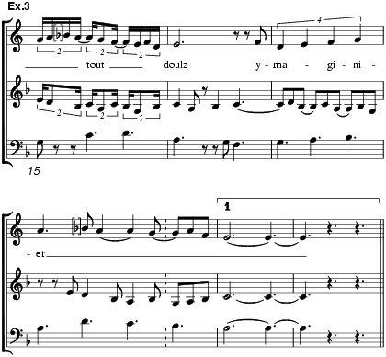
Secular vocal
Cascia,

Slide 29
Virelai
Dufay

Slide 30
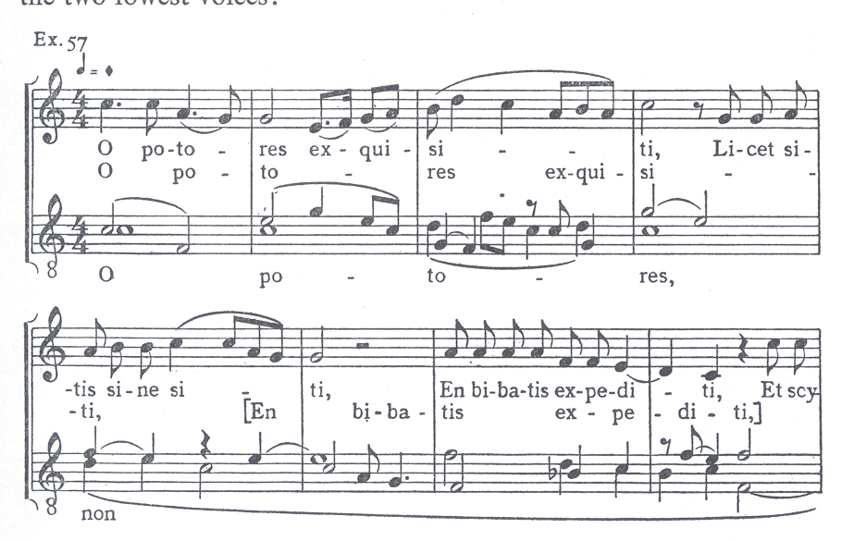
Other secular music
Upper right: Florentine Carnival song
Lower left: Latin drinking song

Slide 31
The Motet:
John Bedingham—sacred parody (bottom) of secular chanson.

Slide 32
Derived subjects
Josquin—Hercules Dux Ferrarae

Slide 33
Expression in the ballade
Binchois’s “Ay douloureux”

Slide 34
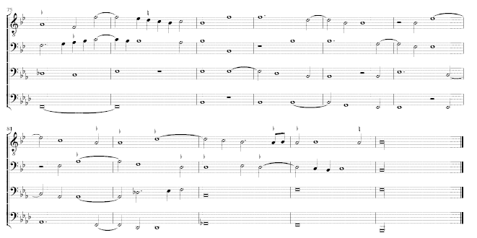
Absalom, fili mi
Absalon, fili mi:
As in source
Absalon, fili mi
With usual editing

Slide 35
Making polyphonic voices cohere

Slide 36
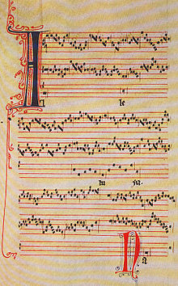
Making polyphonic voices cohere
Perotin: Alleluia Nativitatis
Tenor forced to adopt a “foot”
Meter and rhythm

Slide 37
Puzzle pieces (Ars nova)
“Sub Arturo plebs” by Johannes Alanus (England)
[possibly for feast of St. George, Windsor, 1358,
to celebrate victory at Poitiers]
3 voices, 3 texts
Added part=24 longae,
subdivided in even groups
of 8.
Variable meters (taleae)

Slide 38
Isoryrhmic legacies:
Proportion, voice independence;
Here: polymeter (tenor=2/4, triplum=6/8) in third (diminished) repetition of tenor.

Slide 39
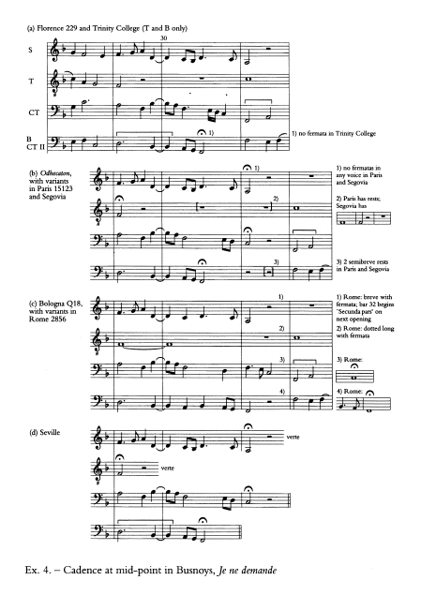
Making polyphonic voices cohere
Melodic cells

Slide 40
Prolational latitude

Slide 43
Eton Choir Book

Slide 44
English partbook
Dow partbook

Slide 45
Lost anthology of early polyphony
Bologna Q15

Slide 46
Chigi Codex (Vatican Library)

Slide 47
Josquin: Fortuna desperata

Slide 48
Capella Giulia Chansonniere (Vatican Library)

Slide 49
Modern editions

Slide 50
Kyrie 1
Dunstaple

Slide 51
Kyrie 2
Dunstaple

Slide 52
Reverse-color notation
Dufay: Conditur

Slide 53
Prophetiae Sybillarum
Lassus (Berger 1980)

Slide 54
Ockeghem

Slide 55
Printing
Obrecht, Agnus Dei

Slide 56
Melodic cells and their migration
Busnois (Blackburn)

Slide 57
Alignment
CMME

Slide 58
Fixed melodies and rhythms
Blackburn (anon)

