Slide 1
The evolving uses of encoded music
Eleanor Selfridge-Field
CCARH, Stanford University
esfield@stanford.edu

Slide 2
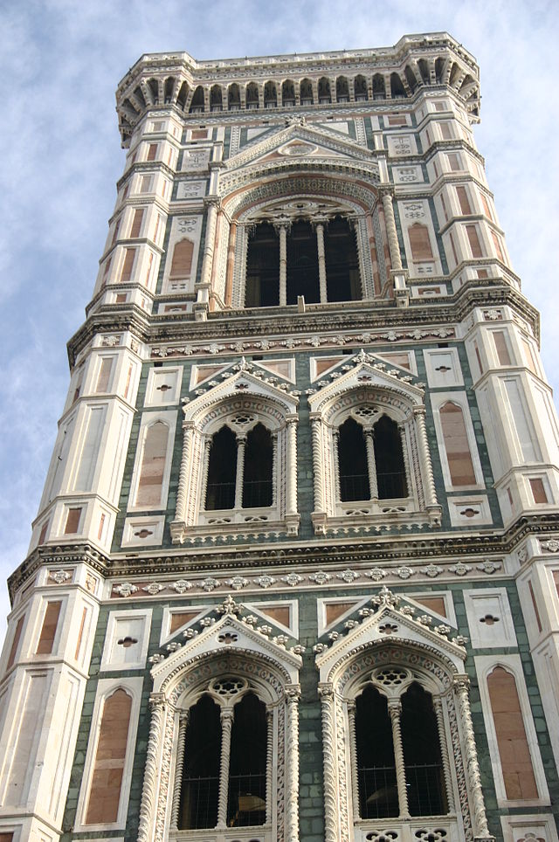
How did we get to MEI?
Technical development
Sound transcription
Score production
Computer-generated music
Markup languages
Changing perception of needs
Text/music integration
Cataloguing for online resources

Slide 3
Purposes of encoding before MIDI
To mechanize score production [DARMS]
To generate sound [Music V, Teletau]
To facilitate pedagogy [IRCAM]
To manage/archive music content [MuseData]
To analyze content [Humdrum]
To visualize musical content [Keyscapes, Timescapes]
To provide critical knowledge of musical sources [MEI]

Slide 4
Young’s “Composing Machine” (1747)
English system from 1747 (Grove’s Dictionary I, 1888)
Grove miscast this: later writings explain that
the piano keyboard drove a type-compositing machine
Main aim: score from performancc

Slide 5
Binary systems in the 19th century
L: Jacquard loom,
Paris, c. 1850
Pattern control for
weaving machines
R: “Punch card” loom
pattern

Slide 6
Score codes of the mainframe era (1966-1973)
Focus: rapid production of publication-quality scores
1966: DARMS (Columbia U., NY Philharmonic)
1967: MUSTRAN (Indiana U., Illinois U.)
1972: SCORE (Stanford U.)
1973: IML-MIR (Princeton U.)

Slide 7
Score codes of the mainframe era (1966-1973)
Focus: rapid production of publication-quality scores
1966: DARMS (Columbia U., NY Philharmonic): “great society” jobs
1967: MUSTRAN (Indiana U., Illinois U.): folk songs, musical examples
1972: SCORE (Stanford U.): new music editions
1973: IML-MIR (Princeton U.): philological and analytical use

Slide 8
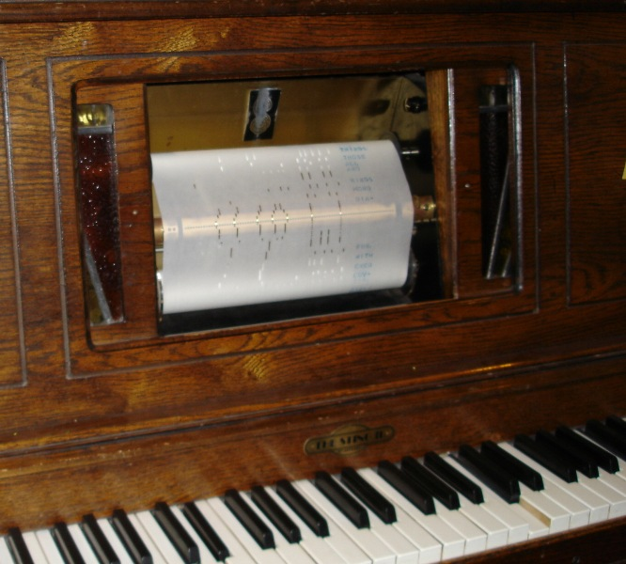
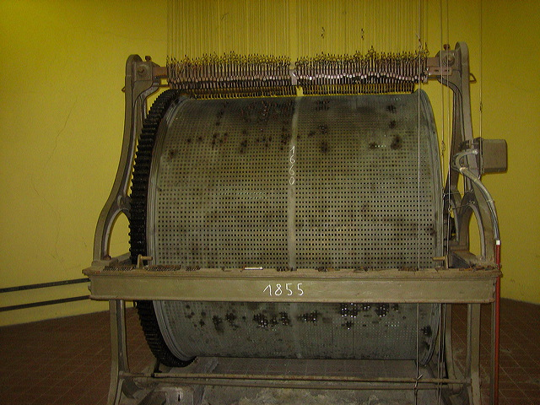
Performance encoding
Organ role, c. 1890
Welty-Mignon piano roll, c. 1905
Pianola roll, c. 1925

Slide 9
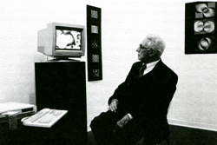
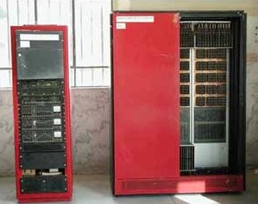
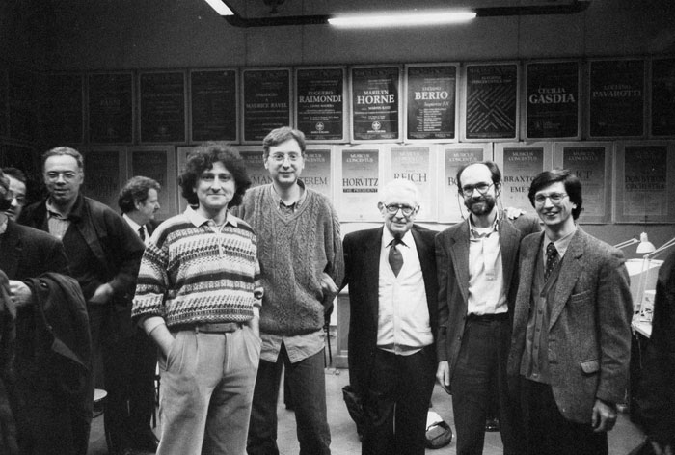
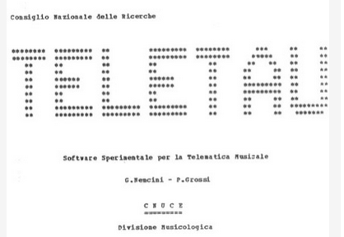
Notelist encoding for sound generation (1986)
Repertory en- codingg
Teletau
Main achievements
Pietro Grossi
(1917-2002)
Pioneer in…..
Florence, Pisa, music, art, “telematics” (interactive music, c. 1970)
Lelio Camilleri (now Bologna)
Codification, applications
Created library of 800 works!
TAU

Slide 10
Other contributions from electronic music
Bell Labs (NJ), fr. 1956:
Music V [Max Mathews]
Csound [MIT] [Barry Vercoe]
Exchange and dispersion
L. Smith, J. Chowning (Stanford): SCORE
J-Cl. Risset (Marseille): interactive
Miller Puckette (San Diego): sound
David Wessel at al. (IRCAM, Berkeley)
Features needed
Frequency (>pitch)
Duration
Timbre
CCRMA
IRCAM, CNMAT:
Open Music
Princeton/Stanford (2008--):
ChucK: streaming data for real-time interactive performance (Ge Wang)
TELETAU

Slide 11
Current purposes
Editions (from sources)
Arrangements, extractions
Pedagogical material
Analysis, visualization
Other kinds of repurposing

Slide 12
Humdrum: The Work of David Huron
Original focus: psychoacoustics
Features needed
Pitch
Duration
Pitch reinterpretation
Fields with generated content
Humdrum (statistical analysis)
-Waterloo U., Canada (interdisciplinary)
-Nottingham U., UK (musicology)
-Ohio State, US (music cognition,
psychoacoustics)
Table 3b from Orpen and Huron, “Measurement of Similarity in Music: A Quantitative Approach for Non-parametric Representations,” Computers in Music Research, Vol. 4, (Fall 1992), pp.1-44.
Cf. Humdrum Portal: http://humdrum.ccarh.org/

Slide 13
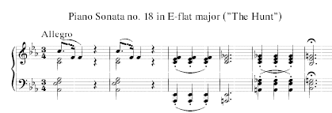
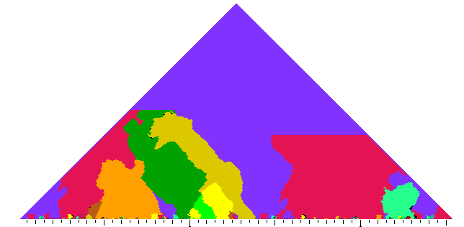
Work of Craig Sapp
Kern Scores
Keyboard music
Early polyphony
1520-1920
Graphical processing
Score display
Analytical-graphical processing
Piano-roll notation
Archived (raw) data
Re-purposable
Analytical processing
Keyscapes
resource
Code
kern.ccarh.org

Slide 14
MuseData: The Work of Walter Hewlett*
Features needed
Pitch
Duration
Score detail (beams, slurs)
Articulation
Transformability
Sound suggestions
Print suggestions
Repurpose-ability
MuseData (score representation):
Walter Hewlett et al.
-Stanford, CCARH

Slide 15
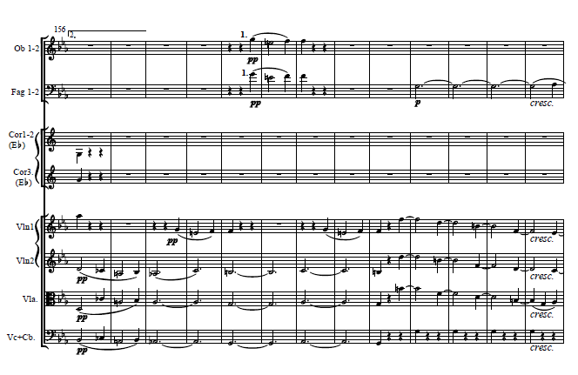
MuseData
Symphonies, operas, chamber music, et al.//scores, parts
1675-1875
Vivaldi: “Spring” concerto, Op. 8, N. 1
ccarh.org
Data + formatting
Score
Data + formatting
Parts
Archived (raw) data
Re-purposable resource
Data conversion
Code: MIDI, kern, PDF….
Beethoven: 3rd symphony
musedata.org

Slide 16
Critical editions
(in the analogue world)

Slide 17
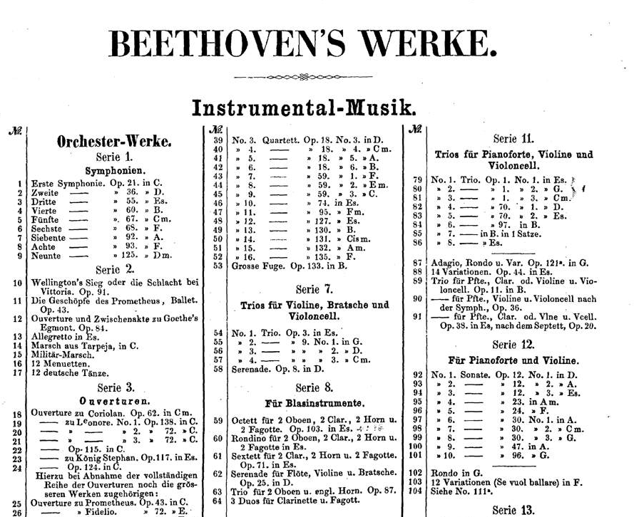
19th-century interest in music editions: B&H
Beethoven, Haydn, Mendelssohn, Schumann, Chopin, Liszt, Wagner, Brahms….
Breitkopf & Härtel from 1719
1830: Intelligenz-blatt der freien Stadt Frankfurt
V. 1 of Beethovens Werke Vollständige, kritisch durchgesehene überall berechtigte Ausgabe (1862)
B&H pub. Allgemeine musikalische Zeitung

Slide 18
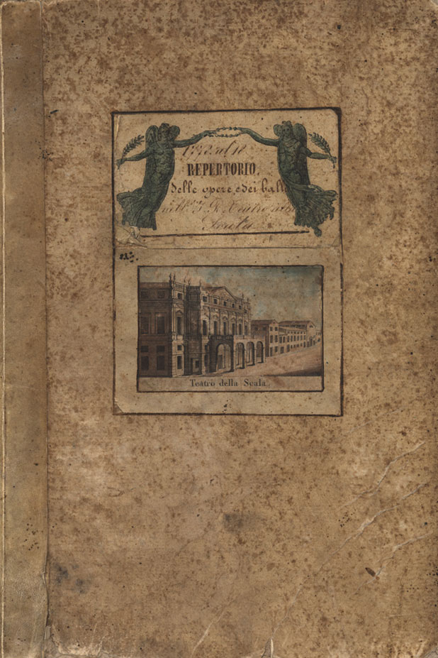
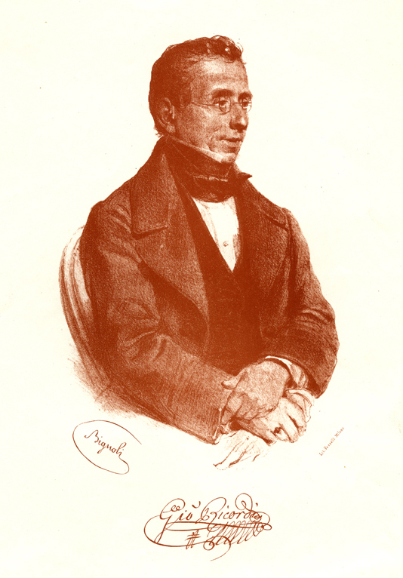
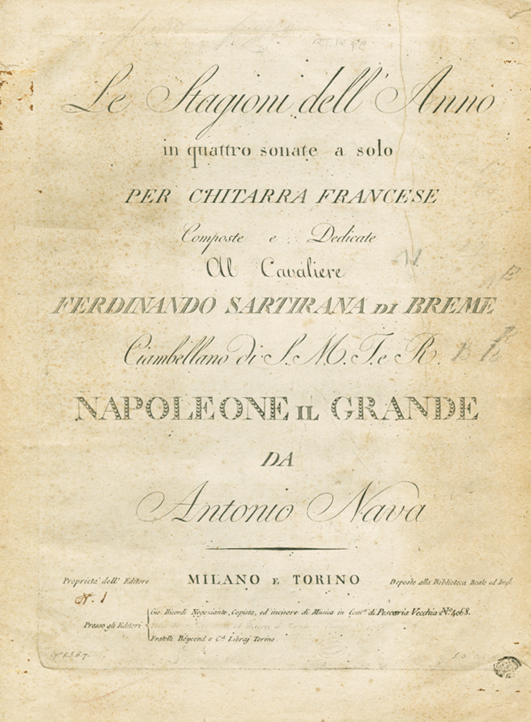
19th-century interest in music editions: Ricordi
Verdi, Rossini, Donizetti, Bellini, Mascagni, Leoncavallo….
Casa Ricordi from 1811
1839: Ricordi acquires opera scores
from Il teatro alla Scala
Gazzetta di Milano: Catalogo della musica,
G. Ricordi, 1828

Slide 19
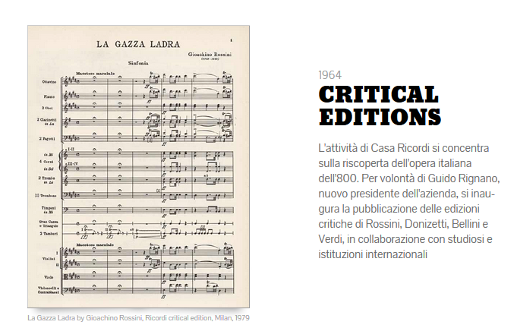
Copyright (1842). Critical editions (1964).
Ricordi now owned by Universal Music.
1842
1964
Ricordi limited to individual
numbers in operas except to
extent he could acquire
performing materials. Still holds Italian rights to Wagner.
Facilitated by La Scala archive
Ricordi Company Archives
http://www.ricordicompany.com

Slide 20
Evolution of critical editions
To 1929 | 1930s | 1940s | 1950s | 1960s | 1970s | 1980s | 1990s | 2000s | 2010s
17 | 4 | 4 | 18 | 7 | 1 | 2 | 4 | 6 | 3

Slide 21
Evolution of critical editions
To 1929 | 1930s | 1940s | 1950s | 1960s | 1970s | 1980s | 1990s | 2000s | 2010s
17 | 4 | 4 | 18 | 7 | 1 | 2 | 4 | 6 | 3

Slide 22
Rising expectations for critical edition
To 1940/50
1950-1980
Individual subscribers
Printed, bound
Limited critical notes
Handsome typography
Institutional subscribers
Printed, bound
Expansion of critical notes
Beautiful typography

Slide 23
Rising expectations for critical edition
1980-2000
2000--
Institutional subscribers
Printed, bound, with DIY inclusions
Further expanding critical notes, companion facsimiles
Mixed typography
Institutional subscribers, independent users
Printed; online; hybrid
Rethinking of critical reports
Mixed typography

Slide 24
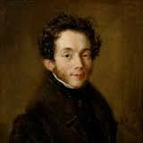
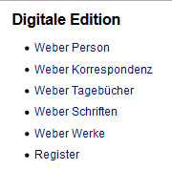
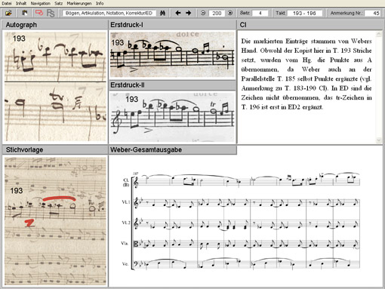
MEI: C. M. von Weber and the Edirom
Information management
Model for:
Reger-Werke
OPERA series

Slide 25
Purposes of current MEI projects
Music/text coordination
Print editions (e.g., C. M. v. Weber Gesamtausgabe: http://www.weber-gesamtausgabe.de/en/Index)
Online editions (e.g. Duchemin “Lost Voices”: http://ricercar.cesr.univ-tours.fr/3-programmes/EMN/Duchemin/
Print with electronic critical apparatus (hybrids) (e.g. OPERA series: https://www.baerenreiter.com/en/program/complete-editions/opera/)
Multiple-source comparison (e.g. Beethovens Werkstaat: http://www.beethoven-haus-bonn.de/sixcms/detail.php/83614)
Metadata links to online scans and editions (e.g. Carl Nielsen Edition:
http://www.kb.dk/en/nb/dcm/cnu/download.html, Danish Center for Music Publication)

Slide 26
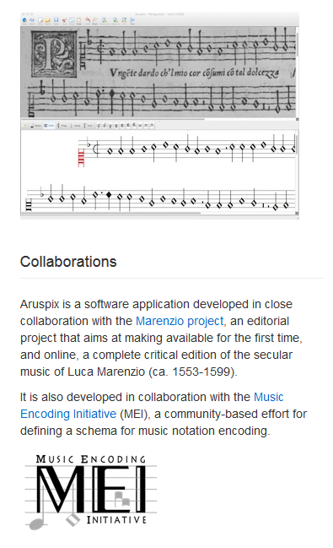
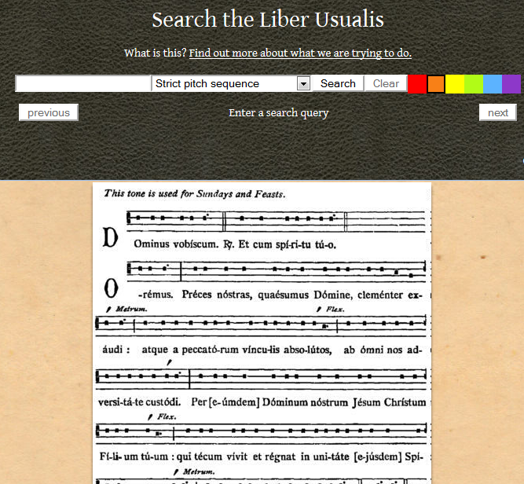
Library-tools associated with MEI
Aruspix
DDMAL): C++ library….
http://ddmal.music.mcgill.ca/
https://github.com/DDMAL/
Liber Usualis

Slide 27
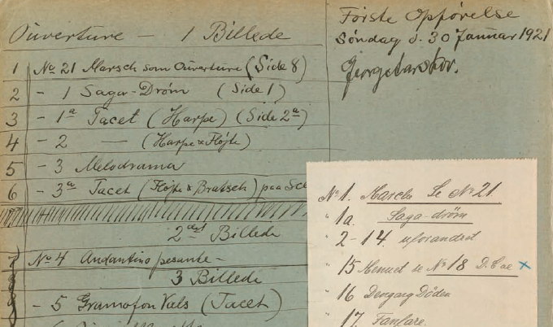
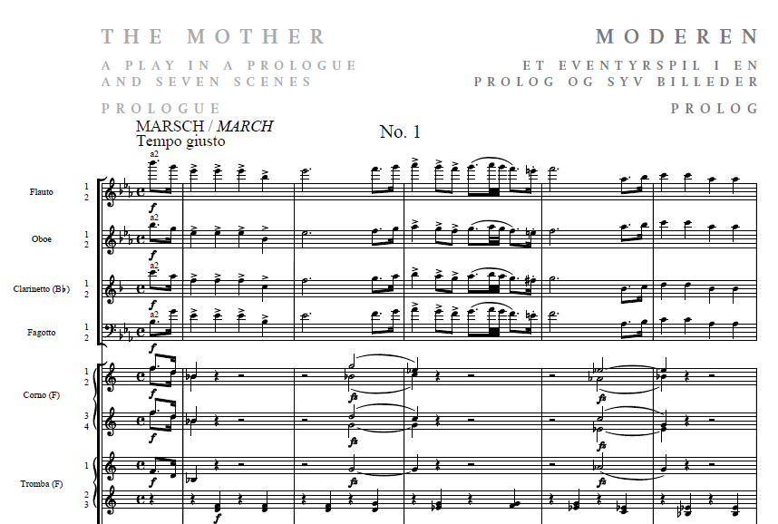
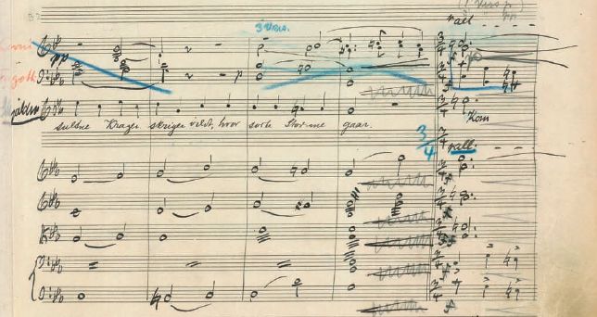
Online editions based on MEI
Critical report, facsimiles, paratexts, musical score all available simultaneously: Carl Nielsen
http://www.kb.dk/export/sites/kb_dk/da/nb/dcm/cnu/pdf/CNU_I_09_incidental_music_2.pdf
Carl Nielsen edn.,
422 p. w/ critical notes;
this work 1921

Slide 28
Selected online
critical editions

Slide 29
Cultural matrix of independent music projects
Individual-enabling tools
Do-it-yourself software (from 1980s onward)
Use-once editions
Consolidation of notation programs since c. 2000
Development of MusicXML (2002)
Institution-enabling tools
Collaborative library cataloguing projects
Promotion of single-library holdings
Massive data collection (e.g. RISM)
Formatting standards (MARC, FRBR)

Slide 30
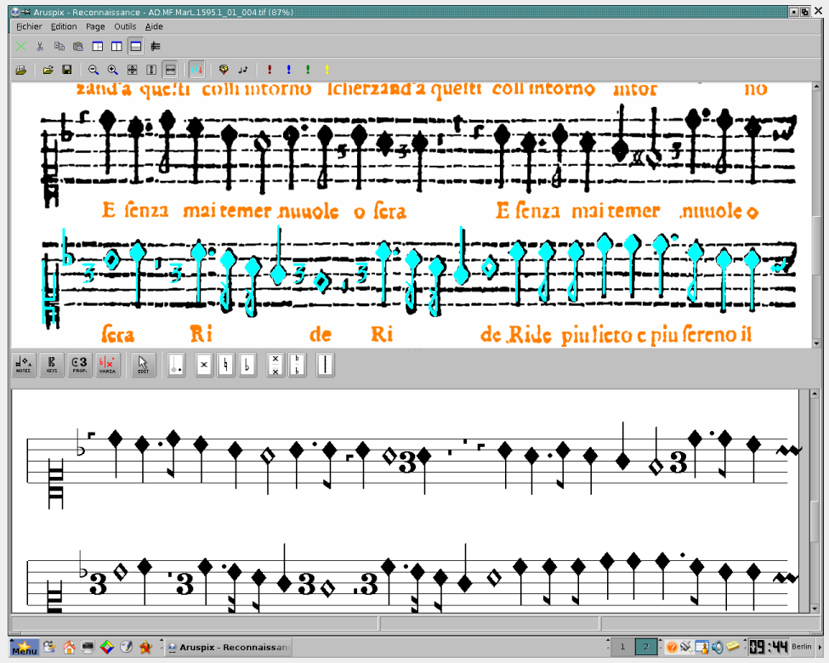
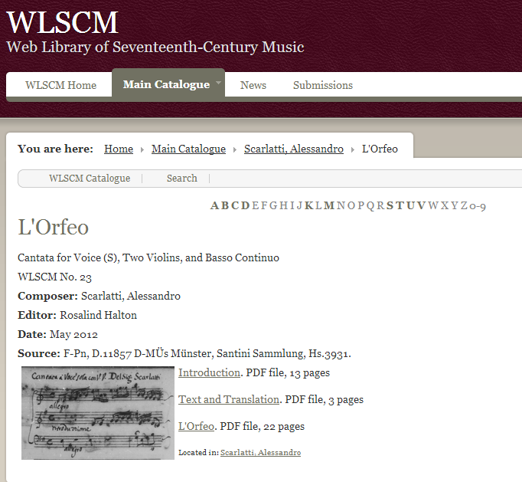
Independent models of digital critical editions
Marenzio Online Edition (right)
Web Library of Seventeenth-Century Music (WLSCM; below)

Slide 31
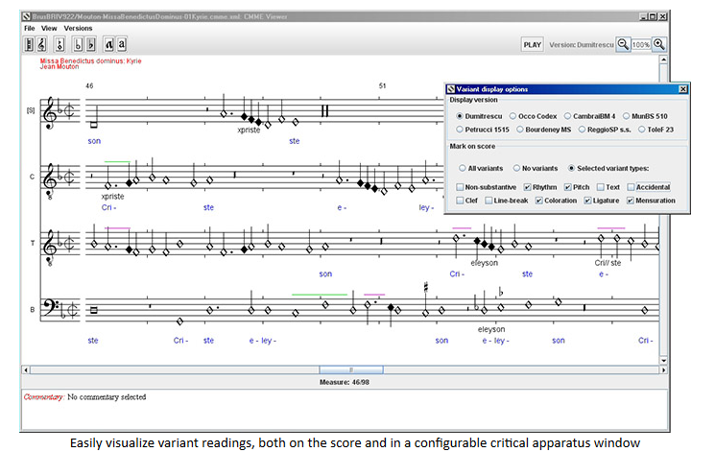
CMME: variant renderings (and sources)
CMME (Utrecht)
http://cmme.org
Online editions
Interpretive choices

Slide 32
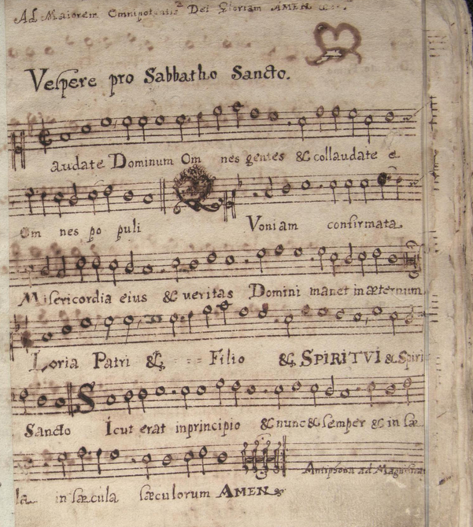
Coordinated resources: Benedictine Music MSS in Poland
Project led by Marčin Konik et al. (Cracov)
Manuscript scans
Modern editions, critical reports
Musical and text concordances, authority files, indices
Hyperlinks to online bibliographical sources
XML, MARC, Dublin Core; search support
Kern (for analysis), activity plots et al.
Watermark, other diplomatic information
English-language prototype only (main site in Polish):
http://staniatki.studiokropka.pl/items/show/83

Slide 33
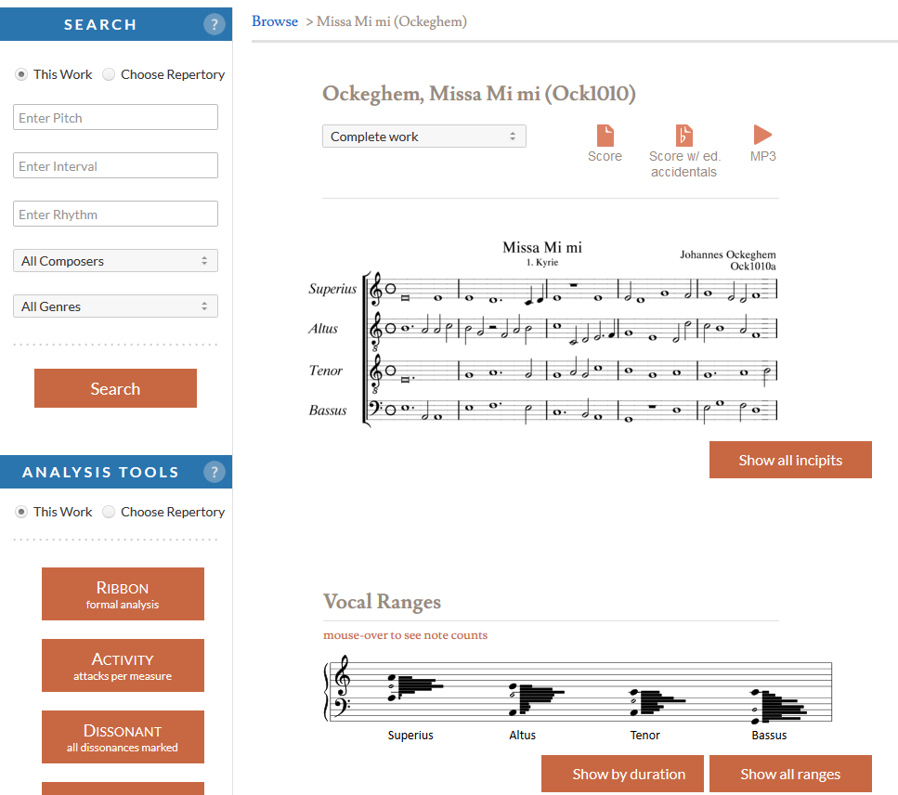
Searchable scores
Ockeghem: Missa “mi mi” in the
Josquin Research Project
jrp.stanford.edu
Josquin Research Project: http://josquin.ccarh.org.

Slide 34
Live Links
Humdrum website:
http://kern.ccarh.org
MuseData website:
http://www.musedata.org

Slide 35
More links
Digital Resources for Musicology
http://drm.carh.org
Josquin Research Project
http://jrp.stanford.edu

Slide 36
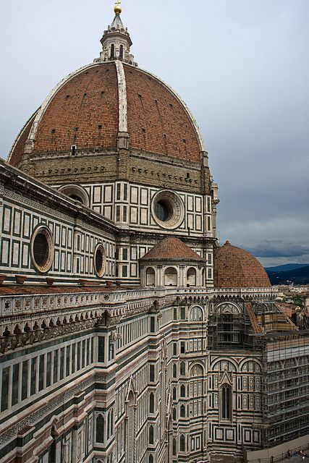
Grazie infiniti
Federica Riva
Giuliano Di Bacco
Lelio Camilleri

