Slide 1
Playing by Ear at 95: A CasE Study
Eleanor Selfridge-Field (CCARH, Stanford University)

Slide 2
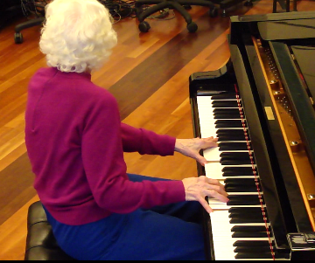
Introducing ME
Born in 1914
Heavily involved with music, 1918-c.1940
Musical interests rekindled, 2006-2016
Has vascular dementia
Resides in assisted living facility in Calif.

Slide 3
Background
Playing by Ear at 95

Slide 4
The early life of ME
1914: Born in Chattanooga, TN
1918: moved to Lakewood, GA
c. 1925: returned to Chattanooga
1931-35: undergraduate in Murfreesboro, TN
1935-36: social worker in Chattanooga
1936-37 (38?): Nashville, TN
1938-45: Nashville, Chattanooga
1918: tried to emulate 6-year-old cousin
c. 1925: enrolled in Cadek Conservatory, Chattanooga, TN
Earned music degree; played 8 instruments
No jobs for music teachers; played in women’s orchestra
Earned master’s degree
1940: married, taught 2nd grade
1946: moved to Jacksonville, FL

Slide 5
The later life of ME
1940-50: no piano in home
1950-2004: occasionally played Baldwin (Acrosonic) spinet
2004-2006: entered assisted living in Jacksonville
2006—: resides in assisted living in Santa Clara Co., Calif.
Reared two sons
Played tuned bells in group (occasional)
2004-06: encouraged by director to play piano in home
2005: first and only known composition
2008-2010: encouraged by her children to play for seniors, churches, parties

Slide 6
ME’s memory lapses
Autobiographical memory
Little recollection of life in Jacksonville (1945-2006)
No recollection of teaching experiences
No recall for names of current associates
Little recall of local detail
Musical memory
No recall of music degrees
Claims never to have learned to read music
Extraordinary recall of music and lyrics
Excellent command of music-theoretical concepts

Slide 7
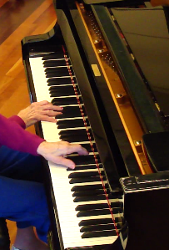
ME’s natural strengths
Physical strengths
Good hearing (slight loss in one ear)
Sees well with uncorrected vision
Impressive agility
No major health problems
Social strengths
Cheerful
Engaged

Slide 8
Method
Playing by Ear at 95

Slide 9
Principal methods
Plays in 7 venues
2 assisted-living facilities
(x 3-4)
1 skilled nursing facility
Incidental entertainments in churches, one civic venue, and one clinic (x 3-4)
Levels of assessment
Musical qualities
style
content
methods of playing
Environmental features
awareness of/interaction with listeners
ability to accommodate requests

Slide 10
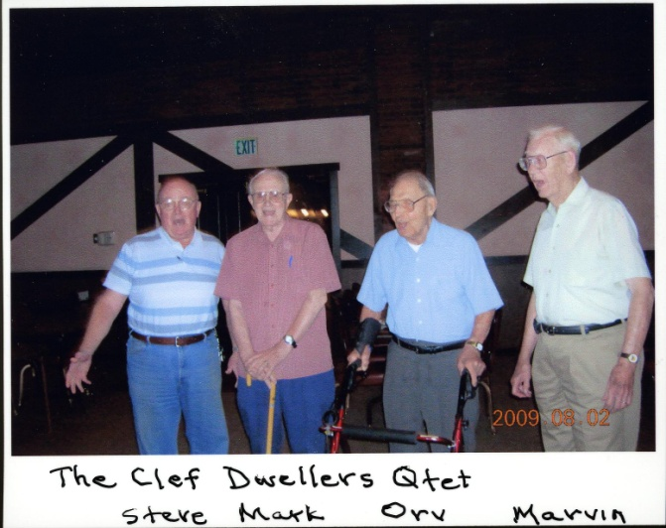
Supplementary information
Database of 400 works ME plays “from memory”
Recordings (Dec. 2009) from disklavier with corresponding digital video
Made at CCRMA
(Recording not allowed in homes)
Video interview (1990) “how to play by ear”
Notated version of own composition
Informal cohort study
7 active musicians
Ages 83-100
Range of musical skills
Choral singing
Choral arranging
Clarinet, brass
Mandolin, keyboard

Slide 11
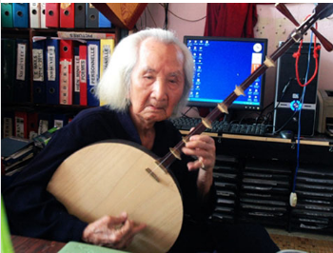
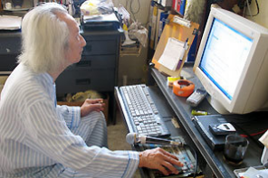
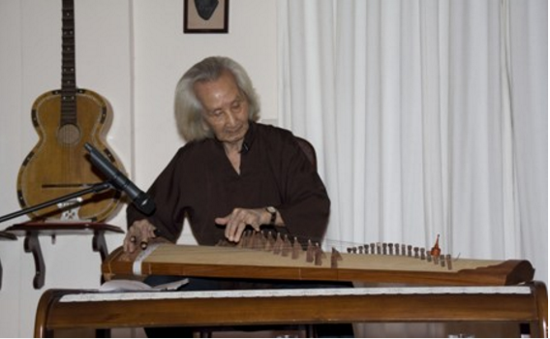
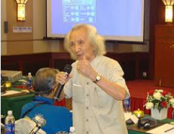
Pending cross-cultural study
Still teaching at 99

Slide 12
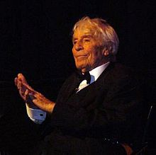
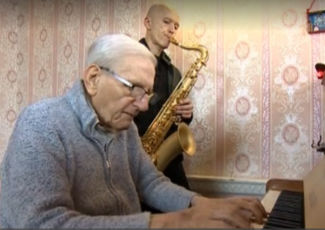
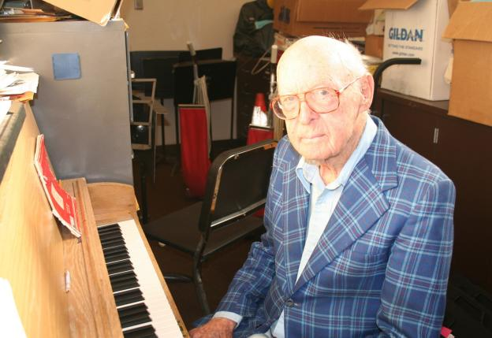
Other interesting cases
Johann Heesters (1903-2011)
https://www.youtube.com/watch?v=4sYAU3KBBj4 [at 100]
93-year-old pianist (Edward Hardy) in Wooky, Someset (UK) home (2015)
http://www.bbc.com/news/uk-england-somerset-35306155
93-year-old teacher (xx Cropsy), Oakland 2010

Slide 13
Results
Playing by Ear beyond 100

Slide 14
Musical status
Performance valuation
General qualities
Confidence
Imagination
Flexibility
Concentration
Musical qualities
Marked accents
Contrapuntal intricacy
Impeccable sense of harmony
Foreground/background diff.
Physical agility
Psychological evaluation
Non-Alzheimer’s dementia
MMSE = 23
(year-to-year consistency)
Poor memory for recent events, spatial details
High scores in sequential memory tests

Slide 15
Conceptual aspects of ME’s playing
General reliance on harmonic schemas
BUT occasionally morphs to the corresponding section of a different song at (ABA or AABA) juncture
Key: defaults to C Major/C Minor (able to play in any key)
Tempo relatively consistent across multiple playings*
Usually knows all the lyrics of what she plays
No evidence of
Autobiographical associations
Preference for any given instrument
Visual triggers to musical memory

Slide 16
Provisional peer findings
Playing by ear not unusual for Americans born before c. 1940
Parlor pianos common from 1880s
Records and radio available from 1920s
No television, fewer films, no digital audio
Visual, auditory acuity not indispensable to skill preservation
Clarinettist MC (85-90) legally blind
Mandolin player GK (99) deaf from age 10 in one ear
Barbershop singer NN (100) deaf in one ear

Slide 18
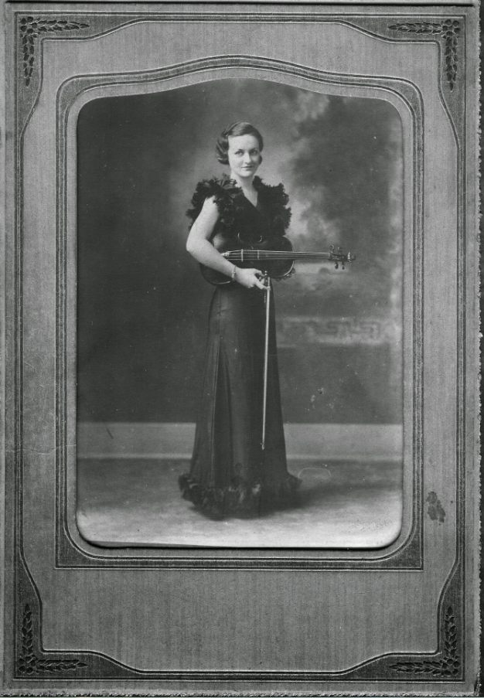
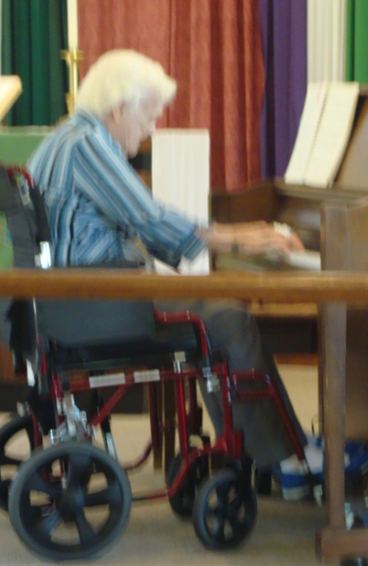
A life in (and out of) music (1914--)
1940
2016

Slide 19
Conclusions
Playing by Ear at 95

Slide 20
Findings (comparative)
ME diverges from most over-80 case histories
No cognitive decline found (18 months)
[similar to Beatty et al 1999 Alzheimer’s study; 36 months]
Cognitive gains from new experience, repertory
[not documented elsewhere]
General confirmation of Nilsson’s 2003 model of differential memory
Episodic memory declines
Semantic, perceptual, procedural memory preserved

Slide 21
Research challenges
Too few studies
“Playing by ear”: meaning, scope, varieties
Musical production in over-80 population
Musical skill retention in non-Alzheimer’s memory loss
[cf. case histories in Cuddy, Duffin 2005; Crystal et al. 1989]
Inability to photo or record in situ

Slide 22
Conceptual challenges
“Musical” memory vs. executive function
Procedural “memory” vs. executive function
[cf. Halperin 1984; Halperin, O’Connor 2000]
When is procedural memory memory?
Differentiation of visual and auditory memory in those with memory loss

Slide 23
Playing by Ear at 95: A Case Study
Credits
Craig Stuart Sapp
Family of ME
Petr Janata
Julene Johnson
Brent A. Field
Several others….

