Slide 1
Musical Similarity

Slide 2
Timbral similarity Recommendation services
Recent research
“Mood” and timbre
“Genre” and timbre
Listeners and timbre
What is mood?
What is genre?
Do all listeners here the same music?

Slide 3
Listener choice: Affective (acoustic) similarity
Fr. Pachet, J.-J. Aucouturier (Sony Labs, Paris)
CUIDADO: tool for generating playlists (2002--)
Selected passages from a wide variety of genres incl. classical, jazz, popular

Slide 4
CUIDADO: Selected results
Piano repertory
orchestral repertory

Slide 5
CUIDADO: Components
Editorial tool: artist, genre, language, voice types, instrument IDs
Quasi-linguistic associations between artists (12,000+) and groups
Acoustical features incl. variance of amplitude, spectral frequencies
Aim: describe music titles by “global timbral quality” modeled on MFCCs (mel cepstrum co-efficients)
Segregate solos from groups
>Pachet et al (2006): https://link.springer.com/article/10.1007/s11042-006-0030-6

Slide 6
General framework for extraction
Stereotype avoidance (e.g. artist and interests)
Want precision in extracted samples
Features sought:
Perceptual energy
Separation of studio vs live recordings
Harmonicity
Percussivity

Slide 7
CUIDADO browser
Method:
System finds co-occurrences and compiles lists
User picks an example, software finds “songs that sound the same”
Cultural similarity (passages in similar contexts)
Web crawler looks for additional matches
Recent frontier: comparing diverse kinds of similarity
See Hughes Vinet: https://www.academia.edu/71611893/The_CUIDADO_Project_The_CUIDADO_Project

Slide 8
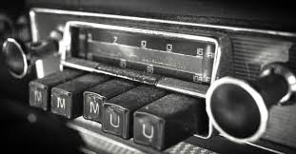
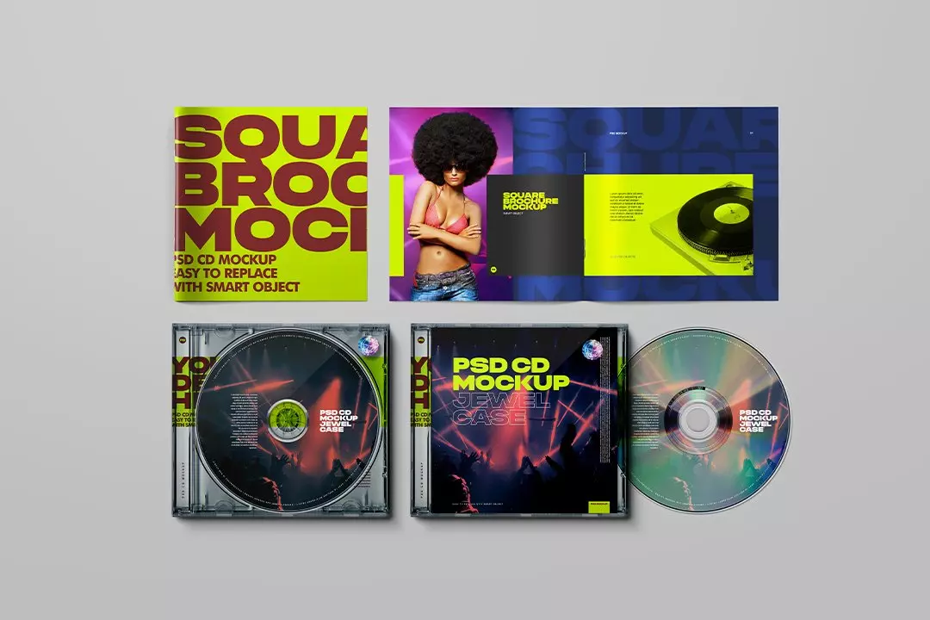
Other audio-based research (human conditioning)
1.Perritt and Gjerdingen (1999--)
-Genre identification via radio by 17-year-olds
-10 genres, popular music
-Aim: establish shortest interval to identify preferred genre
2. Daniel Levitin (c 1996)
-Listeners and pitch entrainment
-Listeners and tempo entrainment

Slide 9
