Slide 1
Introduction of Humdrum
Music 253/CS 275A
Stanford University

Slide 2
Where we’ve been
Sound apps
Temporal or
Sounding pitch
Score apps
Spatial org
Written pitch

Slide 3
“Logical” information (for analysis)
No necessary requirements for
Sound description
Page description
Possible requirements
Gestural information
Selective details of notation or sound
Cues to formal structure
Accentual info

Slide 4
Humdrum Toolkit (1985—)
Goal: encoding for analysis
Inventor: David Huron
Orientation: Context-free grammar
Adaptable to many repertories (incl. non-Western)
Not directly printable [based on Unix]
Offers a wide range of representations
Features and representations can be extended
Features can be minimized or excluded
Availability:
Extensive documentation online
Tool set (official version) downloadable

Slide 5
Local resources for Humdrum
CCARH Humdrum Portal: http://humdrum.ccarh.org/
Downloads of the Toolkit:
http://extras.humdrum.org/download/
Sapp extras: http://extra.humdrum.org/
Data in the **kern form (CMN format for Humdrum TK):
http://kern.ccarh.org/
Humdrum users group: **hug

Slide 6
Overview (comparative)
MIDI: Sound
SCORE: Graphics
MuseData: Core rep.
MusicXML: interchange
**kern: Analysis data
Event-based
Object-based
Event-based
Attribute-based
Event-based
Binary; time-ordered; var-length; score Types 0, 1]
ASCII; score/spatially- ordered; var. no fields
ASCII; fixed/expandable; part-ordered [=MIDI Type 1]
ASCII; fixed/expandable; time- or score-ordered
ASCII; score-ordered but no spatial information [=MIDI Type 0]; selective attribute encoding permitted

Slide 7
A Humdrum **kern file
!!!OTL: Frere Jacques
!!!YEC: ESF 1999
**kern **text
*M4/4
*k[ ] *
!soprano !lyrics
!!First phrase
=1 =1
4c Fre-
4d re
4e Jac-
4c ques,
=2 =2
4c Fre-
4d re
4e Jac-
4c ques,
. ………….
Spines
!!Fourth phrase
=7 =7
4c Din,
4G don,
2c din.
=8 =8
4c Din,
4G don,
2c din.
=9 =9
*- *-

Slide 8
Decoding a Humdrum file
Comment records:
!!! Reference records
!! Global comments
! Local comments
Measure markers:
= Single bar-line
== Double bar-line
Tandem interpretations:
*staff<1> staff no.
*clef<G2> clef name
*<G:> key name
*k[f#c#] key signature
*M<2/4> meter signature
Interpretation records:
** Exclusive interpretation
* Tandem interpretation
*>x Form marker
*- End-of-spine marker

Slide 9
Semiotic aspects of Humdrum
A sample problem of nomenclature: pitch
Humdrum’s answers
Notated pitch
Concert pitch
Relative pitch
Fundamental frequency
Cents
Interval
Scale degree
MIDI note number
Visual appearance……

Slide 10
Humdrum in relation to music
Relies heavily on Unix commands and syntax
Unix regular expressions (grep)
File-manipulation commands (assemble, yank)
Sound-management tools (record, perform)
Pitch translation tools (frequency, cents)
Duration and accent tools (beat, accent pos.)
Melody tools (e.g. melodic intervals)
Harmony tools (e.g. harmonic intervals)
Other music-theory tools (e.g. tone-row, pitch-class sets)

Slide 11
Pre-defined representations (49)
pitch-class
semitones, cents, MIDI, critical bands, cochlear coordinates
melodic interval, harmonic interval
absolute time, relative time, duration, epoch, date
tablatures: guitar, lute, banjo, sitar ...
harmony, embellishments

Slide 12
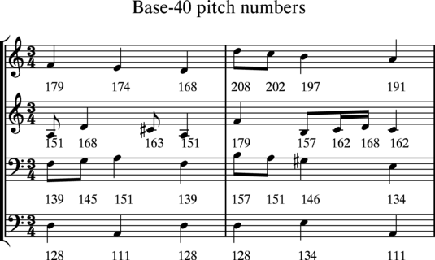
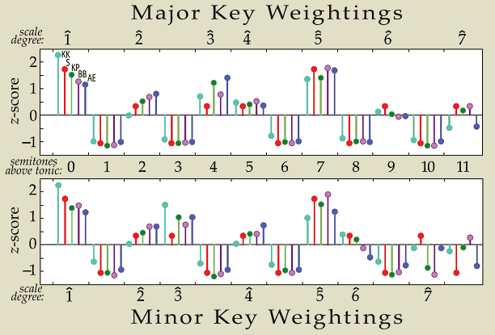
Special qualities of Humdrum
Very elastic
open, documented
extensible

