Slide 1
Visualizing the invisible:
Tools for seeing music
Eleanor Selfridge-Field
Center for computer Assisted Research in the Humanities,
Stanford University

Slide 2
Background
Music and its Domains

Slide 3
Musical data exists in many dimensions
Data for/from sound (audio)
Data for/from notation (graphical)
Pitch
Duration
Page layout
Key, meter signatures
Timbre
Beat, tempo
Frequency (pitch)
Dynamics (volume)
For each dimension there are many code systems

Slide 4
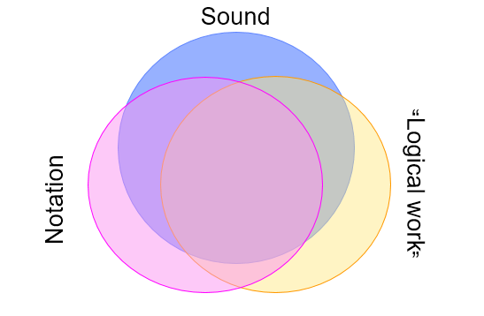
Missing from music codes:
Any equivalent to ASCII

Slide 5
Visual representations of domains
Piano rolls
Scores
Charts,
diagrams

Slide 6
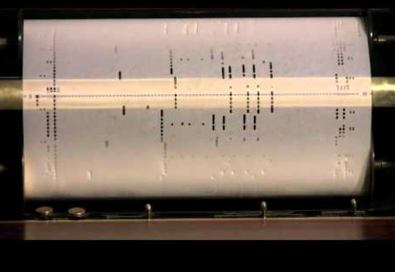
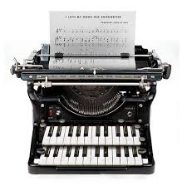
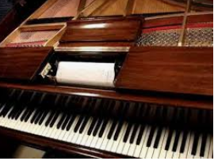

Early prototypes for music technology
Duo Arte Roll
Artifacts of the past are often models for digital equivalents.

Slide 7
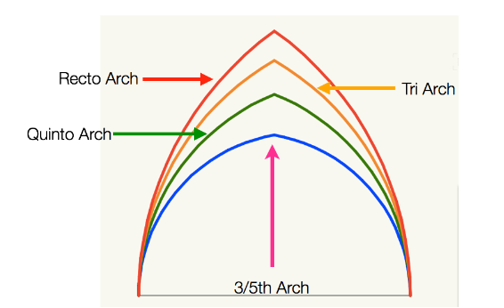
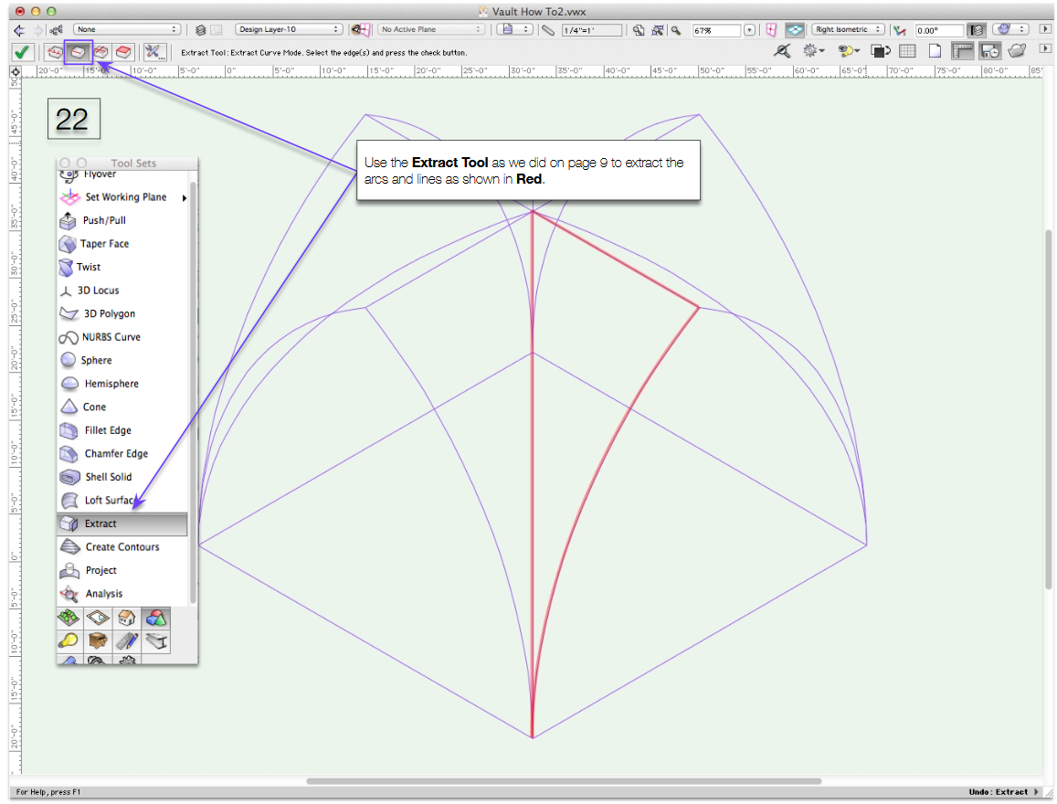
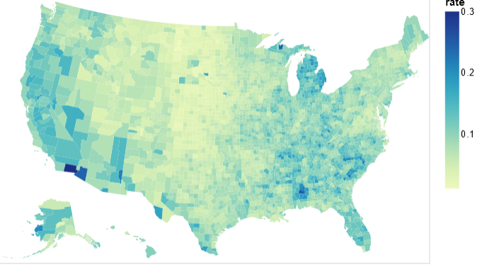
Big data as telescope in humanities
Unemployment rate per country
Visualize lost Gothic buildings in Paris in 3D
(Meredith Cohen, UCLA)
Analytical data superimposed on a map
(layering)

Slide 8
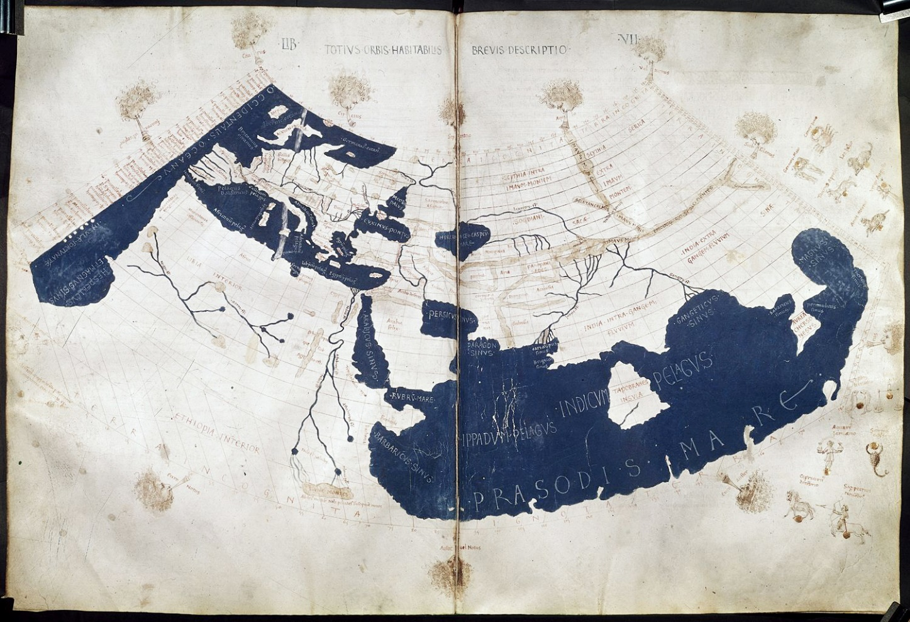
The Renaissance considers antiquity:
Geospatial analysis
Francesco di Antonio del Chierico, Ptolemy’s Geography (Harleian MS 7182, ff. 58-59)
Highlighting
Layered information
The two great seas of c. 150 CE.

Slide 9
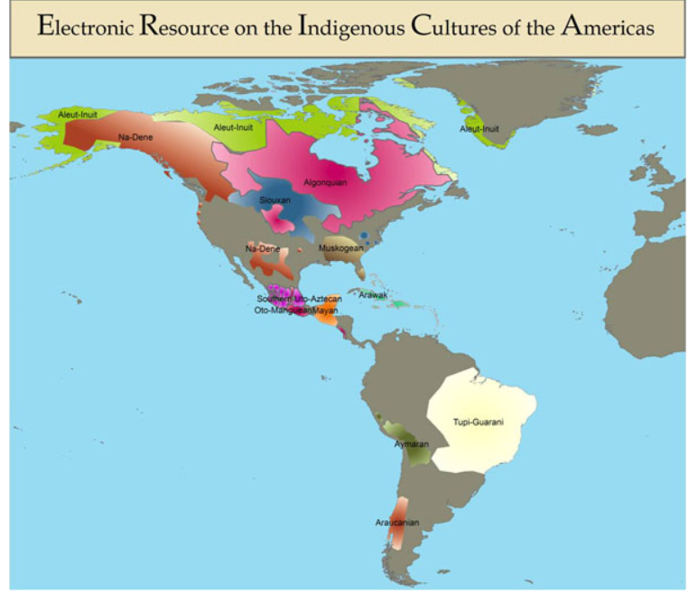
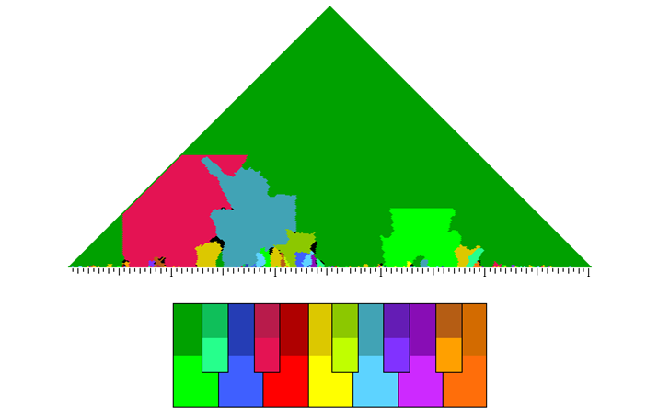
Big data used as microscope in music analysis
Music-based research
Atomic-level views of invisible traits
Humanities-based projects
Global views of externally observable traits
JAHC
Craig Sapp. Harmonic analysis (keyscape)

Slide 10
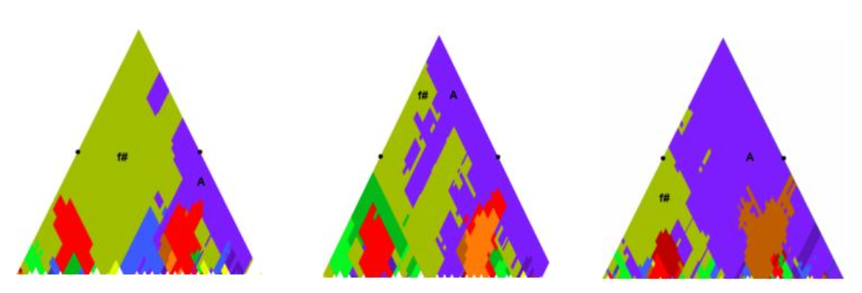
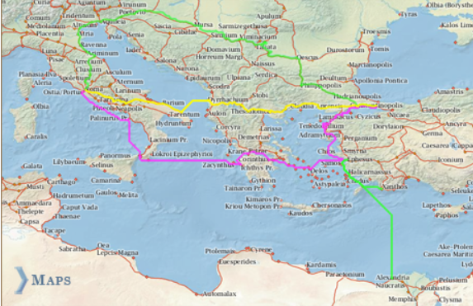
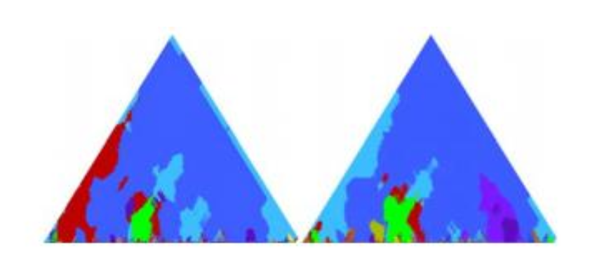
Where does this lead?
Generalization
Differentiation
Sapp: Same music, different theories
Stanford Orbis Project (Roman imperial trade routes)

Slide 11
Obstacles to useful visualization
(music history)
Visualization software needs
  Methods for using historical time and its local inflections
  Methods of using historical maps in ever-changing venues
Historical data requires user to develop data

Slide 12
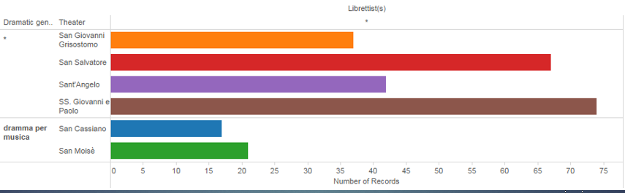
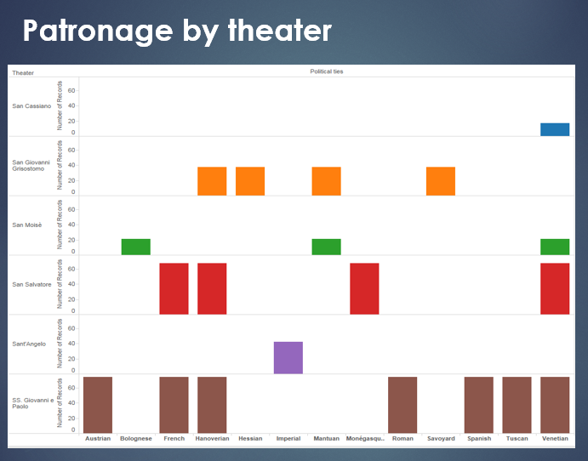
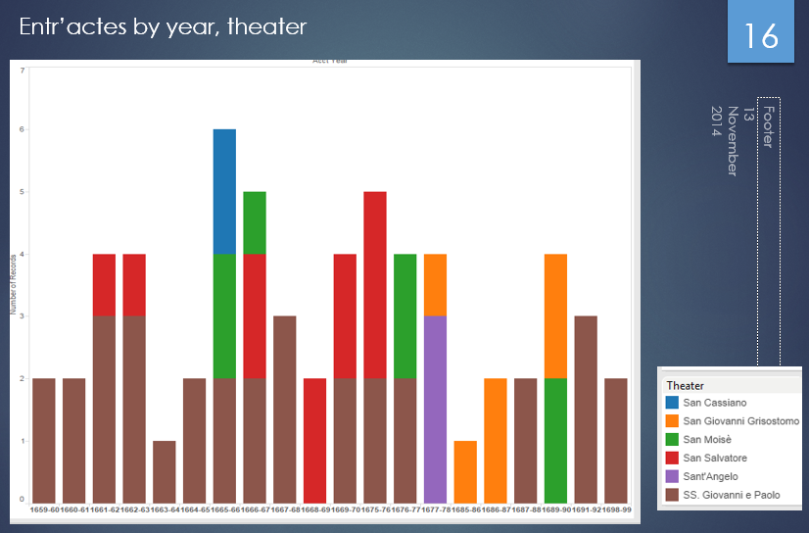
e.g. Venetian opera (1660-1700)

Slide 13

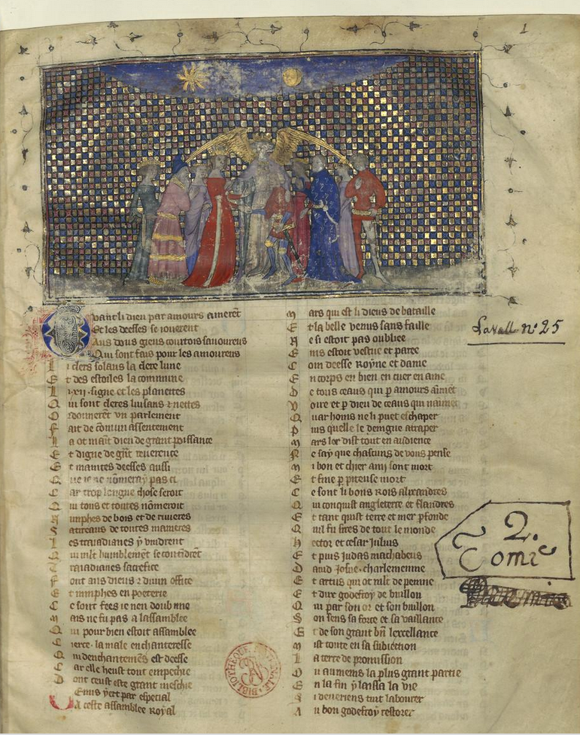
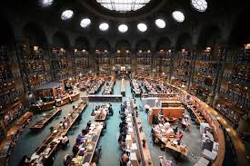
Armchair scholarship
“Music” by Guillaume Machaut
(1300-1377)

Slide 14
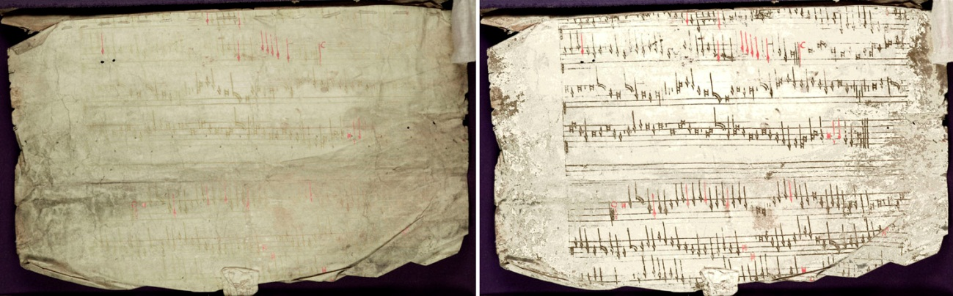
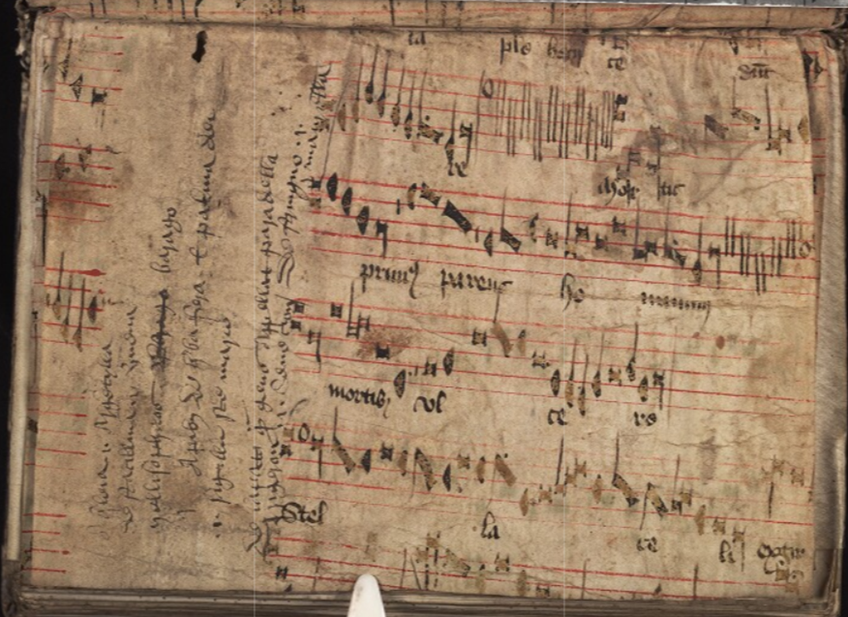
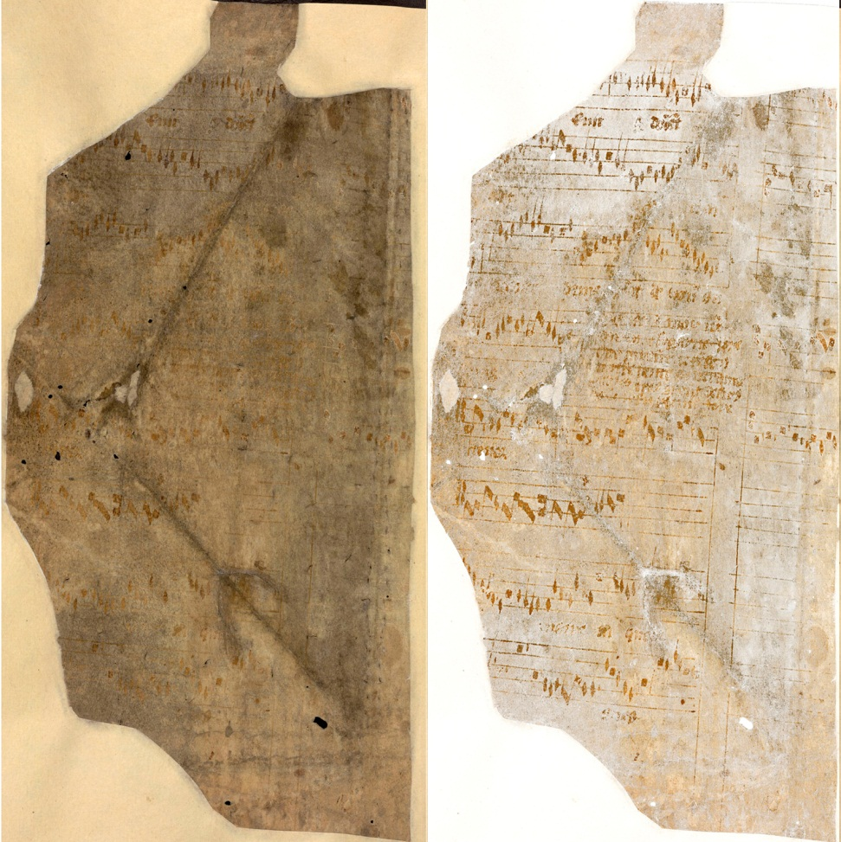

Digital restoration
Digital Internet Archive of Medieval Music
GB_Ouc MS 16, f152v. C. 1430

Slide 15
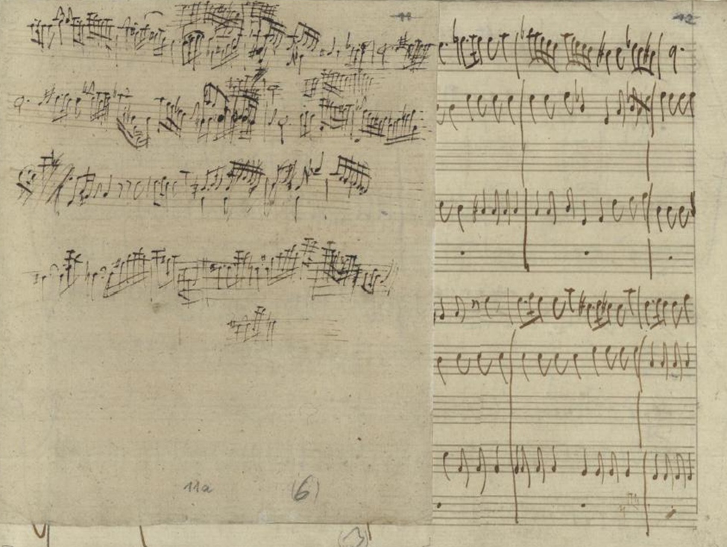
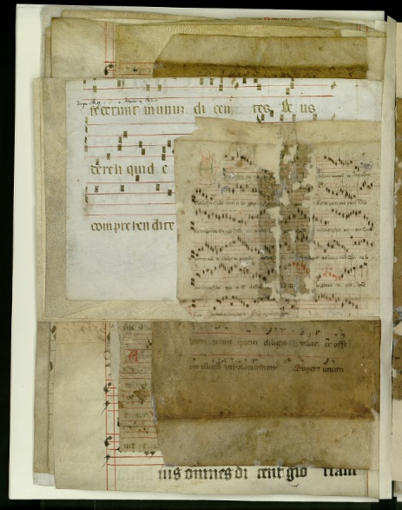
Discovering paste-overs
SLUB, Dresden:
Mus MS 2389-O-43
(RV 340)
Vivaldi

Slide 16
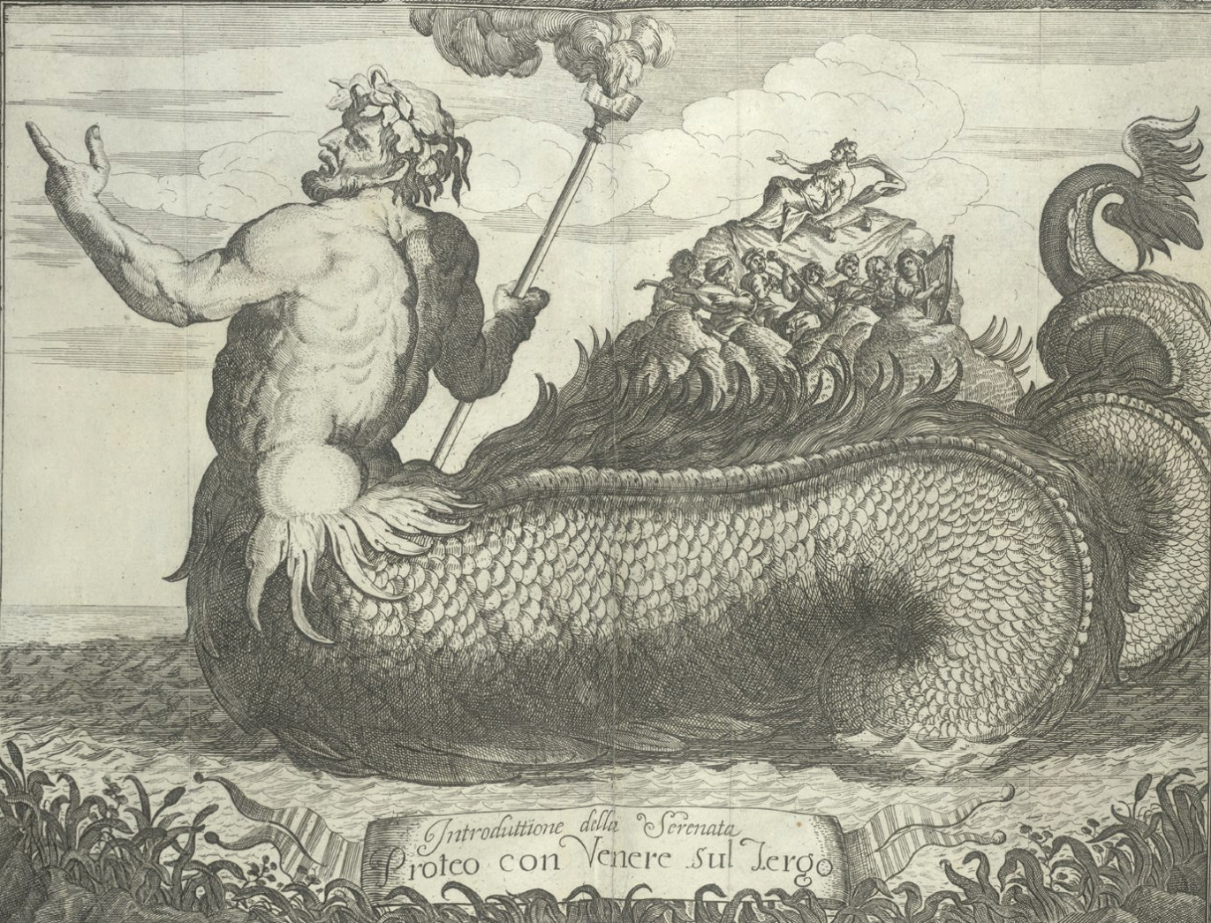
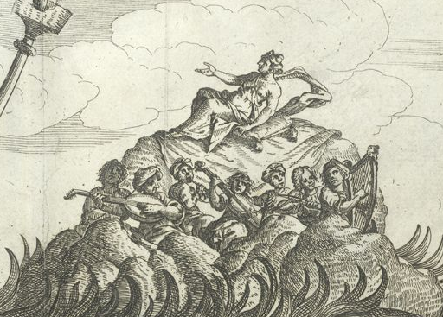
Festival books
Between Music, Graphics, Text, and the Past
Data in the margins
Opera libretti
Festivals books
Event “relations”
Memoirs
Doggerel
From a description
of a Venetian regatta
(1686)
(British Library)
Proteo con Venere sul Tergo [Odyssey, Book IV]
(?Gio. Ant. Ristori, 1686)

Slide 17
Mapping musical features of German folksong
Geospatial analysis
Prevalence of triple meter
Interior phrases end on tonic
Mapping location data to
GPS coordinates
Bret Aarden: “Musical features in German folksong,”
Computing in Musicology 12 (2001)

Slide 18
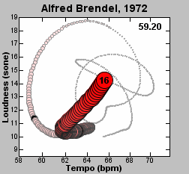


Visualizing sound:
Comparative performanceanalysis
Sound: happens in time
Notation: happens in space
The quantization question:
“Smooth” to quantize and identify work
Leave as is to compare performances of the same work
Sonographs:
different performances of the same work
“Performance worm” of
Artur Brendel, 1972, Schubert D. 899.
Dixon, Goebel, Widmer (2002)

Slide 19
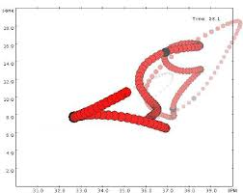
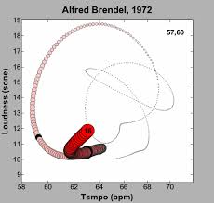
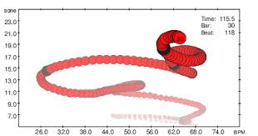
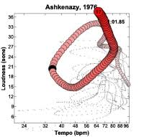
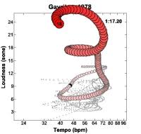
Performance-worm gallery
Real-time expression
Gerhard Widmer
Werner Goebl
Simon Dixon
Variables = tempo,
dynamics

Slide 20
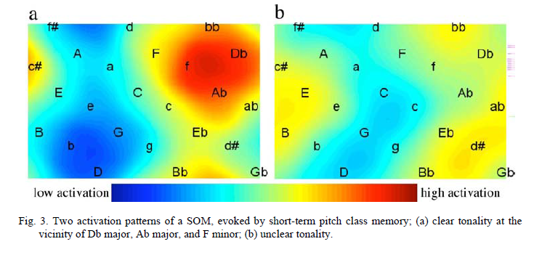
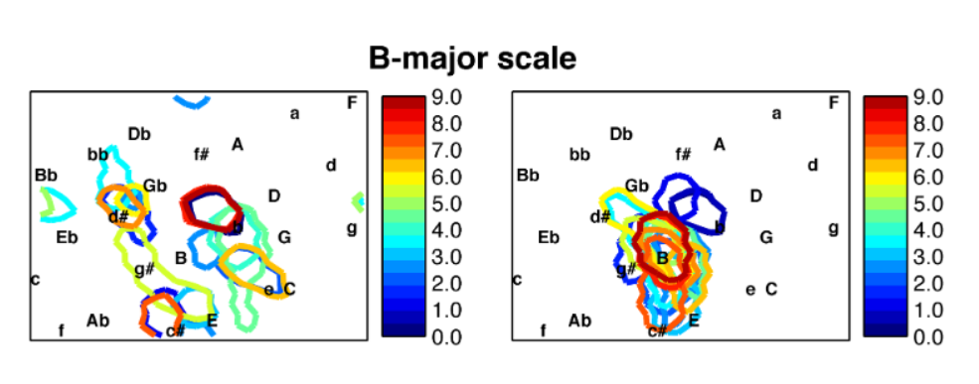
[Harmonic visualization in scientic research]
Petr Janata, Mapping neural responses
to musical stimulate in 12 different keys
Petri Toiviainen,
Self-organizing maps
showing pitch-class relations

Slide 21
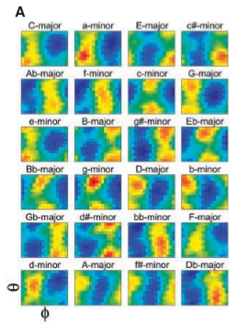
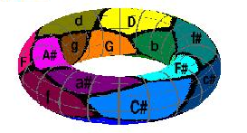
Power is in aggregations
Music-theory: all keys are related to
One another.
Here: Purwins et al.
Janata

Slide 22
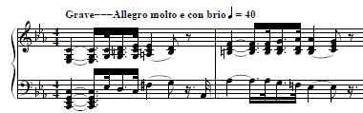
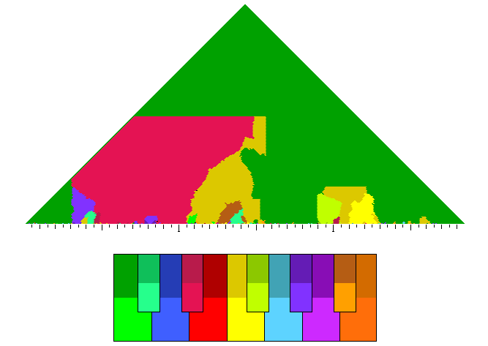
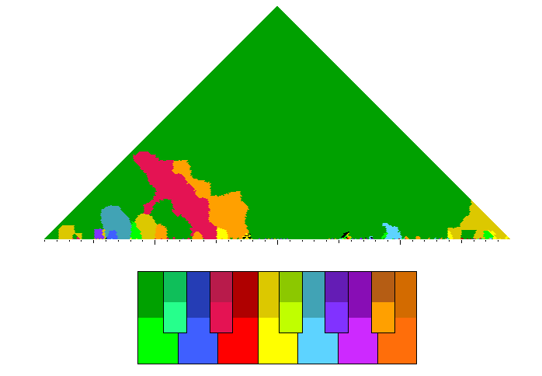
Visual (harmonic) analysis: keyscapes
Gen-eral
Pre-
cise
V: Window siize
H: Time
Beethoven: Sonate Nr. 7 (“Pathetique”), I
Bach, WTC I, Prelude C Minor
Craig Sapp, E. Selfridge-Field: “Beethoven in C Minor” (2011)

Slide 23
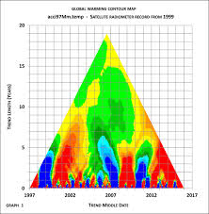
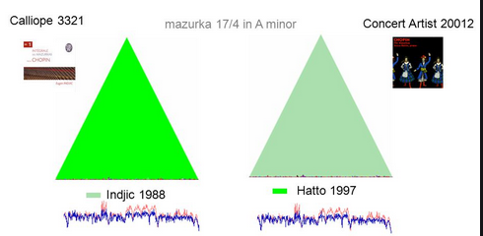
Visual analysis: timescapes
Objective: to study share traits of performance in recordings
Nicholas Cook, Craig Sapp: Chopin Mazurka project,
RHBNC, U. London (2005-2007)

Slide 24
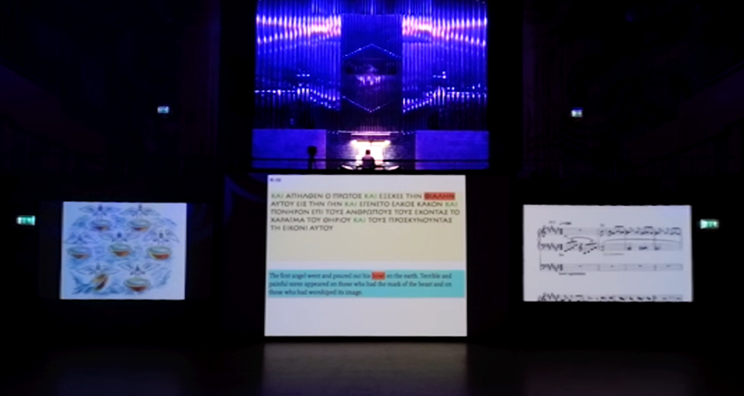

Music in Motion:
From piano rolls to the Music Animation Machine (MAM)
A series of tools for music visualization by Stephen Malinowski
1986: first releases (VHS, PAL)
….
2013: Stravinski “Rite of Spring: centennary release (Vimeo, YouTube)
2018: Video track for Donald Knuth’s Fantasia Apocalyptica

Slide 25
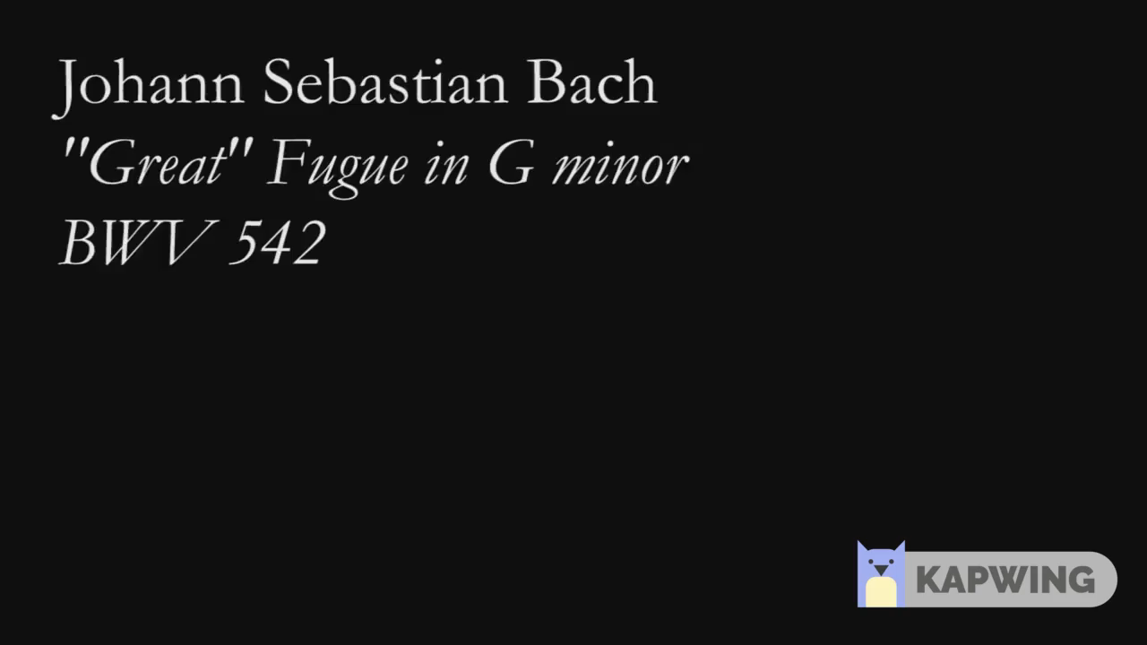
Music Animation Machines
Early example: J.S. Bach Organ Fugue in G Minor
A fugue for four “voices”
Each voice is a different color
Musical features shown
  Note pitch (H)
  Note duration (W)
  Interaction of voices

Slide 26
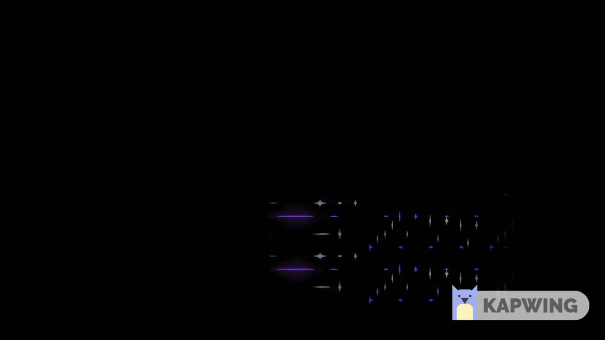
Edvard Grieg (Malinowski):
Peer Gynt Suite, “In the Hall of the Mountain King”
New features
Decay of pitch wedges)
Loudness of pitches

Slide 27
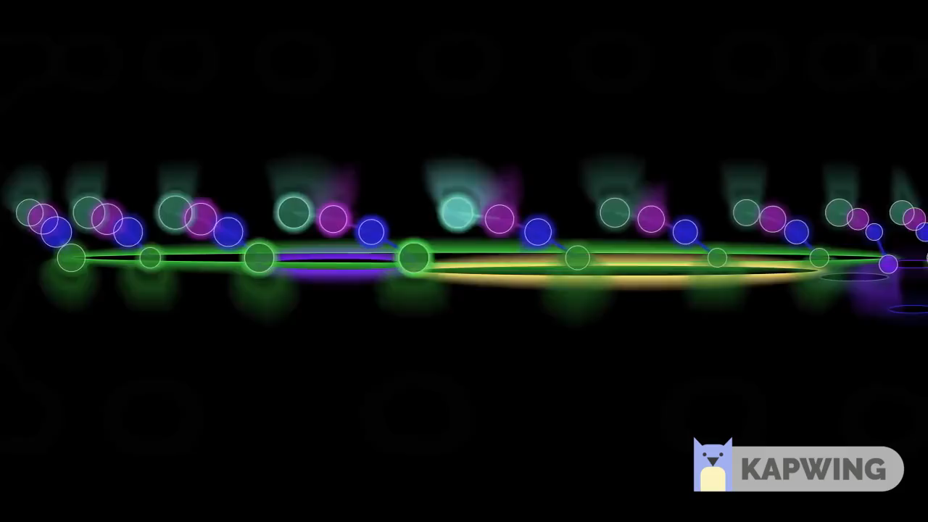
Rachmaninoff: Les Larmes (tears)
New features
  hypnotic ostinato
  threads of counter-narrative
  sonority

Slide 28
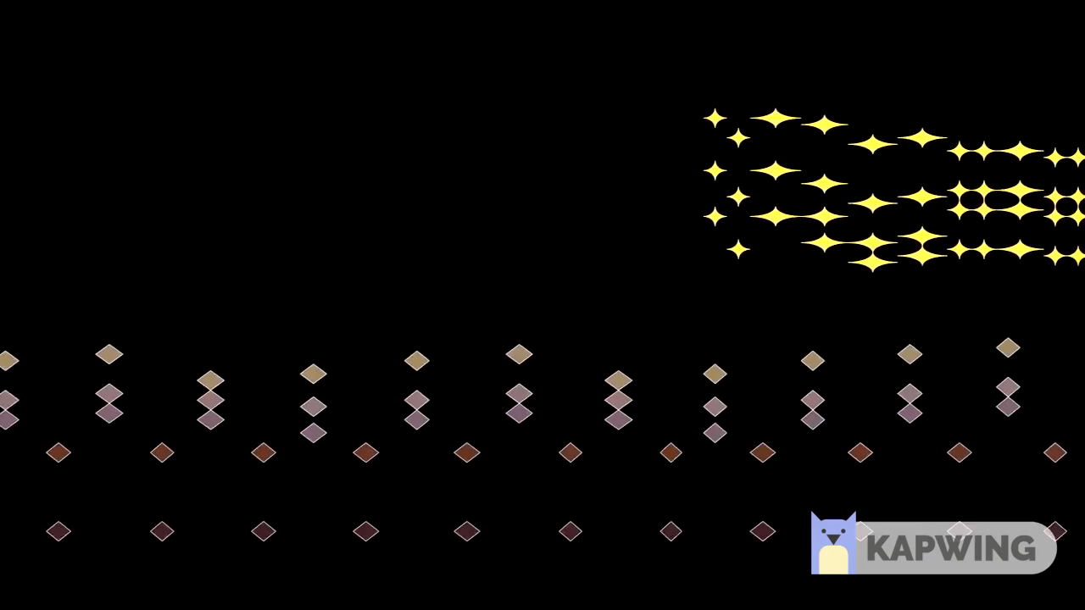
Tschaikovsky: Dance of the Sugar-Plum Fairies from the Nutcracker Suite
New features
Timbral contrast
Perceptual foreground

Slide 29
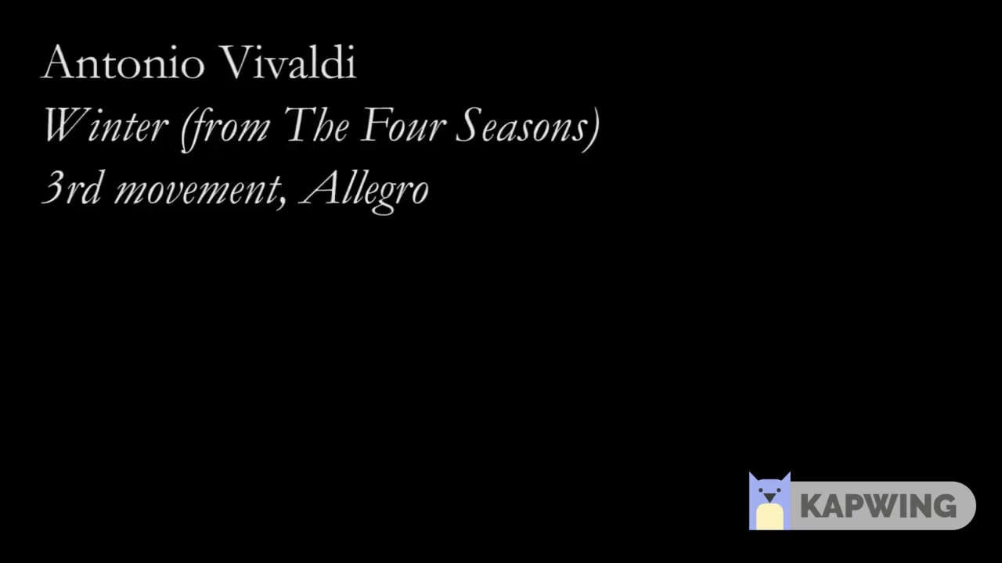
Vivaldi: Winter Concerto
Aspects of violin technique
Legato (staccato)
Crossing parts
Differentiation of upper, lower voices (i.e., soloists, accompaniment)

Slide 30
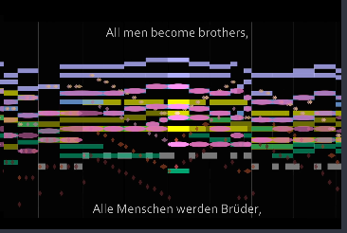
Homage to Beethoven (1770-2020)
Complete Beethoven string quartet animations: https://www.youtube.com/playlist?list=PLtj_HurkS7ZxXrUnAXpnX0P5hzyPy7Hul

Slide 31
A gallery of Beethoven string quartets à la Malinowski

