Slide 1
Playing by ear beyond 100
ICMPC San Francisco 2016
Eleanor Selfridge-Field (esfield@stanford.edu)

Slide 2
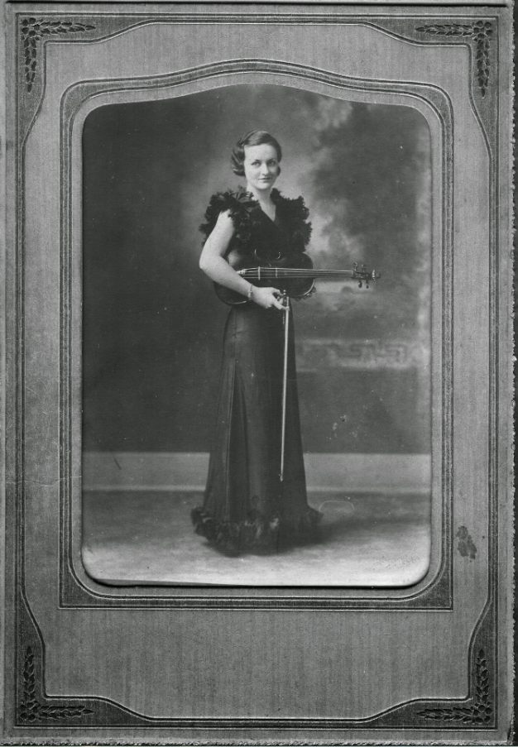
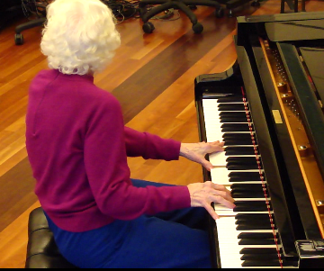
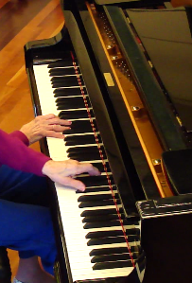
2010
ICMC 11
Early life TN, GA
2 degrees in Mus.
Played 8 instruments
2009
1940

Slide 3
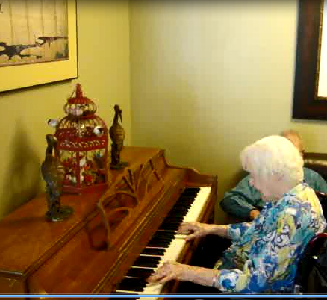
Updates, 2010-2016
Now 101.9 yrs
Stroke in Dec. 2014
Still playing
Areas of change
Simplified arrangements
Loss of digital dexterity
Content, performing style
Scope of repertory (unchanged)
Scope of harmonic vocabulary, rhythmic articulation

Slide 4
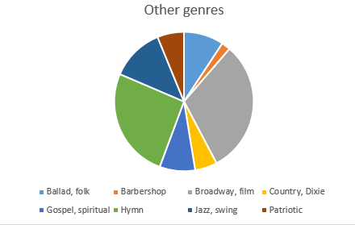
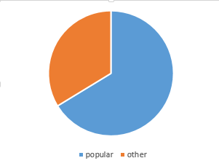
Repertory: Genre
Central points:
Genre ambiguity
Arbitrariness of genre-classification systems
Basis = 365 identified items
Unidentified (omitted) = 33

Slide 5
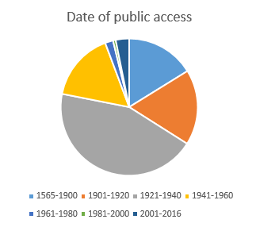
Repertory: Learning window
Central points:
Read clockwise from noon
Peak = school, early adult years (grey, 4:00-9:30)
Learning improved by performance over past decade (blue serge, 11:30-12:00)
Caveats:
Based on copyright records
Many works were re-popularized at one-generation intervals
N = 315
Not classified = 83

Slide 6
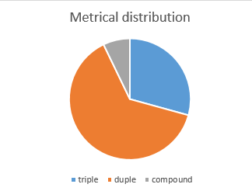
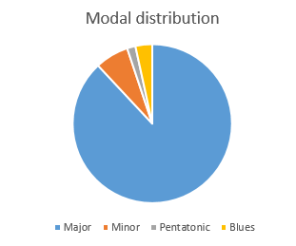
Repertory: meter and mode
N = 315 (mode)
N = 280 (meter)
Central points:
Beware of cultural artifacts
Music pre-1920 leaned heavily to triple meter, major mode
1920-1940: emergence of Broadway, jazz, and blues (complex rhythmic patterns)
1940-1980: strong influence of film music

Slide 7
Musically significant features of performance
Harmonic richness
Inventory of chord types in own composition = 18*
Melodic and harmonic inventiveness
Intermediate and final cadences filled with much improvised activity
Exploitation of register to vary verse repetitions
*Chord varieties in C Major = I, I#5-7, I7, I9, II, II#3, II7dim, ii9, II#3#7, IV, IV9, V, V7, V#5-7, v, VI#3, VI7, VIdim7. Composition date = 2005

Slide 8
Same/different features of performance
Stability of tempo: consistent but not identical from from one repetition to the next
Arrangement ability: gradual tendency to shorten, without significant loss of inventiveness (probably caused by physical, not cognitive, disability)
Tonal orientation: intact but moot
(plays in C Major/A minor unless directed otherwise)
Timbre recognition: intact (20-timbre test)
Adaptability in ensembles: intact (accommodates to duos, trios, vocal accompaniment)

Slide 9
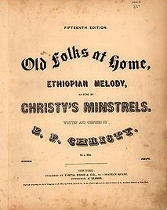
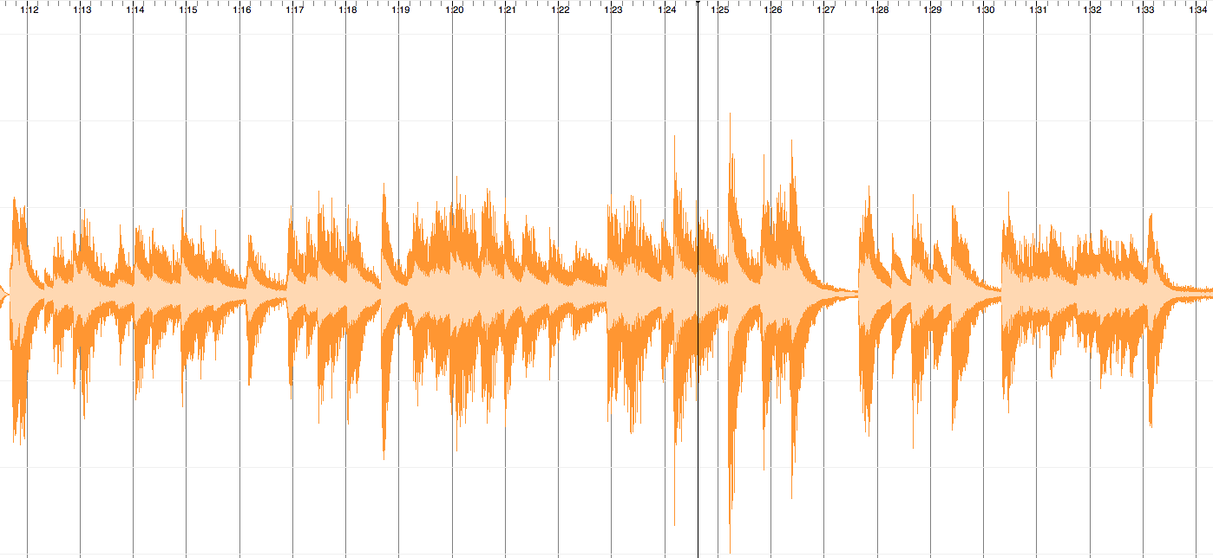
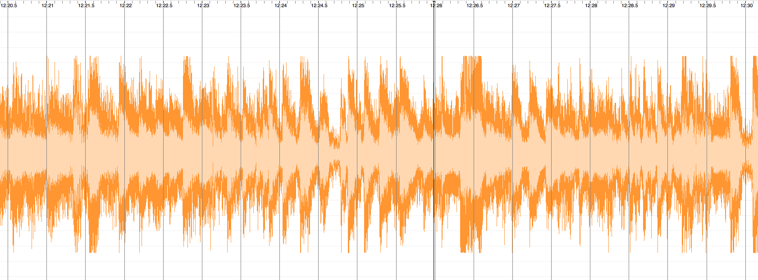
Performance visualizations: Swanee
Swanee 2009
(MIDI)
Swanee 2014
(recording with background noise, sw artifacts)
“Old Folks at Home”, Stephen Foster, 1851

Slide 10
A life in (and out of) music (1914--)
ME, June 28, 2016
Central findings:
Early training
Later opportunities
Social reinforcement
Credits:
Family of ME
Anders Ericsson
Petr Janata
Julene Johnson
Rose Lily
Caroline Palmer
Craig Sapp
San Jose Met. Band
esfield@stanford.edu

