Slide 1
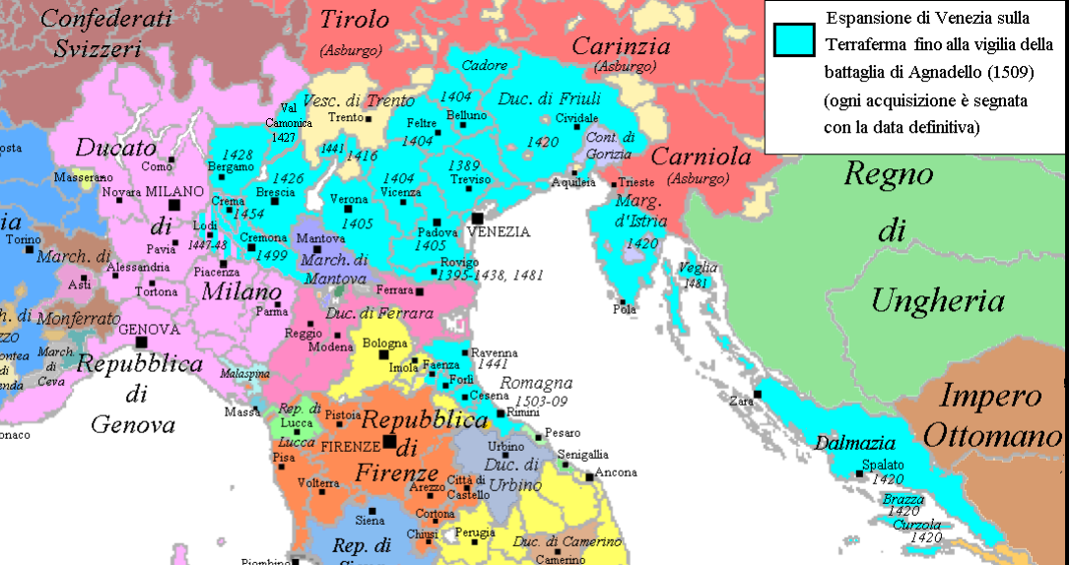
From Vivaldi to Gluck: On the Road with Anna Girò
Eleanor Selfridge-field

Slide 2
c. 1710: b. Mantua Real surname? Tessiere (it.) Tesseire (fr.) Bongiraud [not Giraud] ‘La Girò’ a nickname None of the above Mother’s estranged husband a Mantuan perucchiere 1722: in Venice with mother (Bartolomea) and… Step-sister—Paolina Trevisan (b. c. 1690); Brothers: in Mantua 1723: Treviso, autumn debut as Mirtillo in anon. pastoral La ninfa infelice e fortunata
Preliminaries

Slide 3
1724-25: San Moisè
Albinoni’s Laodice (Clistene)***
Buini’s Il nemico amante (Idalma)
Buini’s Gli sdegni cangiati in amore (Evanco)
1725: Personal life
Bartolomea (mother) ‘eloped’
Girò urged to rejoin father and brothers in Mantua but refused
Sisters settled in Santa Maria Formosa
Anna taken under protection of Alderano Cybo Malaspina , duke of Massa e Carrara
Venice
(1724-29)

Slide 4
Dispute with a harpsichord maker (Andrea Bonazza)
27 August 1725
Two harpsichords of different quality available for 100 zecchini.
Dance master Giovanni Gallo wanted to buy them (secretly for AV).
Vivaldi could “find” only 30 zecchini.
Bonazza was paid only 25.
Bonazza was then accused of selling the better one [by Domenico Pesaro] to an agent for Alderano Malaspina for 60 zecchini.*
The prima donna

Slide 5
La femme furieuse (1726-28)
Reputation built on roles of these few years
1726-27
Vivaldi’s Dorilla in Tempe* (1726)
Brusa Medea e Giasone (1726)
Vivaldi Farnace* (1727)
1727-28
Vivaldi’s Orlando furioso* (Venice, 1727)
Giai’s Tamerlano (Milan, 1727)
Vivaldi’s Rosilena ed Oronta (Venice, 1728) ☹
Gli odi delusi dalle sangue (Venice, 1728)

Slide 6
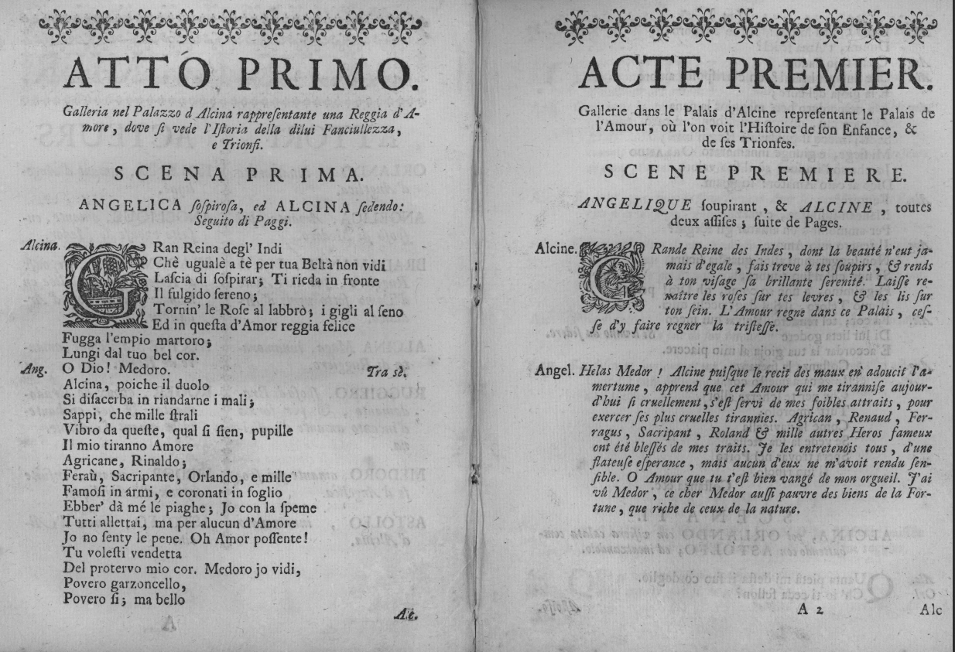
Girò the fearless: 1727
Farnace (Tamiri)
Orlando furioso (Alcina)

Slide 7
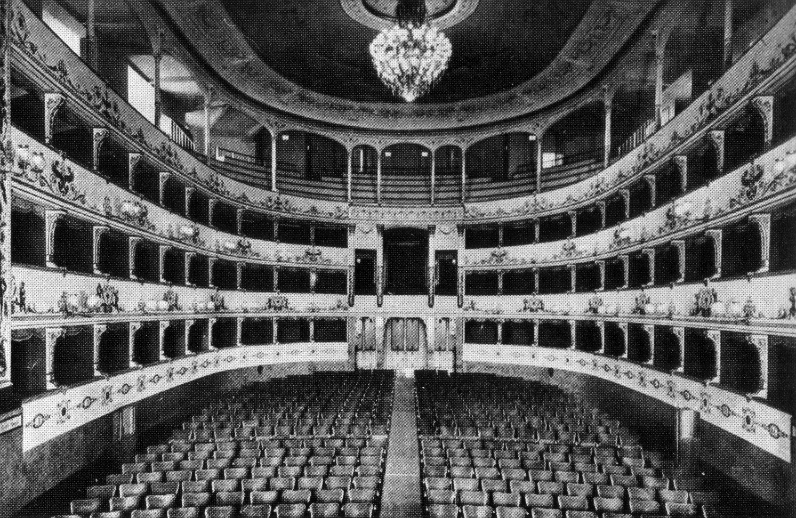
Bologna, Florence (1728-29)
Bolognese theaters
Completely free-form
Florentine theaters (e.g. Pergola)
Run by accademia
Works
G. M. Buini: Teodorico (Bologna)
Vivaldi: Atenaide (Florence)

Slide 8
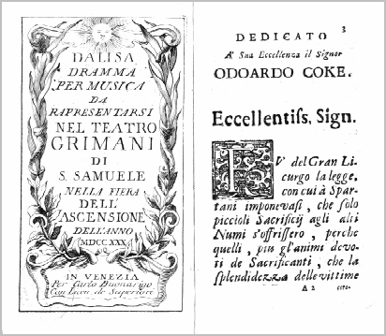
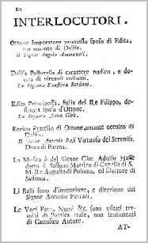
Transitions (1729-1730)
In the absence of Vivaldi…
1729-30: Vivaldi and father go to “Germania”
1730/W: Girò in Milan ☺
Broschi’s Ezio (Onoria)
Giacomelli’s Semiramida riconosciuta
1730/S: Girò in Venice, S. Samuele,
Hasse’s Dalisa (Edita)**

Slide 9
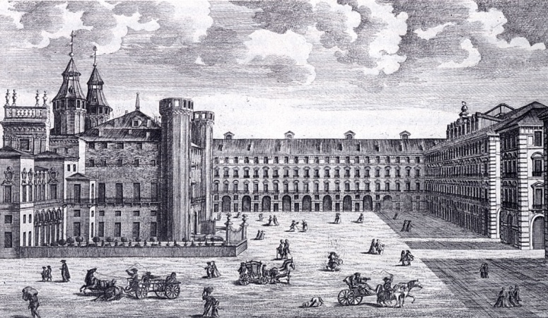
Girò’s Peregrinations (1731-34)
1731
Turin: Brioschi—Ezio (Onoria)
Turin: Porpora—Poro (Erissena)
Pavia: Vivaldi—Farnace (Tamini)
1731-32
Mantua: Vivaldi--Semiramide (heroine)
Mantua: Vivaldi—Farnace (Tamini)
1733-34
Venice: Vivaldi—Motezuma
Verona: Orlandini—Arsace (Statira)
Verona: Giacomelli—Lucio Papirio dittatore
Verona: Vivaldi—Atenaide (heroine)

Slide 10
Vivaldi
Main focus on Verona
New Teatro Filarmonico
Planned from 1716
Scheduled to open in 1729
Leading planner = Scipione Maffei
Premier work: La fida ninfa (Jan 1732)
Theater’s attributes
Very well funded
Lavish scenery
“Arcadian” taste
(1732-1737)

Slide 11
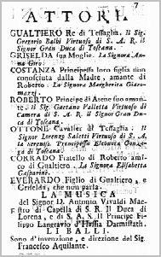
Fragmentation (1734-37)
1734/W: Verona
Filarmonico: Orlandini’s Arsace
1735/S: (opera for the bourgeoisie)
San Samuele: Vivaldi’s Griselda **
1735-36/W: Florence/Pergola
Giacomelli’s Cesare in Egitto (Cornelia)
Vivaldi’s Ginevra, principessa di Scozia (Ginevra)
1736-37/W: Ferrara/Bonacossi
Hasse’s Demetrio (impr. Vivaldi)
Hasse’s Alessandro nell’Indie

Slide 12
Fragmentation (1737-39)
1737/Spring*
Verona: Vivaldi’s Catone in Utica (Marzia)**
1737/Personal: Girò’s mother died
1737/Autumn*
Treviso (Dolfin): Vivaldi’s Farnace
1737-38
Venice: L’oracolo in Messenia (Merope)
Vivaldi: Rosmira (Rosmira)
Vivaldi: Armida al campo d’Egitto (Armida)
1738/Summer
Ancona: Vivaldi’s Siroe, re di Persia (Emira)

Slide 13
Main seasons of Venetian opera
Autumn
Introduced after 1680 to accommodate growing number of theaters
Testing ground for new composers, inexperienced singers
Experimental (no one important in town until early December)
Winter (a.k.a. Carnival)
Squeezed between St. Stephen’s and Ash Wednesday (lunar control)
Carnival portion allowed masking
Government officials, important visitors in town
Works serious, dignified; music by top composers
Main career path = autumn > winter

Slide 14
Other theatrical seasons
Spring opera (Venice from 1722)
Lighter fare
Shorter works
In disarray after 1745: comic operas given in Winter!
Summer opera
Not given in Venice until after time of Napoleon
Introduced north of Alps for royal garden houses
Works usually short, light—and melodious!

Slide 15
Fragmentation (1737-39)
Nov. 1738: Papal legate told Vivaldi he was persona non grata in Ferrara
Priest who did not say mass
Traveled in company of Ms Girò
1738-39/W: Ferrara (Bonacossi)
Vivaldi’s Siroe, re di Persia (Emira)
Hasse’s Attalo, re di Bitinnia (Arsinoe)
Disastrous season for Vivaldi!

Slide 16
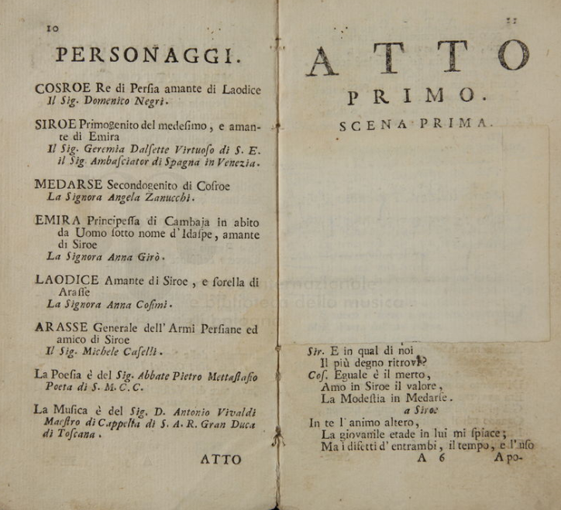
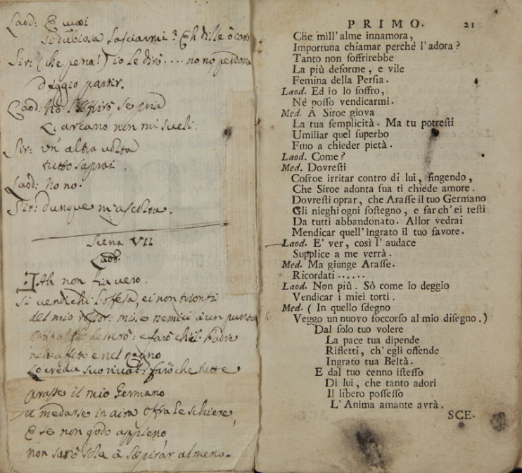
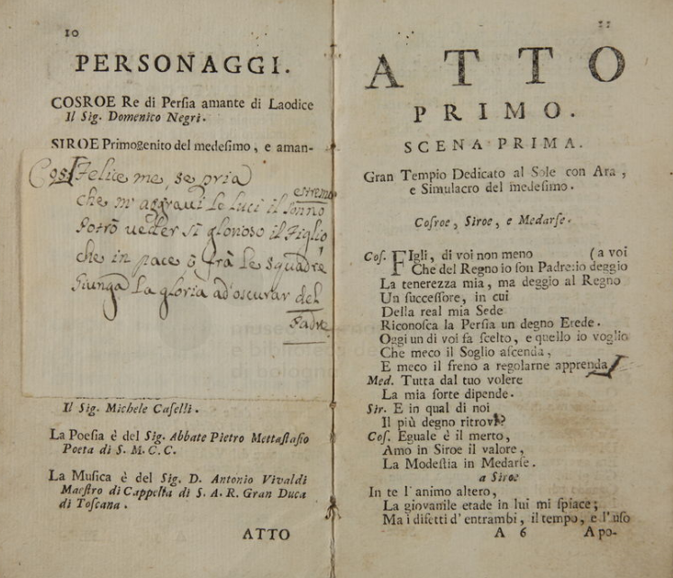
Siroe (Ferrara, 1739), Act One
I-Bc
Heavily changed throughout

Slide 17
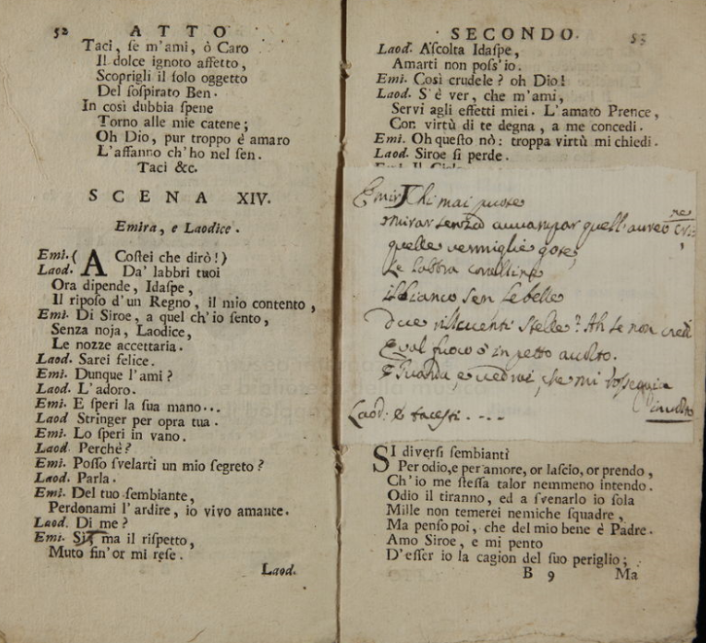
Siroe (Ferrara, 1739), Act Two

Slide 18
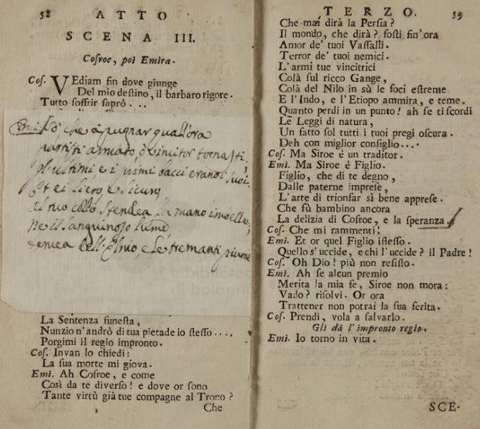
Siroe (Ferrara, 1739), Act Three

Slide 19
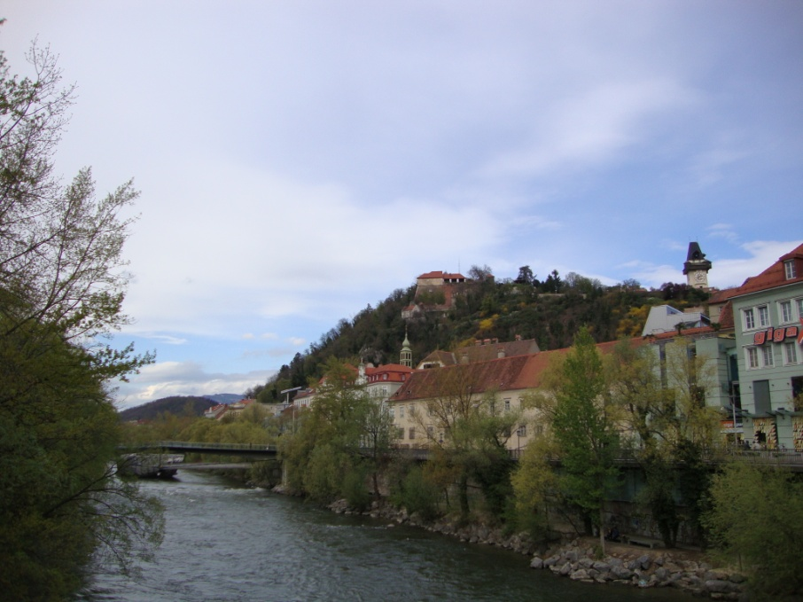
Fragmentation (1737-39)
Girò enters the Mingotti troupe
Moves to Graz

Slide 20
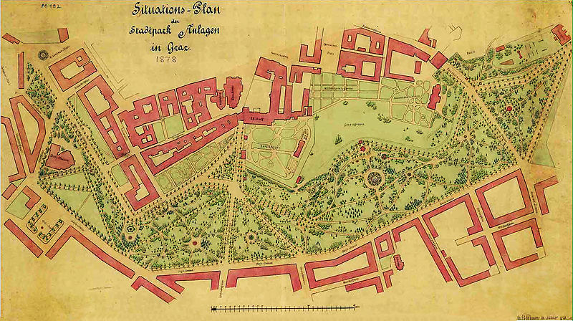
Pietro Mingotti productions (1738-42)
1739/Spring
Ciro riconosciuto (Mandane) (pastiche)
1739/Autumn
Rosmira (after Vivaldi)
1740/Carnival
Catone in Utica (after Vivaldi)
Amor, Odio, e Pentimento (after Porta)
Graz: Tummel-Platz

Slide 21
Mingotti troupe in Venice
1743/W | Sant’Angelo | Latilla’s La finta cameriera*
1744/W-S | San Moisè | 4 works, mainly by Latilla
…
1747 | San Moisè | 3 works, diverse composers
1748 | San Moisè | 5 works, Latilla, Fiorini, Ciampi
1749 | San Moisè | 3 works, 2 = Ciampi, Goldoni
1750 | San Moisè | 4 works, all by Goldoni, 3 by Galuppi (e.g. Il mondo della luna)
1751 | San Moisè | 5 works, 2 by Goldoni/Galuppi; others by Latilla
1752 | San Moisè | 2 works, 1 by Latilla
Maria Giovanna Miggiani, unpub.

Slide 22
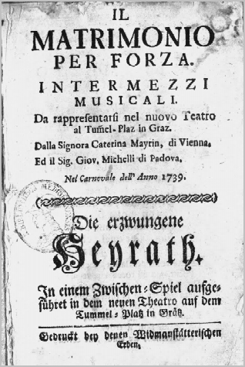
Characteristics of Mingotti productions
Cultural situation
Mercantile
Fortress mentality
Strict religious culture
Troupes peripatetic
Musico-dramatic situation
Libretti bilingual
Texts trans Jos. Karl Pircher*
Not clear that performances were entirely musical
Differences from other troupes
Imperial and northern focus
No core cultural identity
Returned to San Moisè (1744-47)*

Slide 23
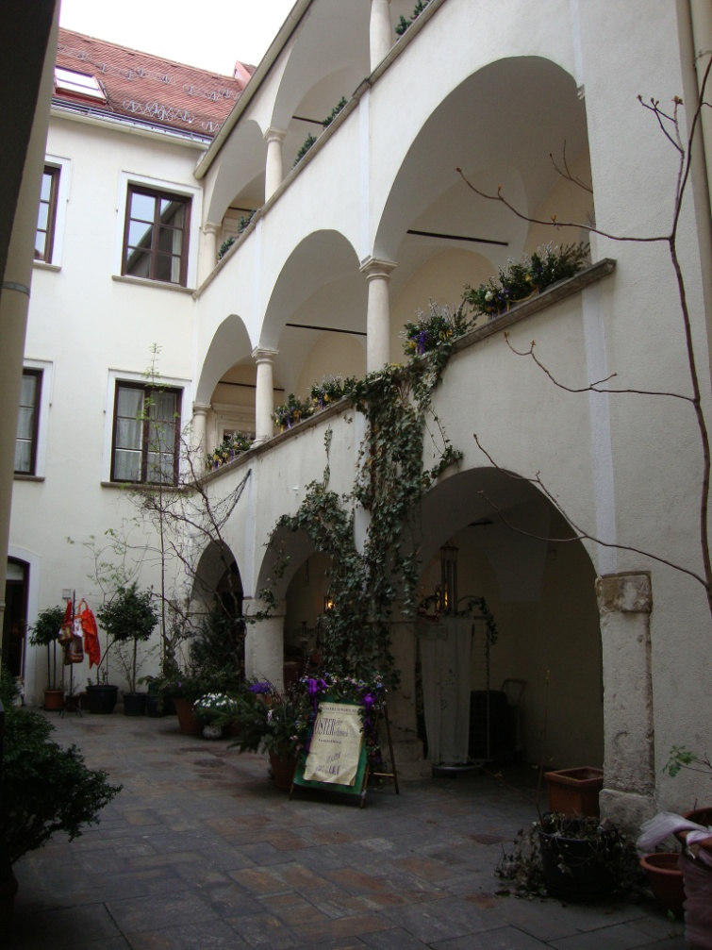
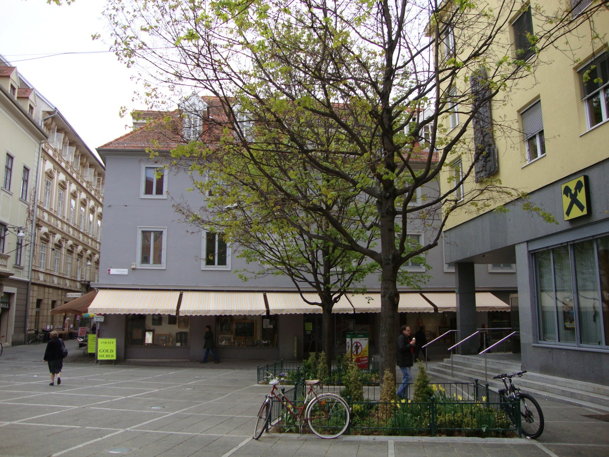
Graz today
Location of Tummel-Platz
Courtyard, Bishop’s palace

Slide 24
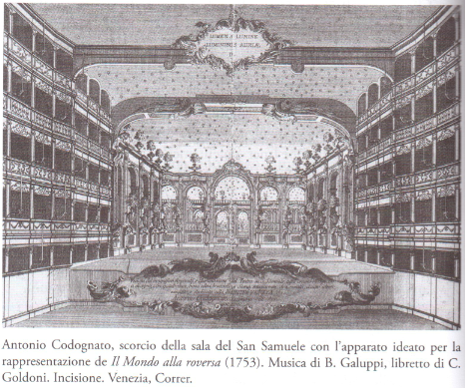
Girò in the Austrian orbit (1742-49)
1742:
Girò in L’oracolo in Messenia (Vivaldi), Kärtnertor, Vienna
Gluck’s Cleonice, Venice, San Samuele, 1742/S
1743:
Girò in Ezio (Lampugnani), Venice, San Samuele (spring)
Gluck’s Demofoonte et al., Milan, Regio (W)
1744, 1745:
Girò, Regio, Milan
Galuppi’s Berenice (Edvige), fr. Venice 1741
Galuppi’s Ricimero (Edvige), also Naples 1753
Gluck/Girò: L’Ippolito* (Fedra) winter
Georg Chr. Lobkovitz
dedicatee of all three Milanese works

Slide 25
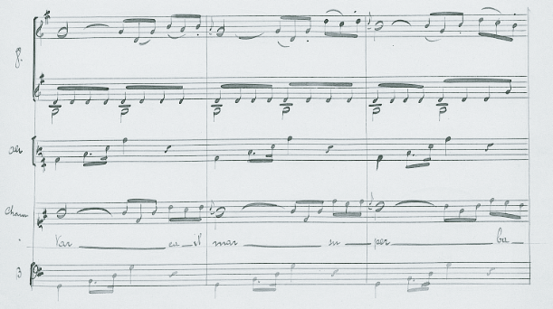
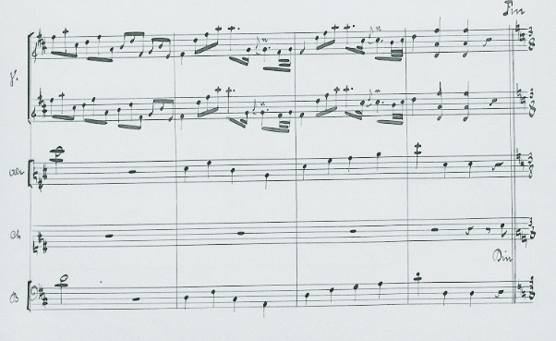
Gluck’s L’Ippolito (Milan, 1745)
Six arias for Fedra survive in Berne
19th-century transcriptions
Gluck anthology, v 2
‘Varca il mar’ [at right]—5 mss
‘Dirai all’Idol mio’ [below]—5 mss
Substantial instrumental passages.
Triadic modules.
Structurally calm, regular.
Thanks to Laurent Pugin for pix.
Sources: See http://www.gluck-gesamtausgabe.de/
gwv/werkregister/eintrag/ippolito.html

Slide 26
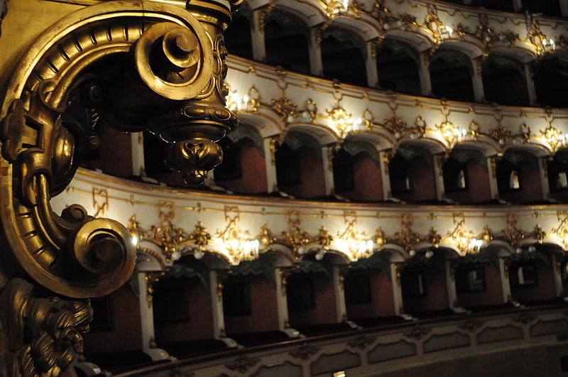
Encores (1747-49)
1747/Spring
Venice: Runcher’s Achille in Sciro (S. Samuele)
1747/Personal
Francesco Trevisan, Girò’s brother-in-law, died
1748/Carnival
Piacenza: Carcani’s Artaserse (Regio)
1748/Personal*
**Girò married (at 38): the Piacenzan count Antonio Maria Landi Zanardi
1749/Autumn
Graz: anon Lucio Papirio Dittatore (Tummel-Platz)

Slide 27
Girò in relation to Gluck (1742-49)
1737-45: Milan
Studied with Sammartini
Knew librettist Carpani
1742-45: Milan, Regio
One Carnival opera per year
All works Metastasian
1742: Venice, S. Samuele (Demetrio)
1744: Venice, S. Gio. Grisostomo (a Grimani theater) Ipermestra
1745-52: London, King’s
Went with Georg Chr. Lobkovitz
1747-48: Dresden/Pillnitz, Mingotti troupe
Gained him attention in Vienna
1748: Vienna, Burgtheater
1749: Copenhagen, Charlottenborg
1739-40:
Graz, Mingotti troupe
1742:
Vienna, Kärtnertor
1743:
Venice, S. Samuele (a Grimani theater)
1744-45:
Milan, Regio
Sponsor = Georg Chr. Lobkovitz
…
1748:
Piacenza with local composer Gius. Carcani
Piacenza/Parma: Bourbon courts
1749:
Graz, Tummel-Platz, with Mingotti troupe

Slide 28
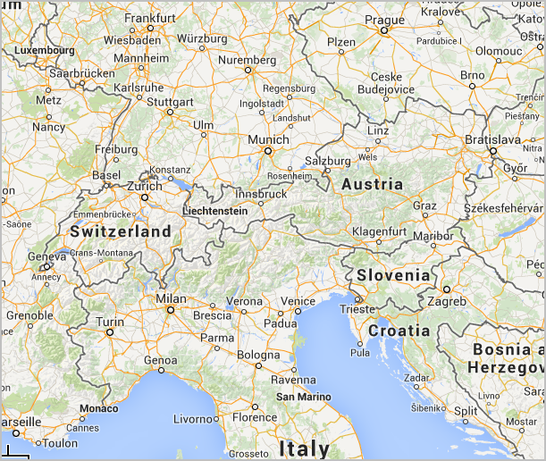
1738-49
1723-38

Slide 29
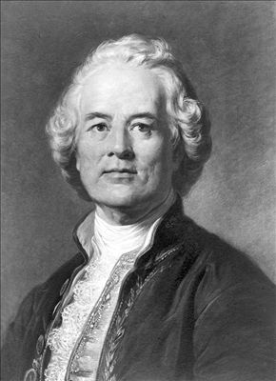
In conclusion…
Stayed focused on career
Was highly adaptable and
Moved from serious opera to lighter genres
Did not stray far from her contacts
Was probably typical of singers Gluck met in his early years

Slide 30
In conclusion…
Stayed focused on career
Was highly adaptable and
Moved from serious opera to lighter genres
Did not stray far from her contacts
Was probably typical of singers Gluck met in his early years…
Even though she was 39 when she retired, after a 25-year career, in 1749

