Slide 1
Venetian Virtuosi at Large
The Madonises, Albinoni, and Vivaldi
Eleanor Selfridge-Field
Stanford University
esfield@stanford.edu

Slide 2
The Madonis and Vivaldi Families
The Madonis Family
The Vivaldi Family
Played violins at S. Marco
Played violins at S. Angelo
Learned to play other instruments
Worked as impresari at Teatro Sant’Angelo
Traveled extensively to Italian and foreign theaters
Played violin at S. Marco
Played violins at S. Angelo
Learned to play other instruments
Worked as impresari at Teatro Sant’Angelo
Traveled extensively to Italian theaters

Slide 3
Evidence for Madonises’ Skills
Instrumentalists Guild, 1711
Testimony of Quantz, 1726
Ranking members
Name | Age | Rate
Vivaldi, GB | 60 | 8:0
Gabiato, Antonio | 58 | 7:0
Madonis, GB | 30 | 6:4
Vivaldi, Antonio | 35 | 4:0
5 others | 25-61 | 4:0
Found “Madonis [Luigi?] and Vivaldi [Antonio]” to be, together with Sammartini of Milan, “the best instrumentalists in Italy”.

Slide 4
The Madonis Family
Luigi, Giovanni Battista, and Antonio

Slide 5
Giovanni Battista Madonis
Sant’Angelo
San Marco
Cf. Antonio Madonis
Life: c. 1681-1740
Son of Lodovico
Guild: 1711*
San Marco: 1714 (violin)
Guild: 1727
Resigned in 1730
[coincides with years when Vivaldi was largely absent]
Returned in 1733 (viola)

Slide 6
[Gio.] Antonio Madonis
Sant’Angelo
San Marco
Performed in Albinoni’s Cleomene (1718/3)
Co-impresario, with Gio. Battista Madonis:
Zuccari’s Seleuco (1724/11)
Porta’s Ulisse (1725/2)
“I fratelli Madonis” = GB and (G)A
Life: c. 1690-1746
Son of Lodovico
1710: auditioned unsuccessfully
1720: hired as violinist

Slide 7
Luigi Madonis
Sant’Angelo
San Marco
Financed production of Vivaldi’s L’incoronazione di Dario (1717/3)
1716/17: “head of the second violins”
Life: c. 1692-1777
Son/brother/cousin of ??
Married in 1716?
No evidence that he ever worked at San Marco
Not listed in guild

Slide 8
Antonio’s wives
Rosaura Mazzanti
Girolama Valsecchi
Long association with Fr. Gasparini
Florentine singer frequently cast at San Cassiano
Half-sister of Antonio Ristorini (basso buffo)
Married to Antonio Madonis from V.1725 to V.1726
Long association with Vivaldi
Made her Venetian debut as Medoro in Vivaldi’s Orlando furioso (1714/5)
Sang in Amore e Sdegno (1726/4) at San Cassiano
Sang in Verona in Vivaldi’s La fida ninfa and Giacomelli’s Gianguir (both 1732)

Slide 9
Between Comedy and Opera
Understanding the Madonises’ Situation

Slide 10
Comedy and Opera (1700-1720)
Commedia (improvised)
The Dramma per musica
Comedy venues
San Salvatore
San Samuele
1703-1708: bickering
Grimani vs. Vendarmin
1708-1733: 25-year truce
Grimani monopoly on comedy
Changing relationship of comedy to opera
Troupe model of organization
Opera venues by season
Theaters with balli, intermezzi
San Cassiano
Sant’Angelo*
San Moisè
Theater with balli, battle scenes
San Gio. Grisostomo
Comedies with singing, violins
San Salvatore
San Samuele
Individual contracts*

Slide 11
The Ristori Troupe
Ristori troupe (Venice)
Ristori troupe (elsewhere)
Father = Tomaso
Son = Gio. Alberto
(c. 1692-1753)
Private performance (summer 1707)
San Moisè (1708 to “1713”)
San Samuele (1711-1714)
Orlando furioso (1713/5)
Opera, Sant’Angelo
Itinerary
Dresden (Pillnitz)
Moscow 1731
St. Petersburg 1732
Warsaw 1736
Violinists (1720s-1730s)
Giovanni Verocai (Joh. Verokay; a.k.a. Capitano)
Giacomo Taneschi (Joachim Janetsch)

Slide 12
Orlando in Venice (1713-1714)
Role, other details | Orlando furioso (1713/5) | Orlando finto pazzo (1714/4) | Orlando furioso (1714/5)
Composer | Ristori, Gio. Alberto | Vivaldi, Antonio | Ristori, rev. Vivaldi
Opening date | 9 November 1713 | c. 11 November 1714 | c. 26 December 1714
Dedicatee(s) | Scipione dal Sale | Karl Wilhelm, Margrave of Baden | Angelo, Annibale Marsigli Rossi (Bologna)
Orlando | Carli, Anton Francesco | Carli, Anton Francesco | Carli, Anton Francesco
Angelica | Giusti, Anna Maria | Gualandi, Margherita (Ersilla) | Gualandi, Margherita
Bradamante | Denzio, Elisabetta | Denzio, Elisabetta (Tigrinda) | Denzio, Elisabetta
Alcina | Faccioli, Margherita | Fabbri, Anna Maria (Origille) | Fabbri, Anna Maria
Ruggiero | Minelli, Gio. Battista | Pacini, Andrea (Argillano) | Pacini, Andrea
Medoro | Landi, Agata | Guerri, Andrea (Brandimarte) | Valsecchi, Girolama
Astolfo | Ramponi, Pietro | Natali, Francesco (Leodilla) | Natali, Francesco

Slide 13
Competition for performers: The Troupes Vs Venice
1724

Slide 14
The Peruzzi-Denzio Split
Antonio Peruzzi troupe (Venice)
Denzio sub-troupe
1668-1735
Son=Gio. Maria
Daughter=Teresa
Son-in-law (from 1719):
= Antonio Denzio
Troupe split in two in 1724
Kuks, Prague (summer 1724-spring 1734)
23 singers and players recruited from Venice
Antonio Bioni
Adapted works by Vivaldi and Albinoni

Slide 15
The Peruzzi Troupe in Breslau
Peruzzi troupe itinerary
Peruzzi troupe personnel (non-Denzio branch)
Breslau
later half 1725
Spring 1726
[Complicating issue]:
Quantz’s praise of “Madonis and Vivaldi”, concurrent with
Porpora: Siface (26.xii.1725)
Vinci: Siroe (2.2.1726)
Presumption
Traveled as troupe in summer
Worked as individuals in autumn-winter
Luigi Madonis
Concert-master
Antonio Madonis
Girolama Valescchi
Antonio Bioni
[Breslau: succeeded in 1728 by Gio. Verocai (violin) and Santo Burigotti (director of new Stadt-Theater).]

Slide 16
Meanwhile in Venice….
Albinoni: Didone abbandonata (1724/12)
Zuccari: Seleuco (1724/11)
San Cassiano
Impresario = Gio. Orsato
Composer = Albinoni
Librettists= Metastasio
Cast
Maria Bulgarelli (Dido)
Nicola Grimani (Enea)
Teresa Peruzzi (Selene)
{Valsecchi in Amore e Sdegno (S. Cassiano) 1724/6]
Sant’Angelo
Impresari = G. B., A. Madonis
Composer = Zuccari
Libretto = Zeno/Pariati
Cast
Giovanni Paita (Seleuco)
Giovanni Carestini (Antioco)
Rosaura Mazzanti (Stratonica)

Slide 17
Comedy satirizes Opera
Albinoni:
Didone abbandonata
L’opera in commedia [1726]
San Cassiano
Impresario = Gio. Orsato
Composer = Albinoni
Librettists= Metastasio
Cast
Maria Bulgarelli (Dido)
Nicola Grimaldi (Enea)
Teresa Peruzzi (Selene)
Satire on opera
Satire on Didone
Linked with Denzio troupe??
Many evidences that Madonis crew
spent winters in Venice,
traveled in spring and summer.

Slide 18
The Peruzzi Troupe in Brussels
Brussels: Le Théâtre de la Monnaie
Influential Patrons
June 1727
Comic intermezzi
Serpilla e Bajocco
Don Micco e Lesbina
Antonio Ristorini
Rosa Ungarelli
Opera
Bioni’s Orlando furioso (Kuks, 1724),
Girolama Valsecchi
[Past: Max II Emmanuel (exiled)]
preferred French style
1726: Returned to Munich
Present: Prince (Emmanuel) of Carignan
Sponsor of the Accadémie de Musique
New sponsor of Peruzzi troupe

Slide 19
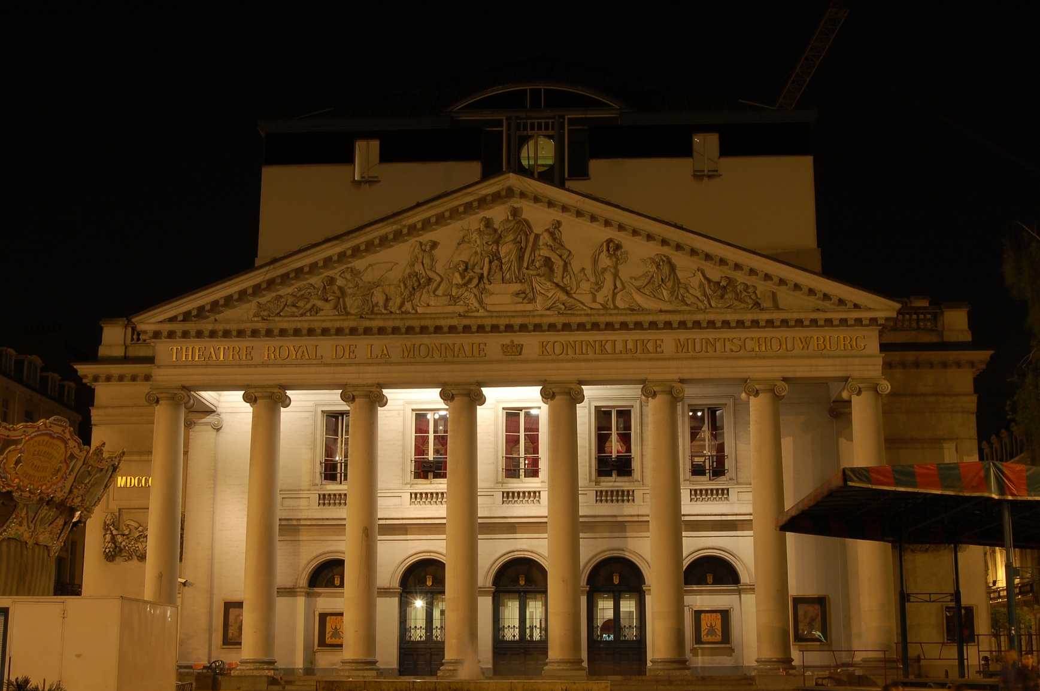
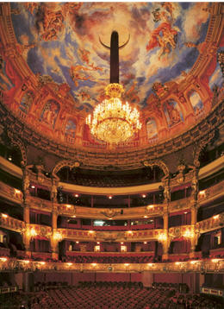
Théâtre de la Monnaie, Brussels

Slide 20
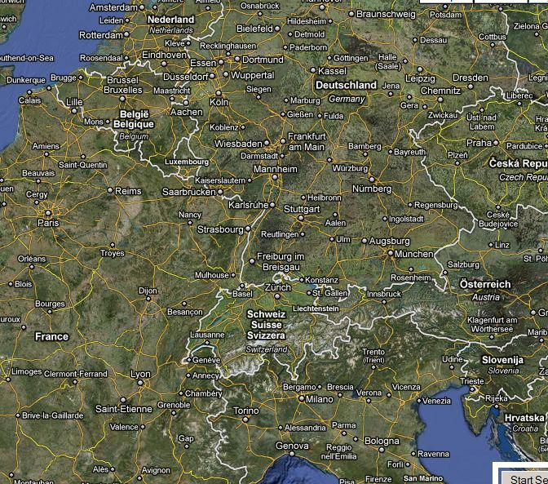
c. 1727-28: Venice-Brussels-Frankfurt-Paris

Slide 21
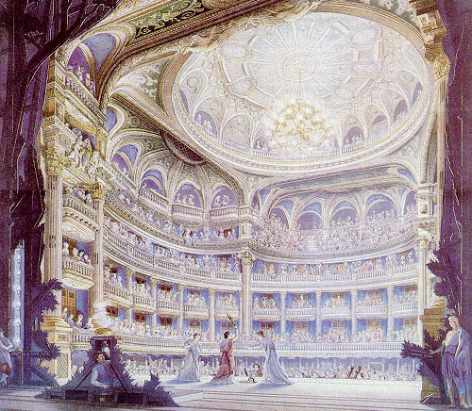
The Peruzzi-Madonis Split
Peruzzi troupe
Luigi Madonis
1728: Frankfurt
“Mssrs Madonis and son”
1729: Paris
Intermezzi
Paris 1729
Arrived with Peruzzi troupe
Concert Spirituel (i.v.1729)
Only Italian to play there
1731
Hired by Venetian ambassador
Dedicated Sonates to Abbé de Pomponne
1733
Recruited by Anna Ioannovna
Com. fr.

Slide 22
Bioni and Denzio
Bioni’s zigzag career
Denzio’s Prague Career
1724: Kuks (Denzio)
Orlando furioso
1725: Breslau (Peruzzi)
1727: Brussels (Peruzzi)
His Orlando furioso staged
Then returned to Breslau as Kapellmeister (to 1734)
Composed operas
Works composed by Bioni, G. A. Guerra, and Denzio
Reset works by Vivaldi and Albinoni
Cast overlaps with many Vivaldi works, incl. Dorilla in Tempe (1726/9)
1729-31: Engaged Antonio and G. V. Madonis
Coincided with travels of the Vivaldi
to “Germania.”

Slide 23
The Russian Exodus
1731-1737

Slide 24
Ristori and Associates 1731-32; 1736
Ristori (Dresden) Travels
Ristori troupe performers
Itinerary
Dresden (Pillnitz)
Moscow : coronation of Anna Ioannovna (1693-1740)
Arrived in Feb. 1731 after 6 weeks of travel
St. Petersburg
Arrived in Dec. 1731
Returned to Dresden April 1732
Warsaw 1736
Instrumentalists
Violin: Giovanni Verocai (Joh. Verokay)
a.k.a. Capitano
Gamba: Giacomo Taneschi* (Joachim Ianesky, Janetsch)
Two horns, one bassoon
Singers
Lúdovica (?)
Margherita, Cosimo Ermini

Slide 25
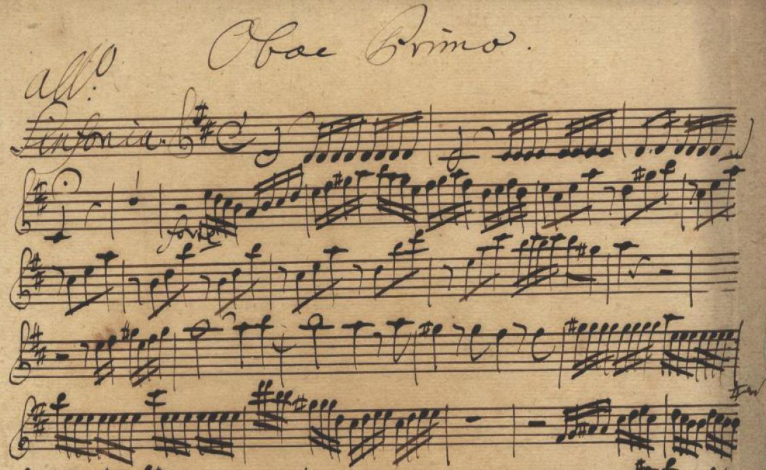
Ristori Troupe—Verocai
Musikalisches Labyrinth in C Major (Breslau, Stadtbibliothek, Mus. Oa 44):
Symphony in D Major (D-Dl Mus. 2819-N-1), oboe parts copied by Pisendel; string, bassoon, and parts copied by Joh. Gottl. Morgenstern (Schreiber D)

Slide 26
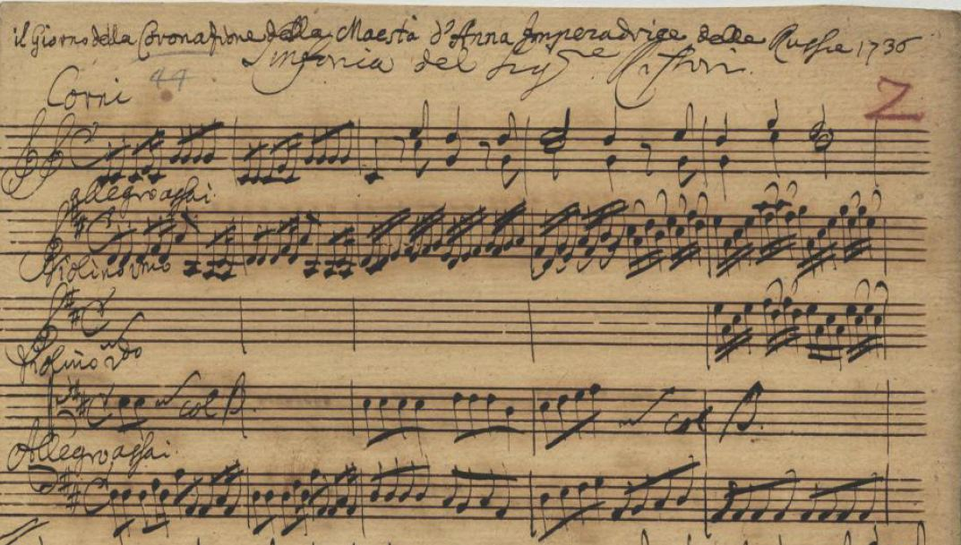
Ristori Himself
Excerpts from serenata for the coronation of Anna Ioannovna
sung in Warsaw, 1736 {D-Dl Mus 2455-G -1—score and 16 parts

Slide 27
Peruzzi and Associates, 1733-35
Peruzzi troupe (w/ Teresa P.)
Denzio troupe (w/ Teresa P.)
Munich-August
Paganelli (troupe harpsichordist)
Narciso al fonte
[Paganelli in Venice 1732-33; 1742]
Augsburg-Sept.-Oct.
Regensburg—Nov. 1733
Il condannato innocente (4.xi)
Filindo (14.xi*)
[Prague: Denzio wanted for non-payment of debts]
[Vivaldi’s Argippo went with them]
[*Vivaldi’s Motezuma score??]
1734: Peruzzi and Denzio reunited
1735: Peruzzi died
1737: Teresa Peruzzi died
1740s: Ant. Denzio settled in Germany

Slide 28
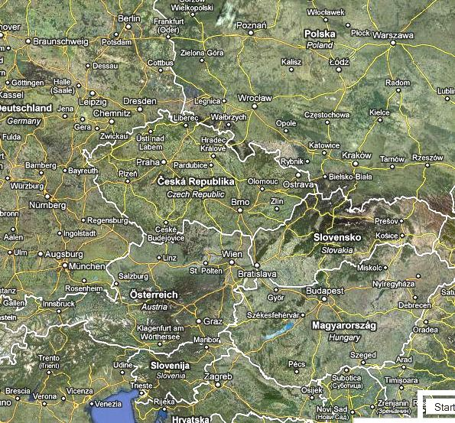
c. 1732-34: Venice-Munich-Augsburg-Regensburg (with Prague, Verona)

Slide 29
Meanwhile in Russia…
Pietro Mira
Francesco Araja
Neapolitan comico (Pedrillo)
Violinist (cum dancer)
Late 1720s: at Saxon court in Warsaw
C. 1731: in Moscow before Ristori
1732:
asked to find Italian troupe to replace Ristori’s
recruited Sacchi troupe (Dresden-Breslau-Warsaw route), but they returned in winter 1733
1735: recruited Araja
1742: bought hotel [Leon Bianco] in Venice
Life: 1709-1770
Composed operas for Venice
1733/7: Berenice [San Gio. Grisostomo; from Florence, 1730]
1735/1: Lucio vero [Sant’Angelo]
Remained in Russia until 1767
L. Madonis had arrived from Paris in 1733 (if not sooner)

Slide 30
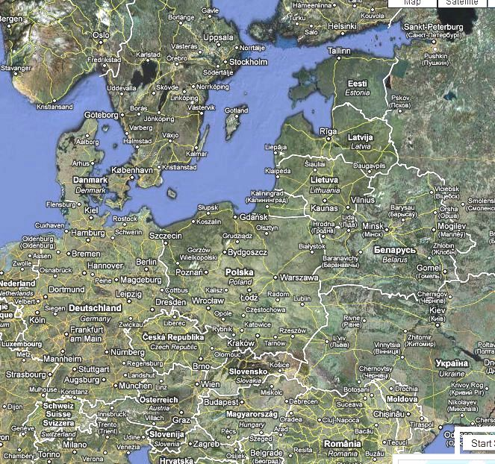
c. 1733-36: Venice-Warsaw-St. Petersburg (via Dresden and Breslau)

Slide 31
Madonises in St. Petersburg
Music in St. Petersburg
Luigi (Loudvik) Madonis
1736: First opera (by Araja) for coronation of Anna Ioannovna
1737: First organ installed
1738: First printing of music*
1738: first singing school
1740: first conservatory of music
c. 1740: onsite musical- instrument manufacture
1738: Douze symphonies…*
(suites for violin, cello, and b.c.)
1742-62: Kapellmeister for Elizaveta Petrovna
Played until 1767
Died in 1777

Slide 32
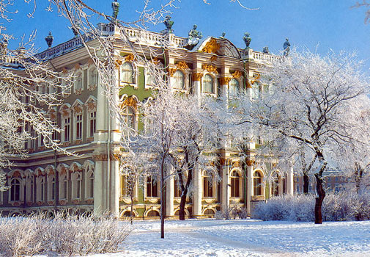
Winter Palace, St. Petersburg

Slide 33
Music by Luigi Madonis
Sonata in D Major Harvard/Houghton, Mus 73, “No. 63a”, pp 317-324. V1, bc.
(Adagio-Allegro-Capriccio-Largo)
Sonata in F Major, No. 62a. Same anthology, pp. 313-316.
(Andante-Allegro-Adagio-Rondeau. Grazioso.
Minuet in D Major. Statens musikbibliotek, Stockholm (S-Skma/ Alströmer saml.)

Slide 34
Luigi Madonis’s Music
Content
Style
1738: Douze symphonies…*
(suites for violin, cello, and b.c.)
Very conservative
Very fluid*
Very “French”
MS sonatas [Harvard]
may be from c. 1721
may be associated with Leclair (1687-1764)
Lyon-Paris-Turin-Paris
Dancer, violinist, lace-maker
Movement 3
Movement 4

Slide 35
Venetian Postscript
Antonio Madonis, 1739-40
Giuseppe Madonis
Venice, 1739-40
concert-master at San Giovanni Grisostomo
Noted virtuoso of viola d’amore
Gave private concerts at Palazzo Pisani
Summer 1740
Returned to St. Petersburg,
Learned to play horn
Died there in 1746
Violinist of exceptional merit
1740: entered S. Marco orchestra
1750-55: auditioner for instrumentalists’ guild
1760, 1766: promotions
1777: gastaldo of instrumentalists’ guild

Slide 36
Conclusions
Sant’Angelo in the 1710s had excellent violinists
e.g., Vivaldi and Madonises
Singers from Sant’Angelo easily lured by traveling troupes
Change starts with Ristori troupe
Perception of Vivaldi’s 1730s style as outmoded may be explained by
Extraordinary lures coming from Russia
For Russian court “Italian” music meant
Neapolitan (opera, intermezzi) and
French-style instrumental music

