Slide 1
Between the acts
Eleanor Selfridge-Field
CCARH, Stanford University

Slide 2
Between commedia and the opera buffa
Font, size, and color for text have been formatted for you in the Slide Master
Use the color palette shown below
See next slide for additional guidelines
Hyperlink color: www.microsoft.com
Commedia
Impresarial opera
Dramma per musica vs opera buffa
Emphasis on extempore presentation
Emphasis on written script
Scripted with improvised elements

Slide 3
Between commedia and the opera buffa
16th century: Commedia [many varieties]
17th century: Impresarial opera
18th century: Dramma per musica vs. opera buffa
Impresarial opera
Commedia
Dramma per musica vs opera buffa
Emphasis on written script
Emphasis on extempore presentation
Unscripted/non-surviving improvised elements
Scripted with improvised elements

Slide 4
Apart from the scripted drama….
Before Act One:
“machine” prologue, usually for the gods
Sinfonia (sometimes)
Within the acts:
Balli (some instructional)
Cori (emphasis on gesture)
Instrumental ritornelli
Visual exhibits (most instructional)
At end of final act:
“machine” finale; festive ballo

Slide 5
Elements that changed
Before Act One:
Gradual shift of emphasis to sinfonia (imaginary scenes)
Disappearance of prologues by end of century
Within the acts:
Balli remain
Cori take on modern focus or disappear
Ritornelli gradually integrated into arias
At end of final act:
Machines decline; festive balli remain

Slide 6
Dividing the seicento
1637-1659
Unsettled, experimental
Librettists had a lot of influence
Several ephemeral theaters open (and closed)
“Season” concentrated in December, Jan-Feb.
Council of Ten influential
1660-1699
3 most important theaters open
San Salvatore (1661)
Sant’Angelo (1677)
San Gio. Grisostomo (1678)
Seasonal expansion
Growing predictability
Council of Ten influential

Slide 7
From intermedii to Cori and balli
Intermedii
Prologues
Cori
Drammi per musica
Balli
Battaglie
Behavioral models

Slide 8
Persistent images
Battles: SSGP (1667…1690) S. Gio. Grisostomo
Accademie:
S. Gio. Grisostomo: Nerone—of musical instruments; also 1685/7
S. Gio. Grisostomo: xx—of military instruments
S. Gio. Grisostomo: of warring forces (Elmiro, 1686)
S. Salvatore: Natural cycles--Hours of the Day, Night/Day, Sun/Moon, (1670/2)
Transformative scenes: Carlo il Grande (1688/7)

Slide 9
Comprehensive themes
Theme | Theater | Date | Examples
Battle scenes | SS. Gio. Paolo; S. Gio. Grisostomo | 1667-1690
Natural cycles | S. Salvatore | 1675 | La divisione del mondo
Transformative scenes |  | 1688 | Carlo il grande

Slide 10
Heroism: Pausanias, Hercules

Slide 11
Analysis

Slide 12
Why?
Variables
Taste?
Librettist?
Composer?
Theater?
Season?
Patronage?

Slide 13
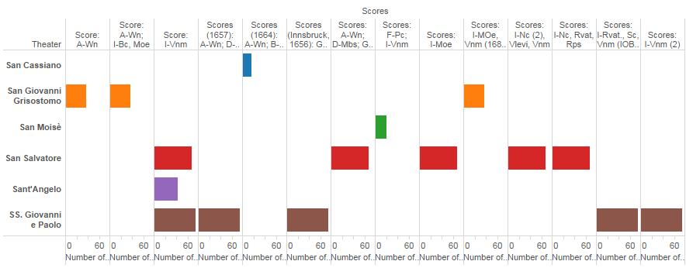
Score survival by theater

Slide 14
Libretti per theater

Slide 15
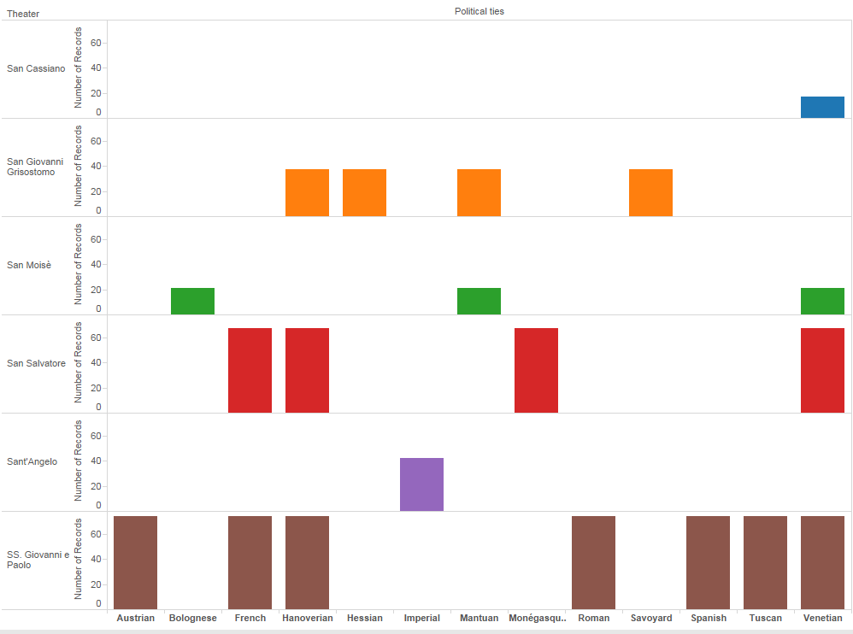
Patronage by theater

Slide 16
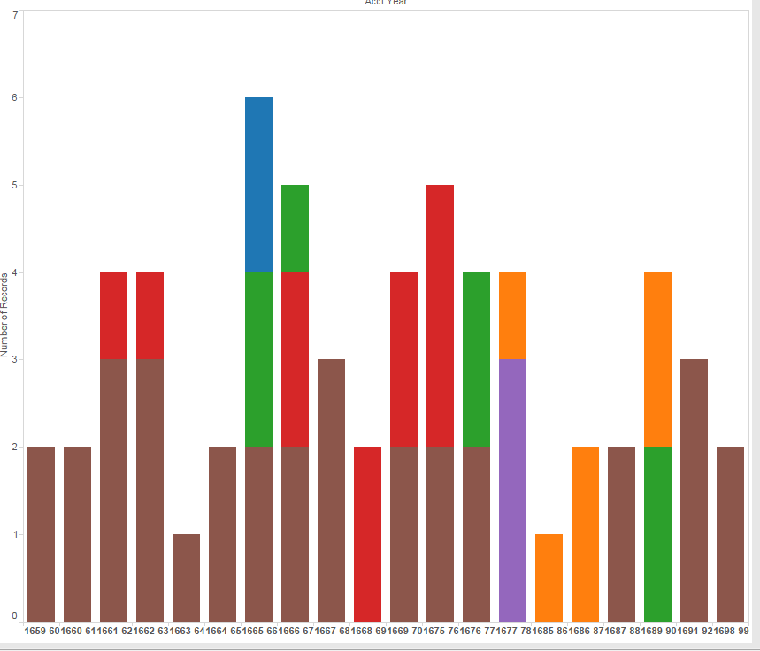
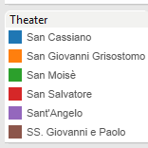
Entr’actes by year, theater

Slide 18
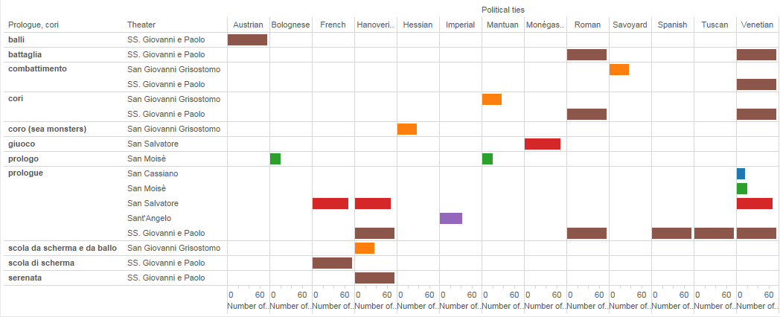
Entr’acte type/theater/patronage

Slide 19
How to ranking of variables

Slide 20
Affect: Domenico Gabrielli, Maurizio (Venice 1687; Modena 1690)

Slide 21
Affect: Domenico Gabrielli, Maurizio (Venice 1687; Modena 1690)

Slide 22
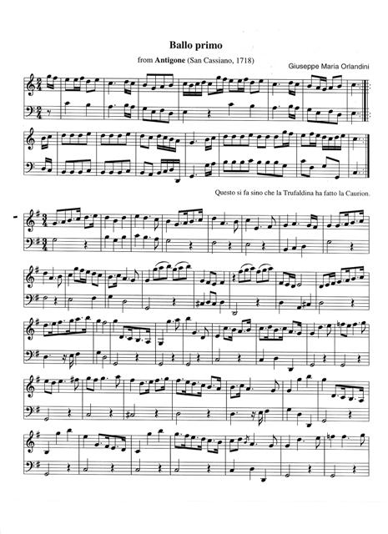
Il Tello
Trufaldina in Antigona?? (1721)

