Slide 1
JS Bach, JG Walther, and their keyboard transcription sources
Eleanor Selfridge-Field
Stanford University, Packard Humanities Inst.
February 2020

Slide 2
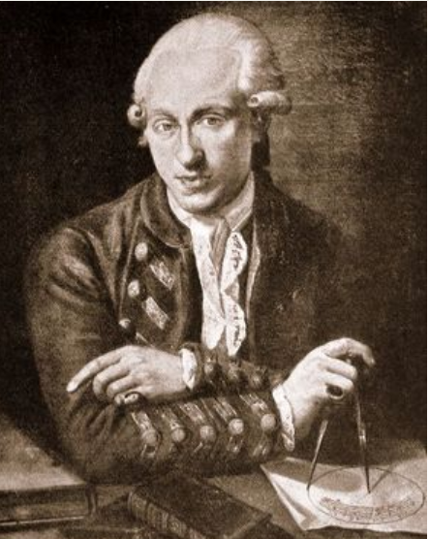
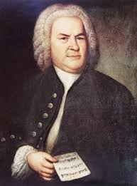
1. Keyboard transcriptions
J.S. Bach (1685-1750) “keyboard with or without pedal”
16 pieces; D-B P 280 et al.
J.G. Walther (1684-1748) for organ
14 pieces; D-B Mus. ms. 22541

Slide 3
Overview: Main figures
Joh. Sebastian Bach (1685-1750)
  Harpsichord transcriptions (Italian models)
  16 pieces: D-B P 280, P 801, P 804 et al.
Joh. Gottfried Walther (1684-1748)
  Organ transcriptions (14 pieces; D-B Mus ms 22541)
    Italian models
    French models
    German models

Slide 4
Overview: Other figures
Other figures
Joh. Bernhard Bach the Elder (1676-1749); Erfurt, house of the Three Roses
  Worked with Telemann in Eisenach (1708-1712); JBBII, copyist for uncle c 1715
Joh. Ernst, prince of Weimar (1696-1715)
Joh. Ernst Bach the Elder (1683-1739); mainly in Arnstadt
Joh. Ernst Bach the Younger (1722-1777); son of J.B. the Elder; went to Leipzig

Slide 5
Main question
By J.S. Bach (1685-1750) for harpsichord
  16 arrangements, multiple movements (BWV 972-987, BG)
By J.G. Walther (1684-1748) for organ
  14 movements, multiple movement (DDT, 1906)
Are these sets related? If so, how?

Slide 6
2. Manuscript networks (c. 1705-1725)
Collapse of music publishing in Italy c.1700
Noblemen’s homes opened to musicians
Composers’ libraries formed
Students sent to transcribe music
Composers’ and musicians’ exchanges
--Kirsten Beisswenger

Slide 7
Musical aspects of transcriptions
Transcriptions were not entirely faithful to model
Genre often changed in process of transcription
Key, instrumentation often changed

Slide 8
Parameters of the transcription phenomenon
Other copyists
  Christoph Graupner
  G. Ph. Telemann
  Bach pupils, wandering progeny
Other instances of the transcription phenomenon
  Tartini’s utilization of Venetian opera arias in concertos (P. Wilk)
  Bohemian princes’ libraries in Vienna

Slide 9
Print networks (1700-1740s)
Dutch reprints and their relationships to Italian prints
  Bologna: M. Silvani: active in late decades of 17th century
  Venice: Giuseppe Sala: active until c. 1705
  Amsterdam: Estienne Roger: filled void, esp. 1706-1716
  Venice: Antonio Bortoli: selectively active, 1708-1720s
Fraudulent editions
  Amsterdam: Pierre Mortier
  Amsterdam: G.F. Witvogel?
  L. Collarile, R. Rasch et al.

Slide 10
J.G. Walther’s concerto transcriptions
Composer well known, attributions substantiated
Albinoni (2)
Corelli (1)
Graupner (1)
Telemann (1)
Torelli (3)
Vivaldi (1)
Composer less well known,
or attribution not confirmed
Gentili (1)
Gregori (1)
Mancia (1)
Meck (2)
Taglietti (1)
Collection published in the Denkmäler deutscher Tonkunst,
ed. Max Seiffert, vv. 25-26 (1906).

Slide 11
Nos. 1 and 2. Tomaso Albinoni’s Op. 2
Sei sinfonia a 6. Concerti à violin di concerto, due violini, alto viola, tenore viola, violoncello e basso continue. Venice: Sala, 1700.
Model for other core interests??
  Nos. 8 and 10
  Both works reprinted in E. Roger No. 7 (1702)

Slide 12
No. 3 (cryptic identification)
Walther: Concerto del Sig.r Blamr appropriato all’organo
  New attribution: François Collin de Blamont* (Versailles)
  Source: Rostock: MS Mus.Saec.XVII:51|2|0, untitled, A major, 6 movements
  Scored for six instruments

Slide 13
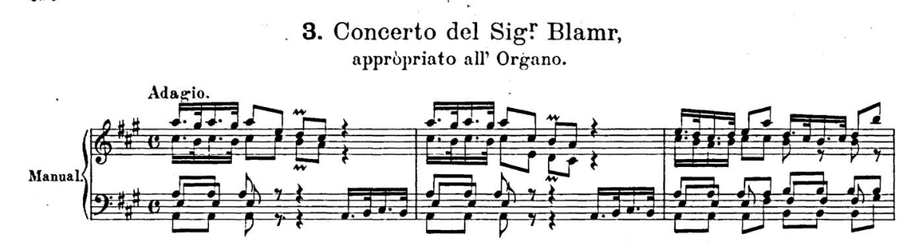
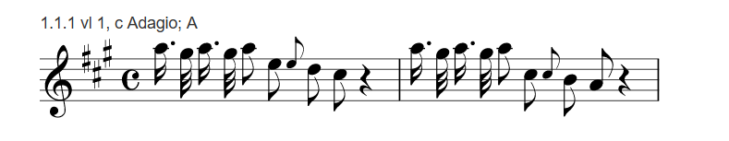
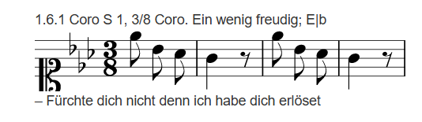
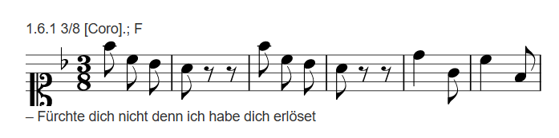
No. 3 (cryptic attribution)
Walther: Concerto del Sig.r Blamr appropriato all’organo
  New attribution: François Collin de Blamont* (Versailles)
  Source: MS Mus.Saec.XVII:51|2|0, untitled, A major, 6 movements,
  Scores for six instruments
Collin de Blamont
Johann Ernst’s “Straf mich nicht in deinem Zorn” in Cantate | über den Gesang: | Straf mich nicht in deinem Zorn. | von | Bach in Eisenach | 1771
2020 Eleanor Selfridge-Field

Slide 14
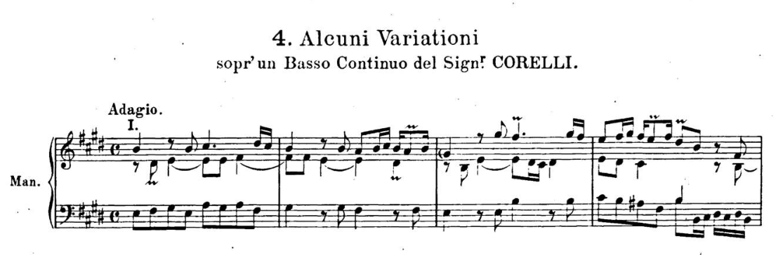
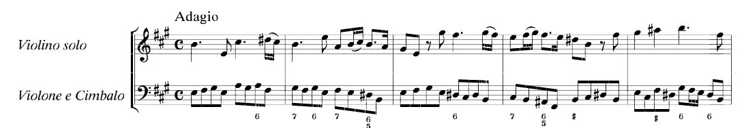
4. Alcuni variazioni sopra un basso continuo del Corelli
Op. 5, No 11, Preludio (Rome 1700)

Slide 15
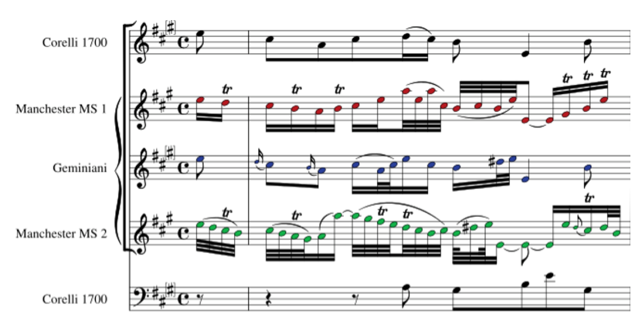
“Agréements” for Corelli Op. 5
Op. 5, No. 9
  E. Roger, No. 75 (1710)
  …dernier èdition gravée proper à la joinder à ses autres ouvrages tre bien corregée tout nouvellement avec la gravée en partiture mais sans les agréements

Slide 16
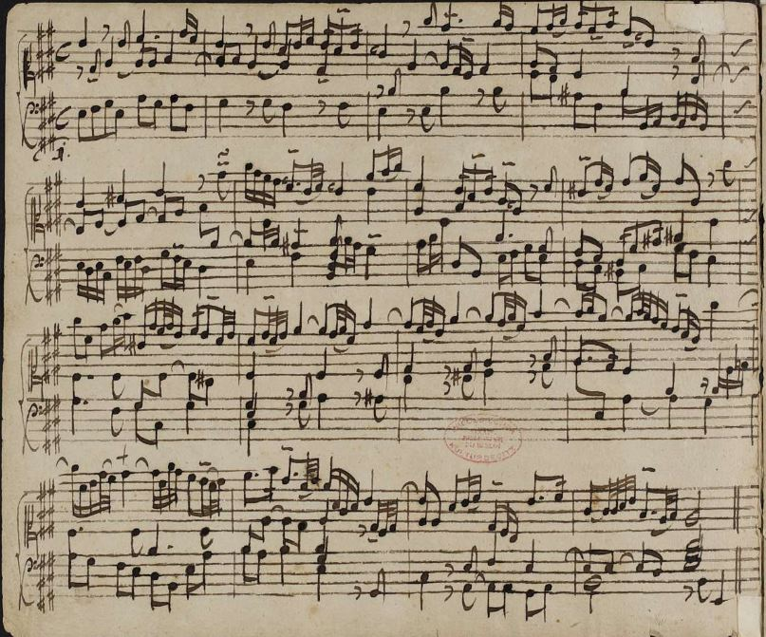
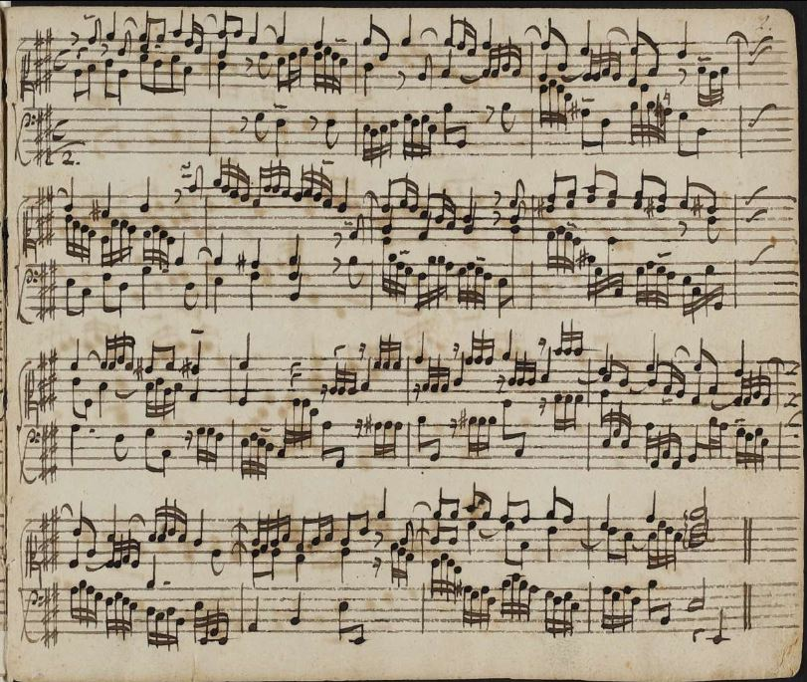
Textures: Walther vs Corelli
D-B Mus.ms. 22541, n. 5

Slide 17
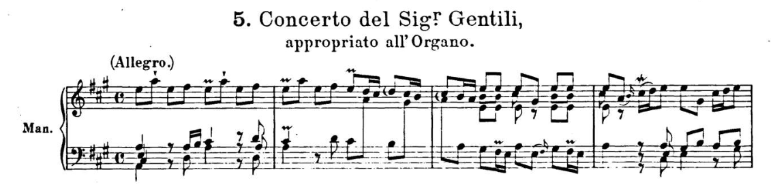
No. 5. Giorgio Gentili
Roger reissues
Op. 1 (#268, 1702)
Op. 3 (#299, 1706)
Giorgio Gentili (c.1668-after 1737). Venetian violinist.
  Five published volumes of sonatas and concertos.
  Some incomplete.
  Op. 6 survives by holograph in Dresden (SLUB).

Slide 18
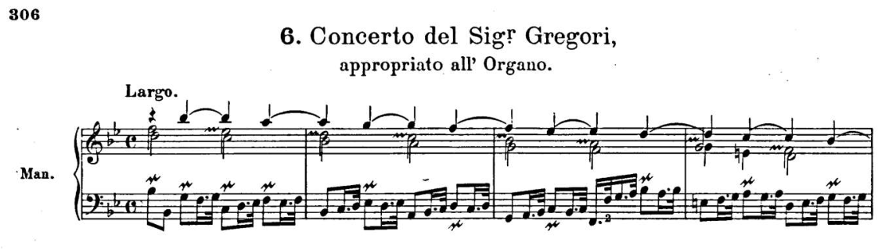
6. Gio. Lorenzo Gregori
1663-1745
Lucca
  Pub. Arie in stile francese that are instrumental (1698)
  Walther = Op. 2, No. 3 (Concerti grossi, 1698, pub. Bart. Gregori)
  No source independent of D-B Mus.ms. 22541 (Walther) known

Slide 19
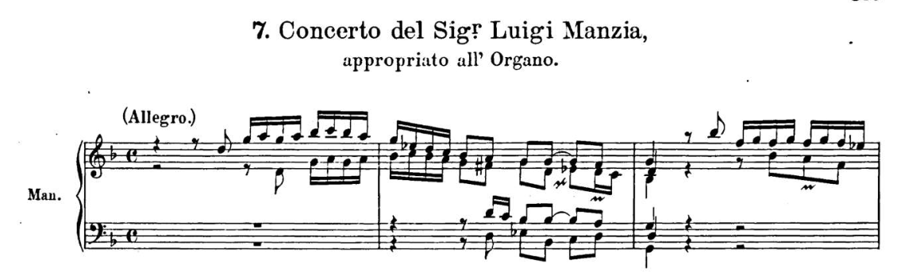
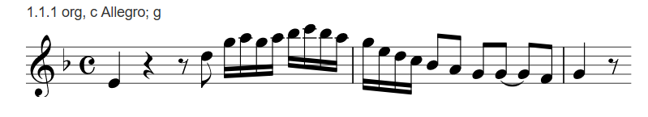
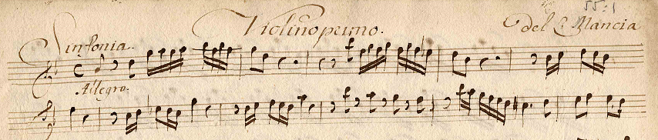
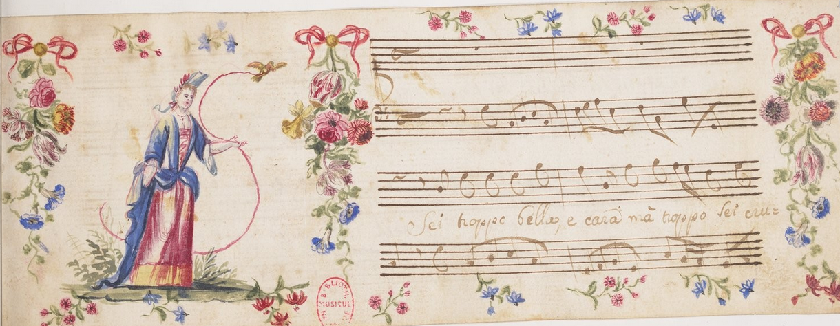
7. Luigi Mancia
Concerto del Sig.r Manzia (c. 1665-1708)
Sinfonia introducing “Qui dove il fato rio lunghi”
Match in Düben Collection (Uppsala)
Well regarded in France
Library of Henri Prunières
Düben Collection

Slide 20
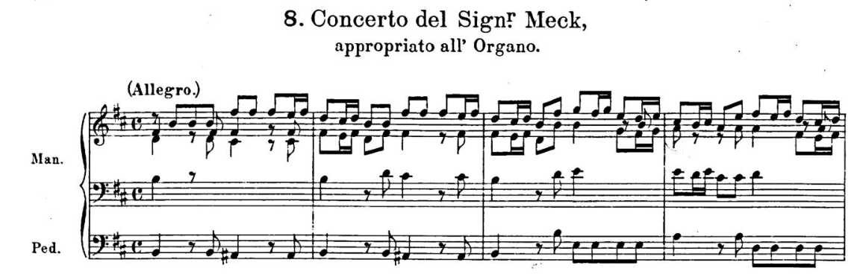
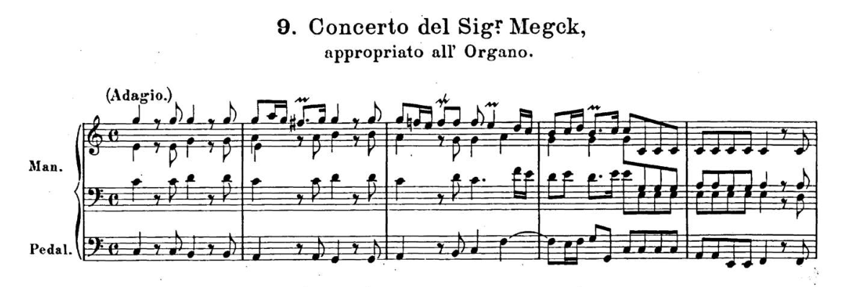
8, 9. Concerti del “Sig.r Meck”
Both mistaken attributions
Joseph Meck (1690-1758)
In Italy < 1711

Slide 21
8. Antonio Vivaldi (RV 275a)
Graupner’s transcription of Vivaldi’s composition
Darmstadt Mus.ms. 411/1 as here
D-DL Mus-ms-O-470-94 (2 clarini, timpani, 2 violins, viola, cembalo)

Slide 22
9. Christoph Graupner?
Sinfonia in D Major GWV 528, m. ii
1690-1768
Ernst Ludwig (1667-1739)
Landgrave of Hesse-Darmstadt
Philip (1671-1736); Landgrave of Hesse-Darmstadt;
Imperial fieldmarshal & governor of Mantua (1714-1736)

Slide 23
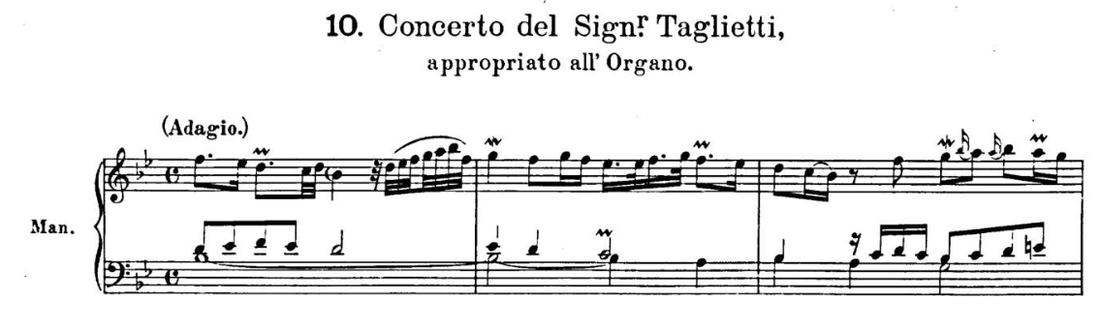
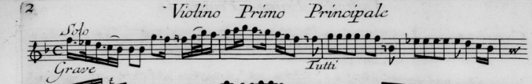
10. Giulio Taglietti
Brescian composer (1660-1718)
Violin teacher at Jesuit College
Concertos modelled on Torelli’s
Op. 11: Concerti à 4 con suoi rinforzi, No. 2, m. ii
No MS source known apart from Walther’s
E. Roger: No. 422

Slide 24
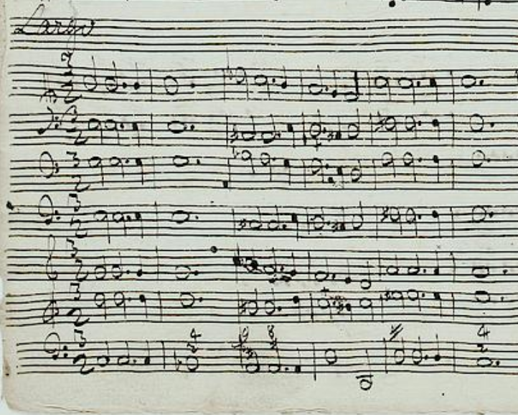
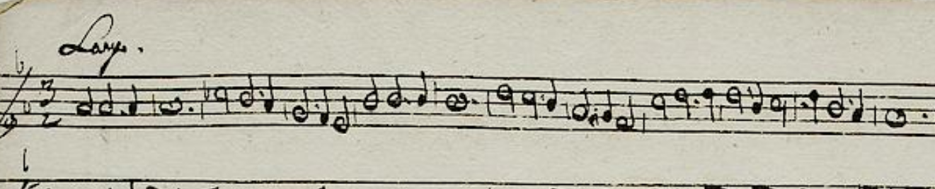
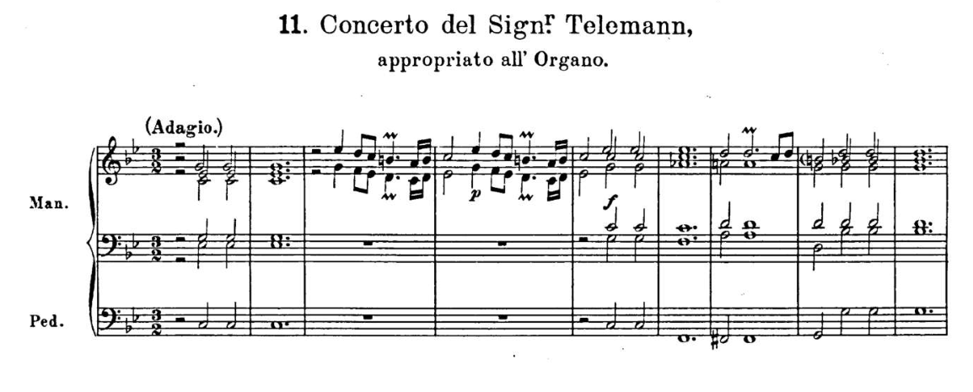
No. 11. G. Ph. Telemann
TWV 52: C 1
Ouverture, ii (Largo)
D-D Mus. Ms. 1033/38(a)
  Telemann’s orch.
    2 Chalumeaux, 2 Fg, Strings
  Copied by Graupner:
D-D Mus. Ms. 1033/38(b)
  Graupner’s orch. same
J. Jaenecke, 1993
(a) post 1718

Slide 25
Nos 12, 13, 14: Giuseppe Torelli
No. 12: Passadore A.3.2.8 = Concerto à 5 Op. 8, No. 7
  Concerti grossi con pastorale per il santissimo Natale (Bologna, 1709)
  A-Wn E.M. 149 (3 parts attrib. A. Vivaldi)
No. 13: Passadore A.3.3.10
  D-Dl Mus. 2035-Q-1
No 14: Passadore A.2.3.2
  D-Dl Mus. 2035-O-6 (copied Pisendel)
  I-Nc Rari 1.6/D. 20/1-3 (copied by Albinoni)

Slide 26
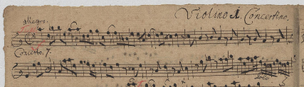
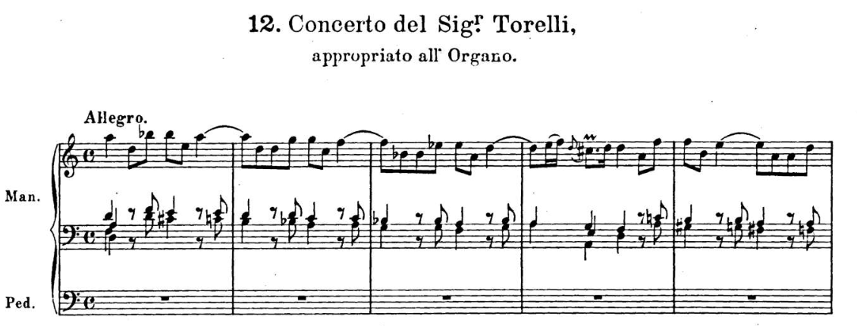
Torelli transcriptions
D-Dlb Mus 2035-O-5

Slide 27
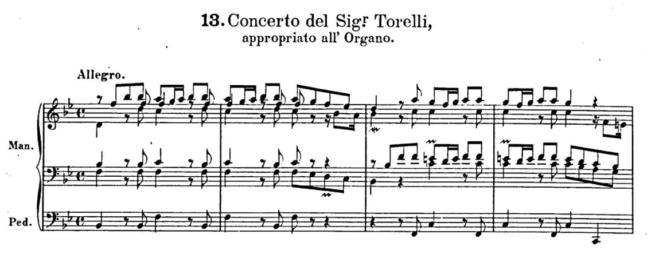
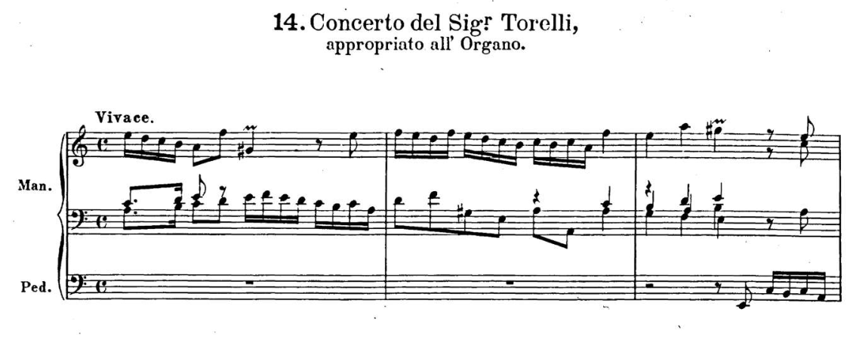
13, 14. Unpublished Torelli examples
Albinoni source (I-Nc) incomplete
Pisendel source (D-Dl) complete

Slide 28
J. S. Bach:
XVI Konzerte nach verschiedenen Meisteren
16 works
Most models are violin concertos
Most from 1708-1716
  Nos. 1-10 all Venetian models (7 Vivaldi, 2 Ben. Marcello, 1 Al. Marcello)
    No. 10 (B.Marcello) in hand of Joh. Gott. Walther
  2 (Nos. 11, 16) confirmed: Johann Ernst, prince of Weimar; 1 (No. 13) unconfirmed
  2 (Nos. 12, 14) confirmed: Telemann; 1 (No. 15) Telemann or Albinoni

Slide 29
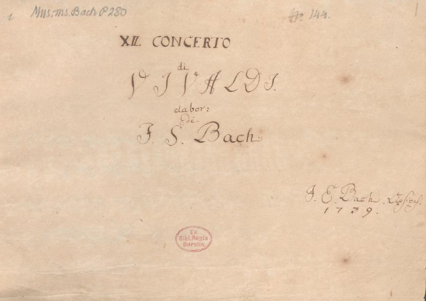
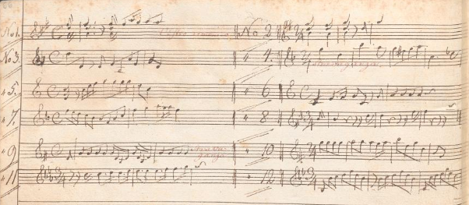
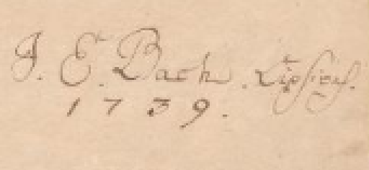
J.S. Bach: 12 Concerti di Vivaldi (P280)

Slide 30
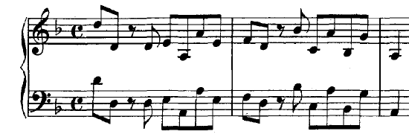
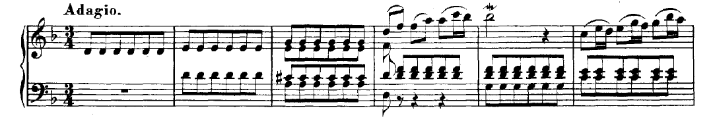
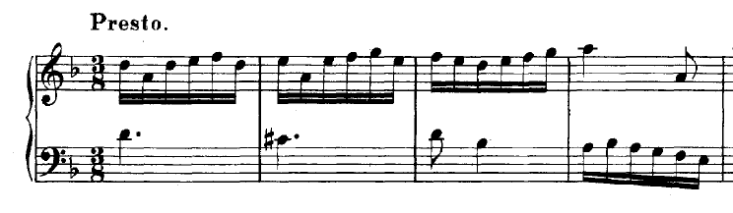
BWV 974 (No. 3)
Alessandro Marcello:
Oboe concerto in D Minor
GWV 327 (sim)

Slide 31
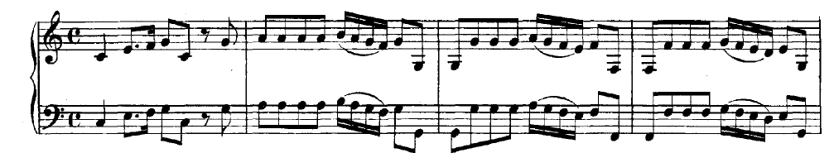
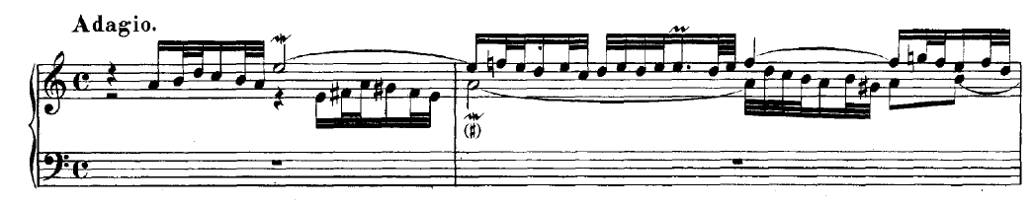
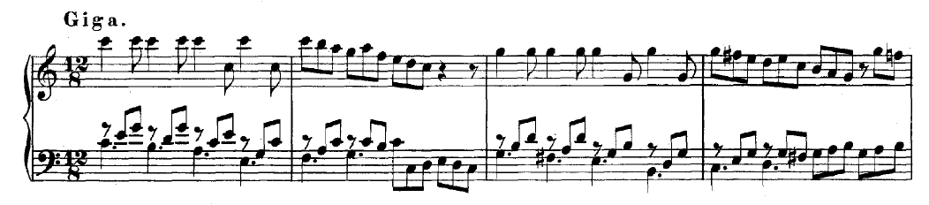
BWV 977 (No. 6, anonymous)

Slide 32
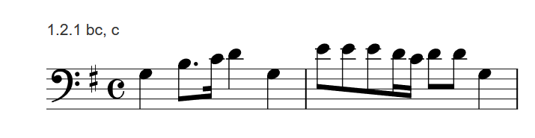
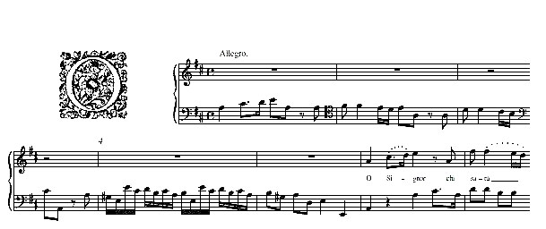
Bach BWV 977
Handel, HWV 96, Clori, Tirsi, Fileno (1707), ouverture ii
B. Marcello, “Si che laggiù”
(comic madrigal, c. 1708)
B. Marcello, Psalm 14 (1724)

Slide 33
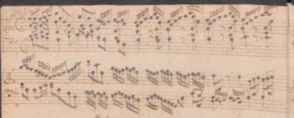
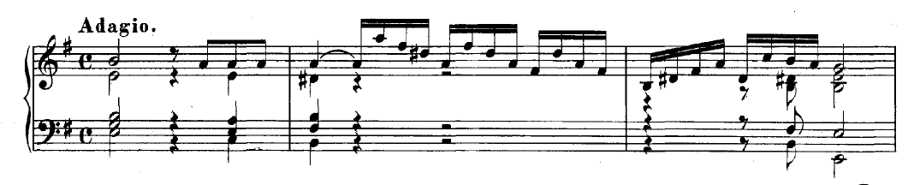
BWV 986 (No. 16)
Hand of Wolfgang Nikolaus Mey in
D-B P208, Fazsikle 46.
Strange structure

Slide 34
Structural comparison
J. S. Bach
Group A
Composed c. 1700-1712
Favors violin concertos
Group B
Composed c. 1715-1730
Models favor string music`
J. G. Walther
Group A
Composed c. 1695-1710
Favors concerti grossi
Group B
Composed c. 1715-1730
Models include ouvertures, symphonies

Slide 35
Collection structure: Walther 14
Nos. 1-14
Multiple groupings
Hand of Johann Gottfried Walther
Concerto grosso emphasis throughout
Nos. 1, 2, 5
Nos. 4, 6, 7, 8, 10, 12-14
Nos. 8-14
Venetian; No. 3 = French
Other Italian
Collected by Meck? Graupner? Telemann?

Slide 36
Collection structures: Bach 16
Pieces (3) by Johann Ernst, Prince of Weimar
  Bach’s pupil in Weimar (1708-1714)
  Walther’s pupil in music theory? (1707)
  Dedicatee of Praecepta (1708)
BWV 972-982
BWV 984-987
“12 pieces by Antonio Vivaldi”
Was Telemann an intermediary?
Nos. 1-9, 11 in hand of Joh. Bern. Bach (D-B P280); No. 10 J. G. Walther
Nos. 12. 14-16 in hand of Wolf. Nik. Mey; No. 13 J. Ringk
Telemann’s preface to the prince’s Concerts (1718)
Collection gathered by Joh. Ernst Bach the Younger (1722-1777)

