Slide 1
Ear, Mind, or Brain?
Reflections on Musical Similarity
Eleanor Selfridge-Field
Stanford University

Slide 2
Topic 1 of 2:
Musical similarity in digital music studies

Slide 3
Parameters of musical similarity in symbolic (notation-based) analysis
Harmony
Melody
Rhythm
Lots of tools and online manuals linked to Stanford music/CS sources:
253.stanford.edu
254.stanford.edu

Slide 4
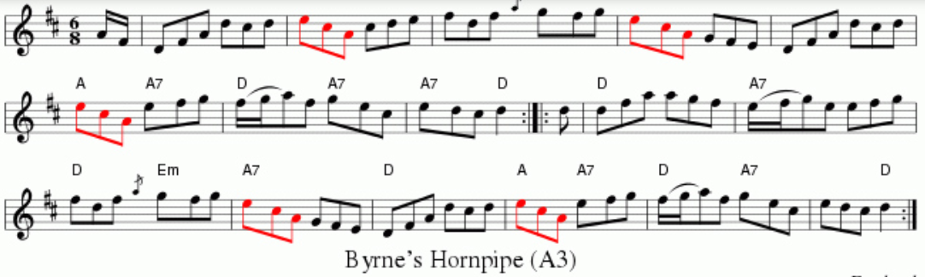
Simple approaches to melodic matching
Lorentz workshop, NL (2015)—focused on hearing

Slide 5
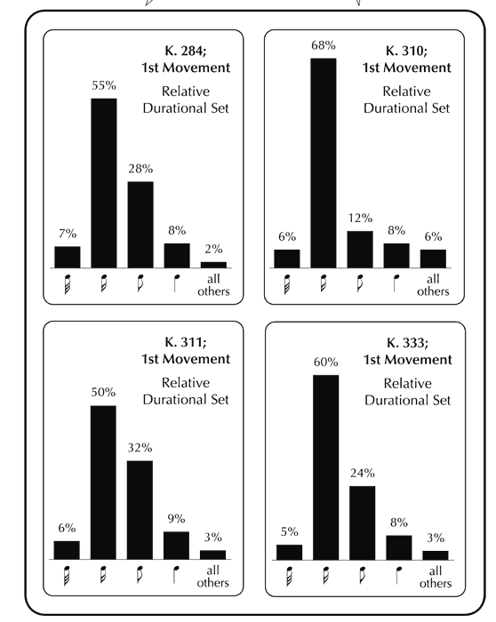
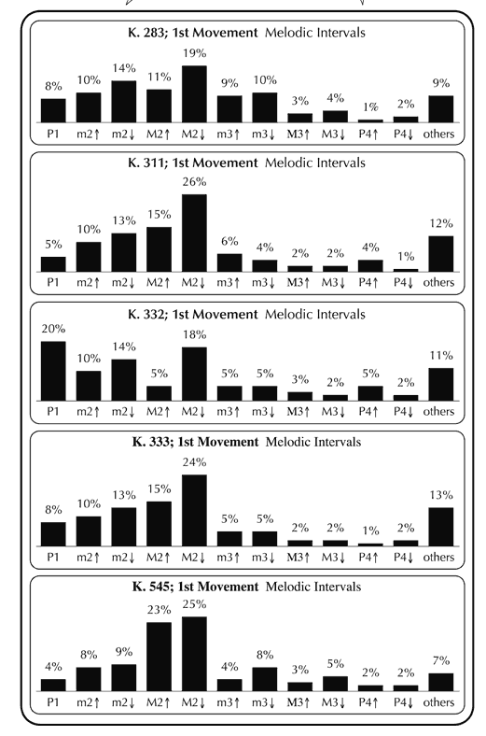
Simple approaches to melodic summarization
Adam Ockelford, 2009

Slide 6
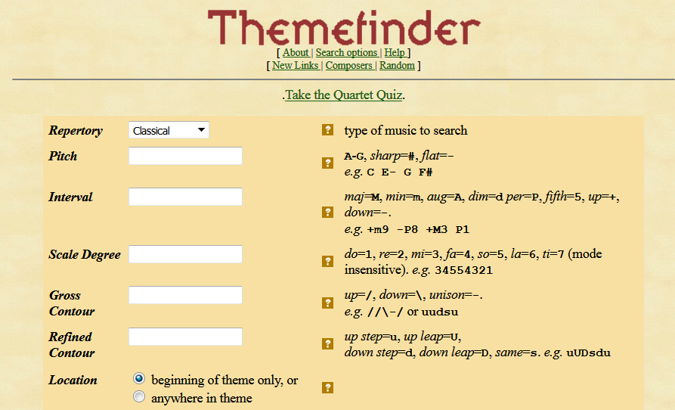
Melodic search: Themefinder (1996)
http://www.themefinder.org

Slide 7

Contour matches (accidental)
Target:
  Chant: “Lucis Creator”
Some hits:
  Bach WTC
  Bizet: Carmen
  Saint-Saens: Carnival (via Offenbach)
  Mozart: Symphony No. 41, IV

Slide 8
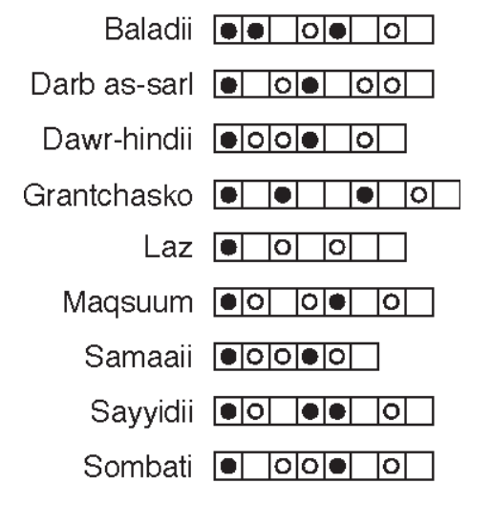
Rhythmic evaluation and search
Methods mainly auditory
(repertories without notation)
Middle Eastern rhythms

Slide 9
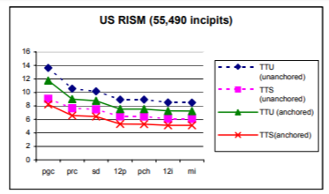
Two-dimensional search more efficient, more challenging
Semi-solutions
More features required
More generalization needed
When is it efficient to specify?
When is it efficient to generalize?
Sapp, Liu, Selfridge-Field: ISMIR 2004

Slide 10
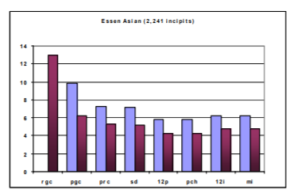
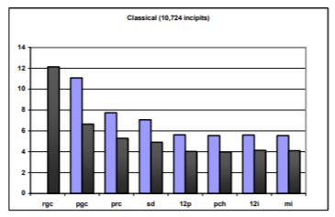
Contradictions in two-dimensional space:
Specificity vs. generalization
Solutions
More features required
More generalization needed
<Folk songs
Classical>
Sapp, Liu, Selfridge-Field: ISMIR 2004

Slide 11
Confounding aspects of melody: elaboration
Bach, Art of Fugue (after Wiering et al.)
Recognition simple for ear, difficult for computer searches

Slide 12
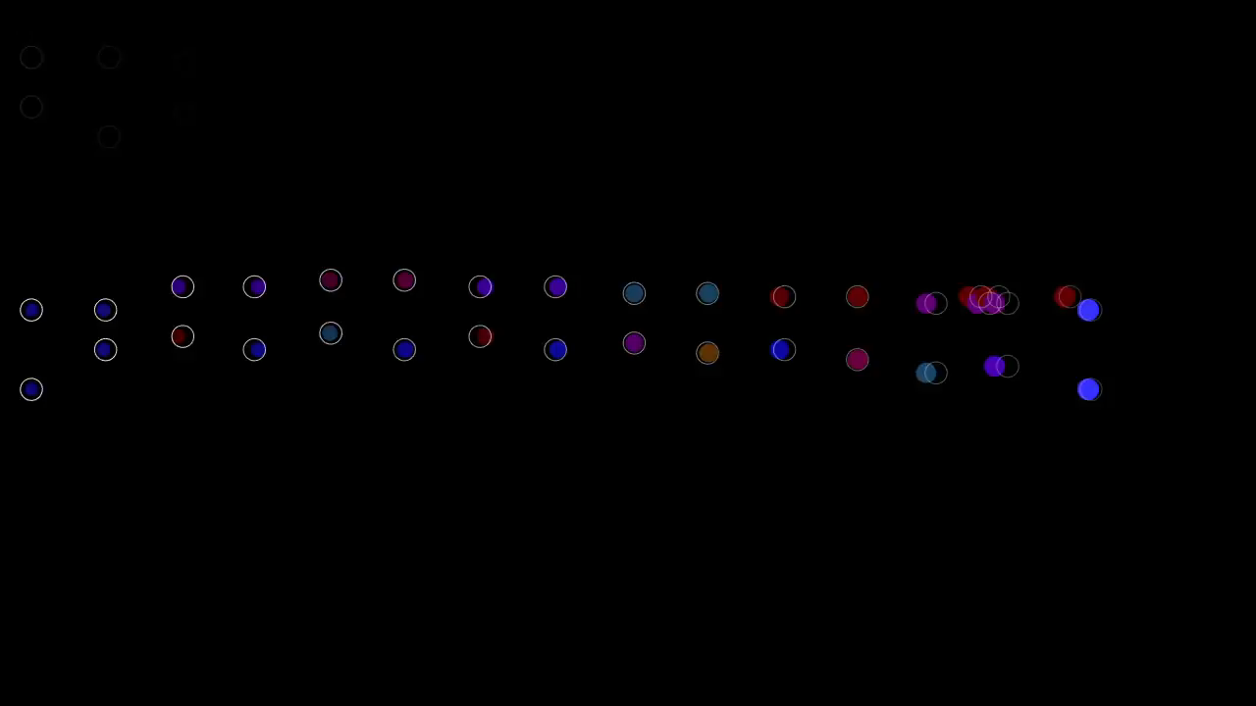
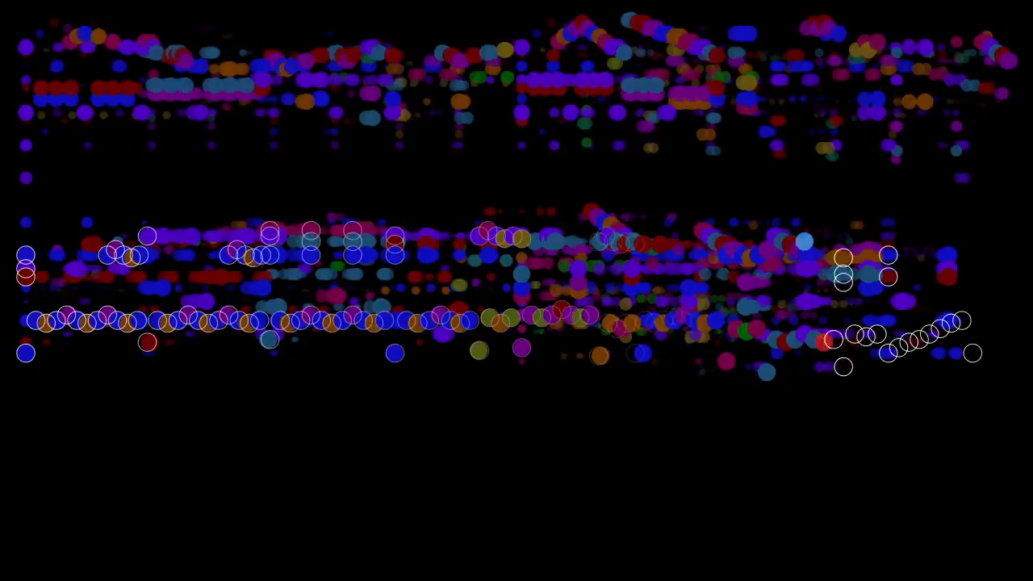
Melodic elaboration in Mozart
Visual realizations by Stephen Malinowski, Music Animation Machine, after Mozart:
“Ah vous dirai-je Maman”, K. 265 (YouTube: Musam 2016)
Example 1:
Example 2:

Slide 13
What the ear hears vs what the eye sees
Human factors in assessments
  Cognitive weights of feature-based comparisons
  Perceptual factors in the experience of “similarity”
  Cultural conditions

Slide 14
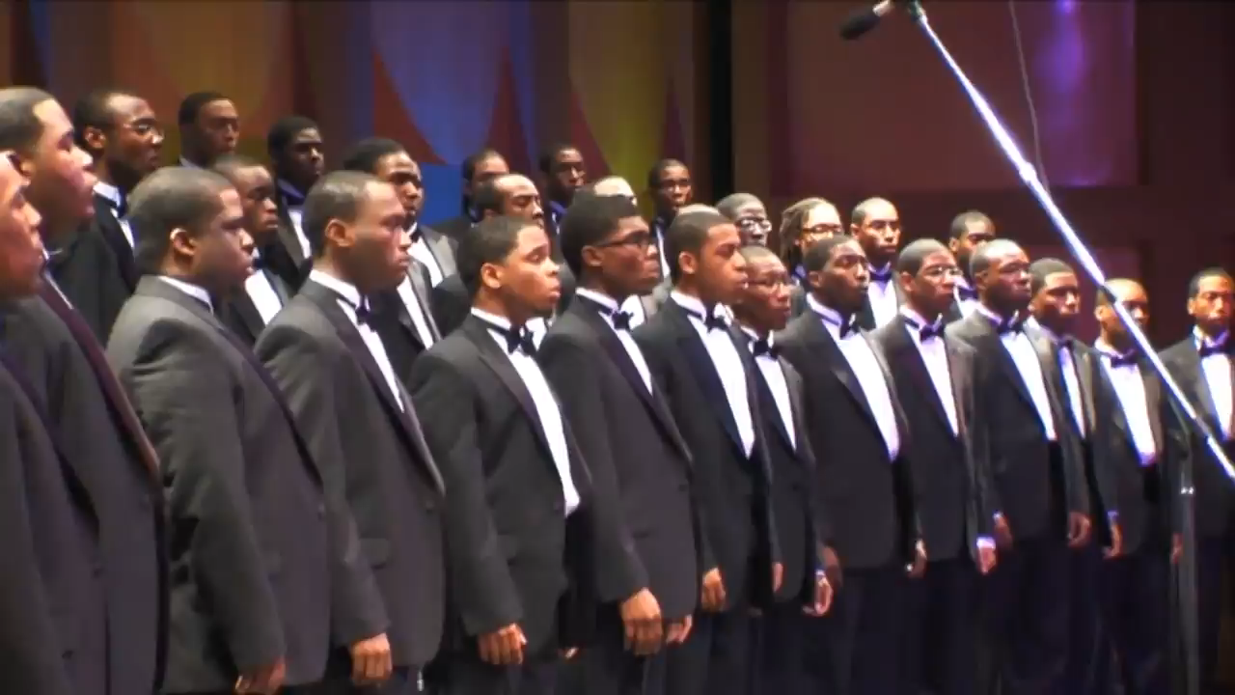
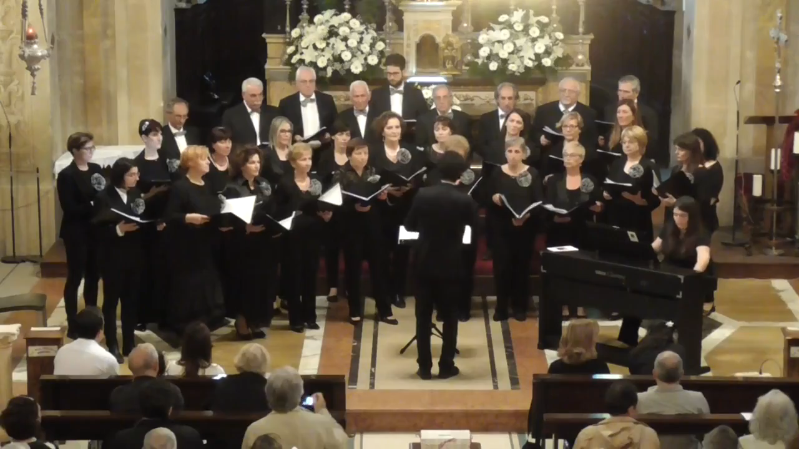
Cultural dissonance
We shall overcome
Morehouse College Glee Club 2009
[arr. Wendell P. Whalum]
O Sanctissima (after Beethoven, WoO 157)
https://www.youtube.com/watch?v=Aor6-DkzBJ0
Coro Città di Castelarano, dir.
Marco Giudorizzi, 2017

Slide 15
Cultural factors in musical evaluation
Empirically observable features
Comparable melodic contours
Comparable harmonic schemes (assuming same mode, rhythm)
Inter-subjective features
Comparable rhythmic pattern
Common genre
Common mood
Common style

Slide 16
Topic 2 of 2
Musical similarity in music-copyright infringement

Slide 17
Two foundational cases
Arnstein vs. Porter (1946)
  establishes concept of substantial musical similarity (SMS)
  establishes idea of lay listener test
Gaye vs. Williams and Thicke (2013)
  Verdict on appeal—March 2018
  Provisionally prohibits similarity of style in protected work

Slide 18
Ira Arnstein and the concept of substantial musical similarity
Arnstein vs. Porter (1946)
Long series of cases (1940…) in which Arnstein was the plaintiff. (He always lost.)
1946 ruling by Jerome Frank established two principles:
  Similarity must be “substantial”
  Likeness must be determined by “lay listeners”

Slide 19
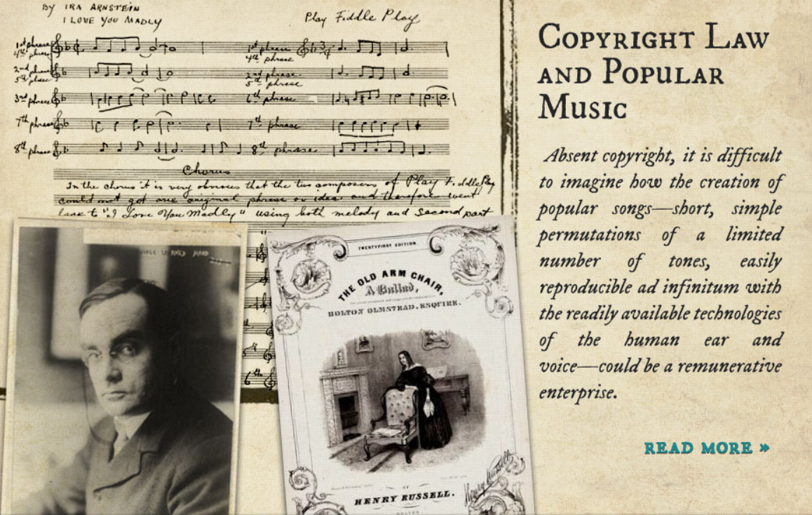
Sardonic view of music copyright

Slide 20
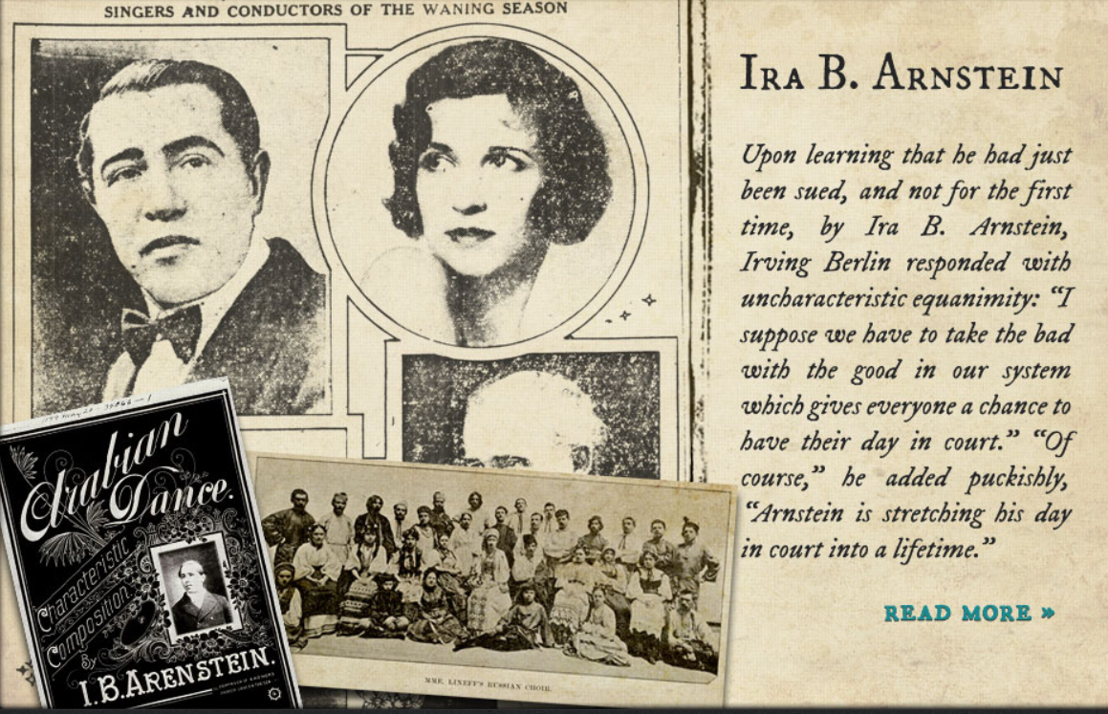
Irving Berlin’s opinion of Arnstein

Slide 21
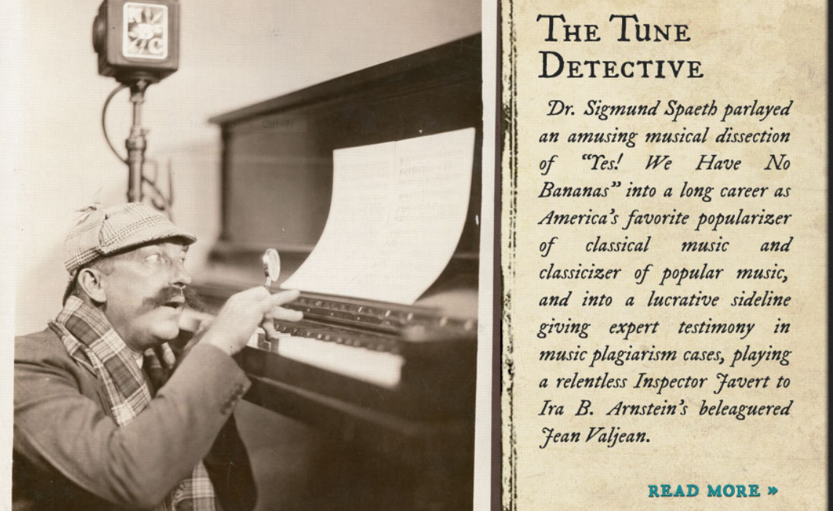
Detectives investigate musical similarity

Slide 22
Similarity of which features?
1946: Notation base
Main parameters
Melody
Harmony
Rhythm
2013: Audio/video base
Main parameters
Timbre
Tempo
Dynamics

Slide 23
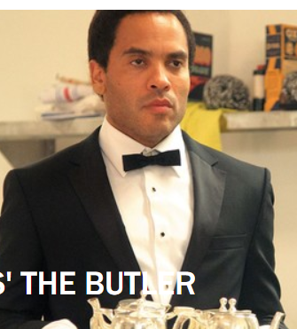
Contractual disagreements
We shall overcome (2015)
Audio-visual synchronization rights: $100,000 [film = The Butler, lee Daniels, 2013]

Slide 24

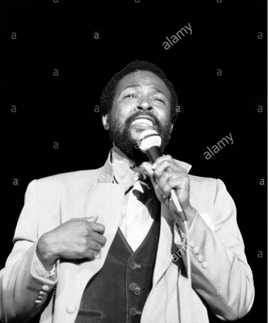
Gaye vs Williams, Thicke
(2013; appeal, 2015; re-appeal pending)
Estate of Marvin Gaye RE: “Got to Give it Up (1976/1977). This photo: Birmingham, UK 1976
Pharrell Williams and Robin Thicke (2013).

Slide 25
Gaye estate vs Williams and Thicke; Williams et al vs Gaye estate*
2013, 2015, 2018, ??
Standing judgment:
*Musical style is a protectable element

Slide 26
Parameters of substantial similarity vs parameters of style [= performance style?]
Features of notated music
Melody
Harmony
Rhythm
Features of performed, recorded music
Timbre
Tempo
Dynamics

Slide 27
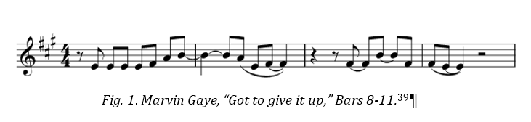
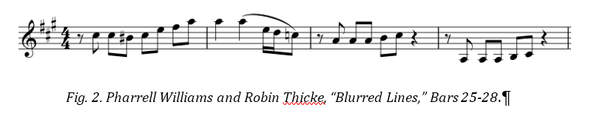
Melody comparison (involves slipping oppositions)
Timbre
Tempo
Dynamics
Note position,
Scale degrees

Slide 28
What is a substantial melody?
Timbre
Tempo
Dynamics
Note position,
Scale degrees

Slide 29
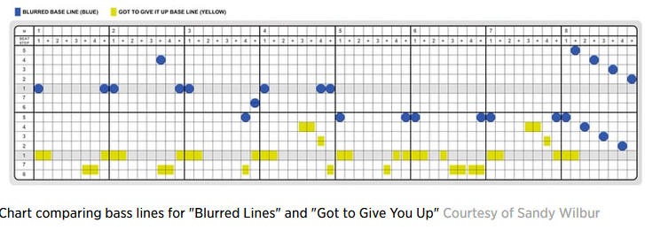
Notated vs. performed music in copyright litigation
Sandi Wilbur’s diagram
of rhythmic activity

Slide 30

“
Notated vs performed music in (US) copyright registrations, 1940-2017
Decade | Score only | Recording only | Score & recording | Music video/film | MIDI file
1940-49 | 2 | 3 | 7 | 2 | 0
1950-59 | 0 | 2 | 7 | 0 | 0
1960-69 | 1 | 0 | 5 | 0 | 1
1970-79 | 1 | 0 | 4 | 2 | 1
1980-89 | 2 | 4 | 3 | 3 | 3
1990-99 | 2 | 9 | 5 | 1 | 2
2000-09 | 0 | 25 | 0 | 0 | 1
2010-17 | 0 | 21 | 1 | 0 | 0
Source: Charles Cronin’s

Slide 31
Drift in registration media (1940-2017)

Slide 32
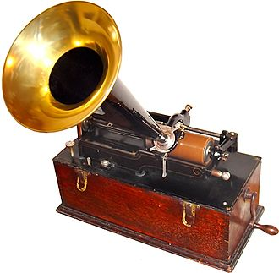

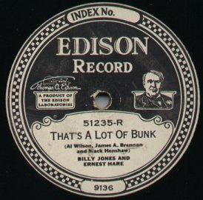

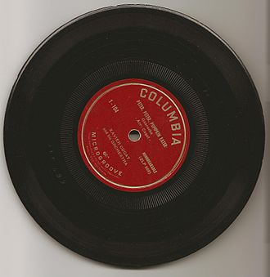
Changing music technology
  1999 Record sales peak
2009 Streaming music downloads peak
2015 Digital downloads = 90% music sales
1900
2000
1920
2018
1950

Slide 33
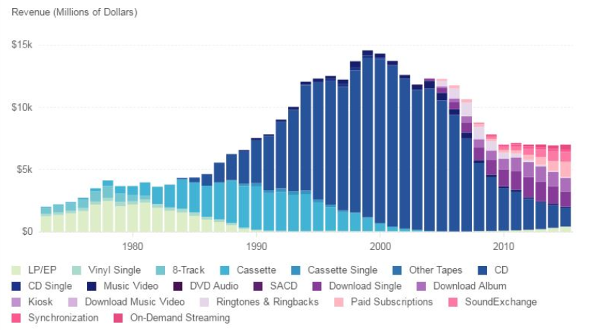
RIAA revenue by delivery medium (2016)

Slide 34
Controversial points ( “Blurred Lines”)
Should cases be argued on the basis of registered copies only?
What should happen when each registration is in a different medium (notation, sound…)

Slide 35
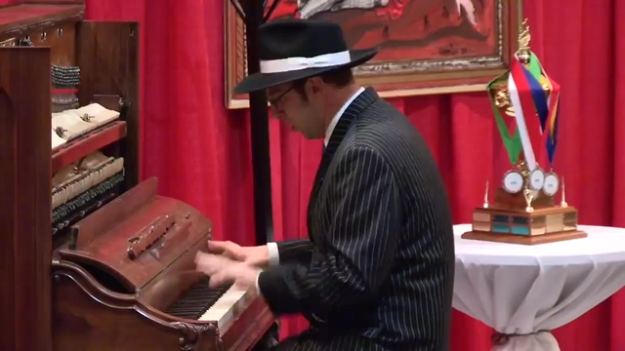
Should every “style” be exclusive to its own creator?
Improvisatory pastiche (18th/20th centuries)
Ethan Uslan, 2012

Slide 36
In conclusion…
My cordial thanks for the wonderful staff support at CIRMMT

