Slide 1
Aspects of Rhythm and Meter
Music 254

Slide 2
Rhythmic parameters
Meter
Ordinary meters as notated
Ordinary meters as sounded/heard
Unmeasured music
Polymeter; hypermeter
Accent
Prosody approach
Tonal and inflectional
Hierarchical aspects of rhythm
Melodic contributions
Harmonic contributions

Slide 3
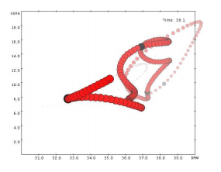
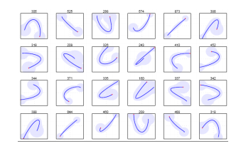
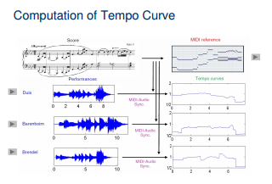
Widmer (2006-09): Performance worms
Performance alphabet
Beat-level changes:
Famous performers

Slide 4
Performance of time
Tempo-loudness visualizations (Widmer et al.)

Slide 5
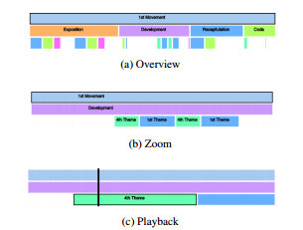
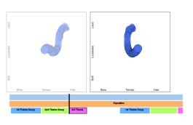
Widmer et al. (ISMIR 2015)
Focus: Classical music on the web
Objective: compare visual user interfaces
Observations:
popular music – linear listening
classical music – content-oriented
Multi-modal navigation: Beethoven’s “Eroica”
Symphony (No. 3)
Structural navigation

Slide 6
Accent

Slide 7
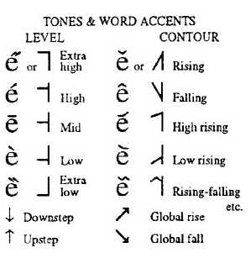
Accent: Text and Music
Prosody models
Combination measures

Slide 8
Metrical challenges
Mensural notation
Beat ambiguity
Unmeasured music

Slide 9
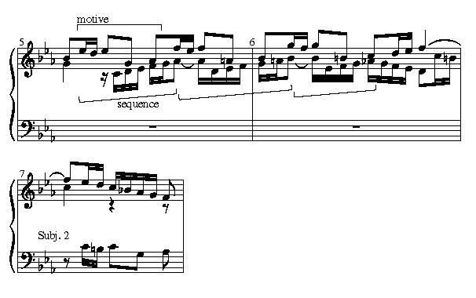
Pitch accents (Jones, Pfordresher, 2003)
“Melodic” vs. “rhythmic” accent
First, last pitches in phrase
Highest, lowest pitches in phrase
Various combinations of these in judgments of melodic similarity
Cf. Essen software for folk-song research

Slide 10
Hierarchical Aspects of Rhythm

Slide 11
Harmonic Rhythm: Joseph Swain
2. Rhythm of Harmonic Change
1. Activity levels
3. Root rhythm

Slide 12
Harmonic rhythm (Swain), cont.
5a. Density + Function

Slide 13
Harmonic rhythm (Swain), cont.
4. Density
6. Final tiered view

Slide 14
Less metrically oriented approaches
Winograd (1968)
Temperley (Melisma, c. 1999)

