Slide 1
Patterning and coherence in music

Slide 2
Symmetry and Similarity
Developments in parallel with partimenti in Naples
Binary constructions expounded in Dresden, then Berlin
Joseph Riepel: Joseph Riepel’s Theory of Metric and Tonal Order (1752, 1754)
A short history

Slide 3
Josef Riepel’s main thrust: A theory of melodic construction
Development of opening motive
Emphasis of metrical regularity
Based on rhythmopoeia
Focus on second half of a minuet (or trio)

Slide 4
Continuing a melody after two bars
Riepel offers:
Monte (up and up)
Fonte (up, then down)
Ponte
(melodic shapes)
Repetition of small elements up to four times

Slide 5
More (mechanistic) examples
Up-down-same approach for phrases

Slide 6
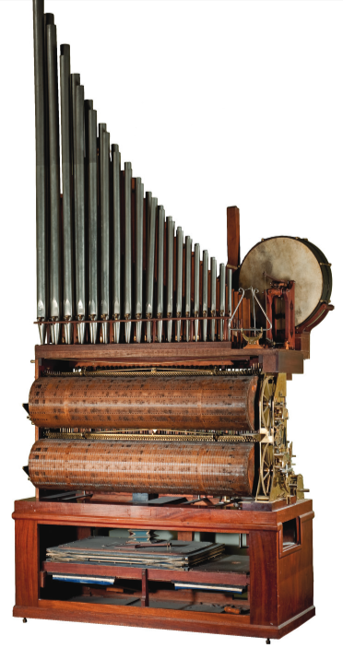
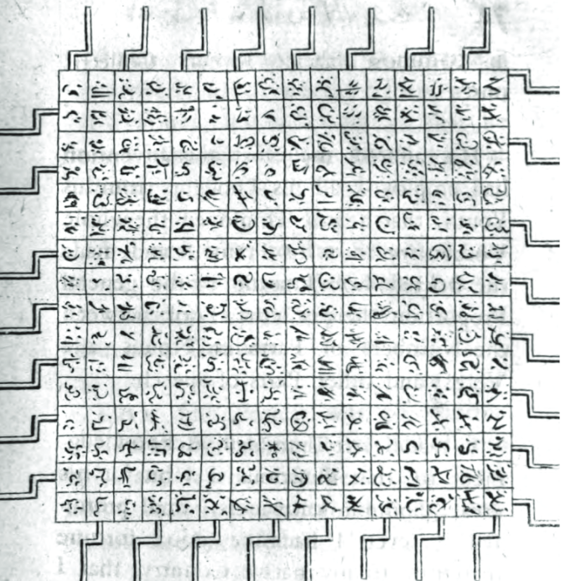
Mechanical composition
At right: Componium (Brussels Mus,. Mus. Instr.)
At left: Jonathan Swift,
device to enable monkeys
to recreate all the world’s
literature (1726)

Slide 7
Other number-based approaches to assembling a composition from small bits
A formula for polonnaises

Slide 8
Timbral similarity

Slide 9
Timbral similarity: Aucouturier & Pachet
Jean-Julien Aucouturier, François Pachet (IRCAM, Sony Labs)
Series of listener studies (Paris) mixing popular and classical genres
Focus on short passages at corresponding tempos and dynamics
All examples are polyphonic
Works with 1:1 pairs, not 1-to-group of songs (genre ID)
Matching uses Mel Frequency Cepstrum Coefficients (MFCCs)
Computes probabilities
Part of European project CUIDADO

Slide 10
Sample pairs (Aucouturier, Pachet)
Same artist matches by timbre:
Schubert Op. 90, No. 2
Schubert Op. 90, No. 4
Same orchestral textures:
Wagner, Ride of the Valkyries
Wagner, Brunhilde (Solti)
Same medium:
Bach harpsichord prelude BWV 849 (C# Minor)
Couperin, Gavotte

Slide 11
Unexpected resemblances (A, P)
Piano music
Schumann, Kriesleriana, Op. 16, No. 5 (Horowitz)
Gershwin, “I loves you, Porgy” (Bill Evans)
Orchestral textures
Beethoven, Romance for Violin and Orchestra, Op. 50, No. 2
Beatles, Eleanor Rigby
Observations
Numbers by same artist, genre do not necessarily have close scores (no influence on timbre)
Some generational changes in performance noted

Slide 12
Re-examinations of MIREX data

Slide 13
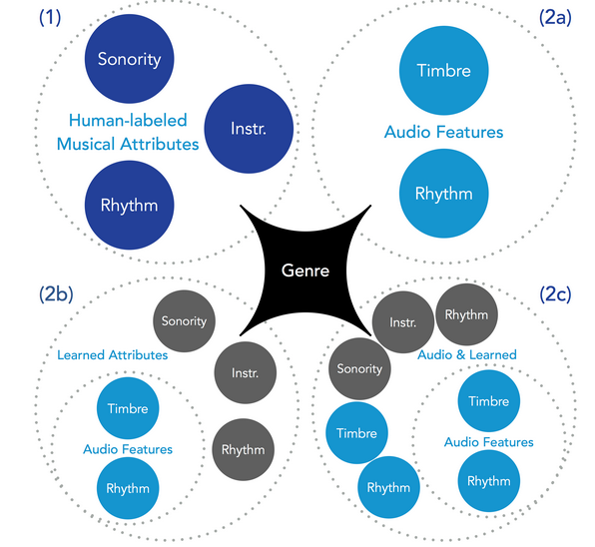
Meta-analysis of MIREX data
Music Information Retrieval Exchange (MIREX)
Sets tasks each year for researchers to test new algorithms
Works better in some areas than others
Results announced at ISMIR conference
Tasks focus on ten or so areas of MIR
Grading done by volunteers
Two important meta-analyses of results

Slide 14
Alan Marsden meta-analysis (JNMR 2012)
Looked at MIREX 2002-2006, with emphasis on 2005
Similarity may be in the ear (or eye) of the beholder. [Credit = A/ Tversky]
Reductive approaches produce inconsistent results.

Slide 15
Mozart, K. 464,II
Citations include…

Slide 16
Arthur Flexer⁽¹⁾ et al. meta-analyses: MIREX 2006-2014 plus own data
With Thomas Grill (no picture), Markus Schedl (2), and Julián Urbano (3)
Stage 1: re-examination of MIREX analysis related to similarity
Stage 2: independent user studies with off-label Austrian pop

Slide 17
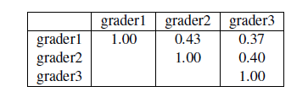
Flexer et al. 2014
Inter-rater agreement in audio music similarity (ISMIR2014)
In 2006-2015, performance peaked in 2009.
Why lack of inter-rater agreement?
Concept of music similarity is too “coarse”
Upper bounds can be achieved by algorithms
Performance in 2009 cannot be exceeded without changes of approach

Slide 18
Flexer et al., 2014
Observations
Musical similarity is complex and depends on individual exposure and experience.
Human judgments will therefore vary from person to person
“Any evaluation of MIR systems…based on ‘ground truth’ [as] annotated by human beings”…has the same limitations.

Slide 19
Flexer and Grill (2016)
“The problem of limiting inter-rater agreement in modelling music similarity”, Journal of New Music Research 45/3 (2016), 239-251.
http://dx.doi.org/10.1080/09298215.2016.1200631
Quantitative relations should mirror human perception of similarity…
but they don’t.
Computational models that exceed limits of human perception are useless.

Slide 20
Tests used by Flexer and Grill
Performance comparison
Modeling music similarity between pieces.
Modeling structural analyses [i.e. segmentation, of pop] within pieces.
Set-up: Three graders for each task
Highlights from findings
1. In Task 1, timbre and rhythm were most influential features.
2. Same algorithms did not perform consistently from year to year.
3. Algorithms performed almost as well as people [cf. Haydn/Mozart QQ]
4. Classical and world music more difficult to model than popular music.

Slide 21
Flexer and Grill, Tasks 1 and 2
Questions:
Should MIR evaluate whole systems instead of individual items?
Should we refocus of a core set of better-defined tasks? (MIREX)

Slide 22
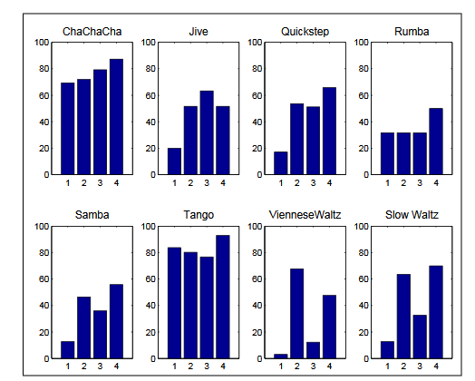
Other work by Flexer
With Markus Schedl, 2012:
Genre is too fuzzy a concept to model. Use similarity instead.
Make personalized systems.
Probablistic combination of features for music classification (2006)
Rhythmic similarity in dance-music data

Slide 23
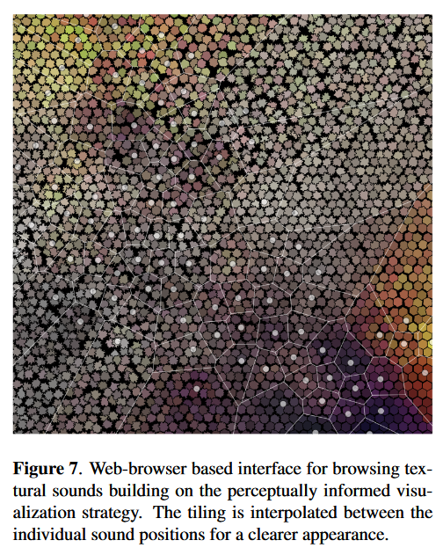
Sensory mapping (for intuitive searches); Timbral-visual mapping
2012 (WWTF)

Slide 24
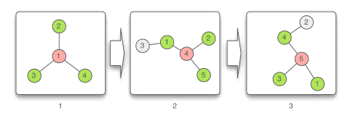
Limitations of audio-based recommendation systems (ACM 2010)
Series of experiments under title FM4Soundpark
Main focus: Why some songs in a large database are never recommended?
User builds similarity net
Focus on hub
Performance evaluated by actual listening, not mere downloading
Songs similar to many others more likely to be listened to

Slide 25
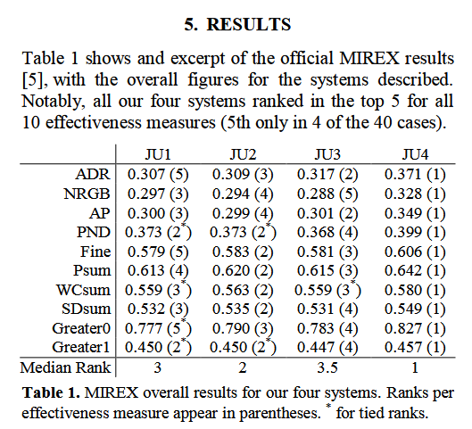
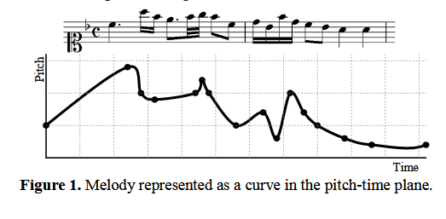
Work of Julián Urbano et al.
Geometric models of melodic similarity (symbolic data): ISMIR 2013
Transposition invariant
Time-scale invariant (CMMR 2010; Springer Verlag)
Evaluation of MIR systems

Slide 26
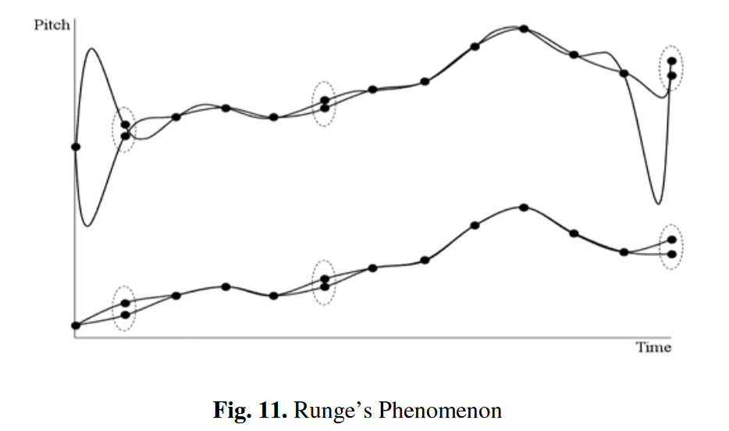
Accommodation of variation (Urbano)
Use of interpolated splines
Experimental results
Graphical edit distance
Insertion
Deletion
Substitution
Match
Findings
Spans of 4 notes perform best; performance degrades with length
Model ignores rests, which are often missing in MIREX test sets

Slide 27
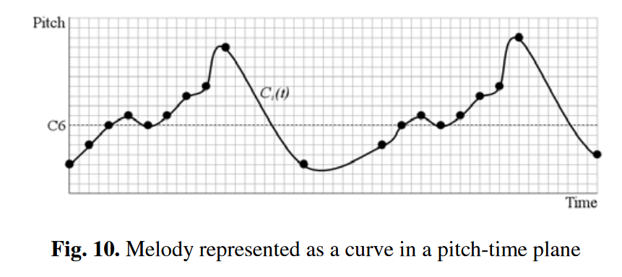
Urbano:
https://link.springer.com/content/pdf/10.1007%2F978-3-642-23126-1.pdf
Compares diverse concepts of “equality”
Octave equivalence
Degree (harmonic) equality
Note equality
Harmonic similarity
Time-signature equivalence
Tempo, duration
Measures of dissimilarity

Slide 28
Urbano: vertical features in “matching”
Octave equivalence: allow (perceptually, I’d say disallow)
Scale-degree (melodic) equivalence: if key irrelevant
“Note equivalence”: same as transposition/scale degree
Pitch variation: allowance of approximate matches (no discussion of accent)
Harmonic similarity: rank
Voice separation: problem of working with composite and single voices

Slide 29
Urbano: horizontal features in matching
Time-signature equivalence: 2/4, 4/4
Tempo equivalence: gets into metronome markings
Duration equivalence: quality of performance
Duration variation: or, Privilege accented notes?

Slide 30
Solutions to equivalence problems
Nos. 1-3: use scale-degree differences, not exact pitch differences
Horizontal requirements:
Time signature difference not important when equivalent
Duration can be measured two ways:
elapsed time in performance
Implied time in score: he gets into pitch-time splines here
Then: measure dissimilarity in splines (oscillation)
Finally: a new model for transposition and time-scale invariant comparison.

