Slide 1
Midi Shortcoming: Temperament, Expression

Slide 2
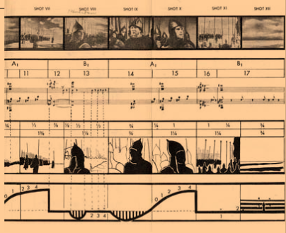
Video synchronization via MIDI
Score (track)
Moving images
Frame numbers
Bar numbers
Sound track

Slide 3
Shortcomings: Tuning, Temperament
Pitch
Diatonic scale
Non-Western
Non-equally tempered
Interpretation of accidentals (inflections)
Blues scale
Modes vs. chromatic scale

Slide 4
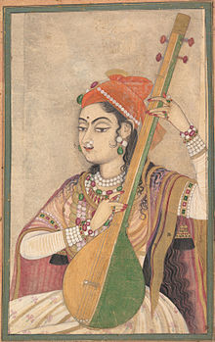
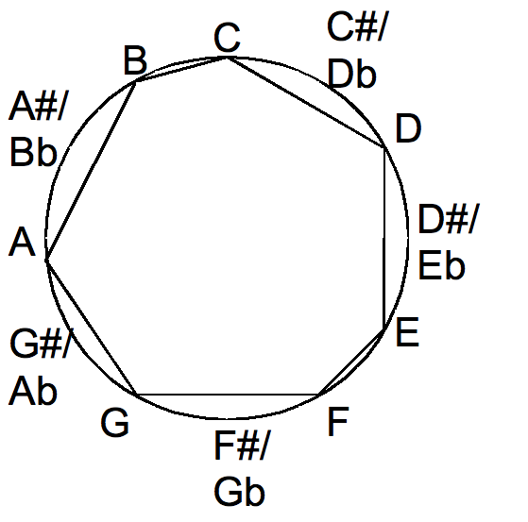
Mapping (or not) to the chromatic scale
Diatonic=8 tones
Chromatic=12 tones
Pentatonic=5 tones
Lady playing tanpura, c1735

Slide 5
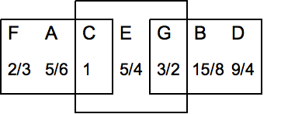
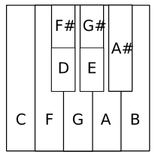
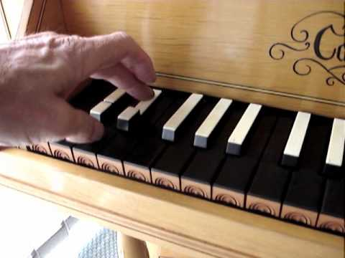
Non-equal temperament
Arbitrary 8ve arrangements
(“short octaves”, split keys)
Baroque tunings (18th century)
“Just” intonation
Meantone
Werckmeister III

Slide 6
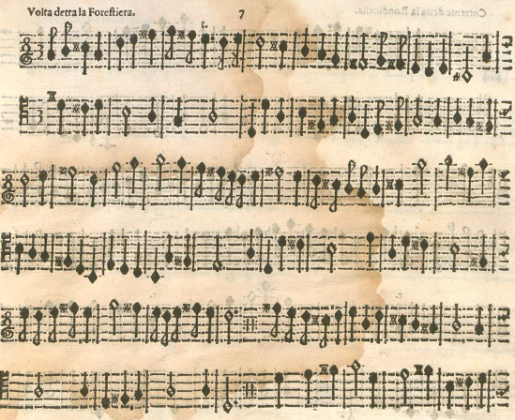
Vicentino’s enharmonic harpsichord (pitch equivalents in cents)
Music for enharmonic harpsichord (from c1550) here by Martino Pesenti (c1650)

Slide 7
Electronic Replicas offering unequal temperament

Slide 9
Steinway Spirio (electronic recording piano)

Slide 10
Quantized vs unquantized MIDI files
Quantized
Unquantized
Expression requires unquantized files
Unquantized files messy to work with
Quantized files preferable for transcription and hard to listen to
Notation
Listening

Slide 11
Listening quiz: Quantized or Unquantized?
1.
2.
3.
4.

