Slide 1
MIDI and extended pitches
Tuning and Temperament

Slide 2
“Pitch”: Notated pitch relative to key
Absolute key number
36 etc.
48 C 8ve below Middle C
60 Middle C
72 C 8ve above Middle C
84 etc.
Absolute pitch = “90”
Pitch names are contextual
F#/Gb/E##

Slide 3
MIDI: Tuning, temperament, expression
Max Mathews, CCRMA: Radio Baton (emphasized expression—tempo, dynamics)
https://www.youtube.com/watch?v=3ZOzUVD4oLg

Slide 4
Pitch and timbre: Music V and CSound
Approaches that define sounds
Music V: Max Mathews (Bell Labs, 1960s, 1970s)
Csound: Barry Vercoe (MIT, 1980s, 1990s)
score
scot
Strengths:
decimal system using cents (frequency)
Instruments can be arbitrary (scot)
Arbitrary objects can be encoded (pling command)
Canonical Csound Reference Manual: http://csounds.com/manual/html/indexframes.html
Tutorial: https://www.youtube.com/watch?v=rkBIUrJoJ3Y

Slide 5
Shortcomings: tuning, Temperament
Pitch
Diatonic scale
Non-Western
Non-equally tempered
Interpretation of accidentals (inflections)
Blues scale
Modes vs. chromatic scale

Slide 6
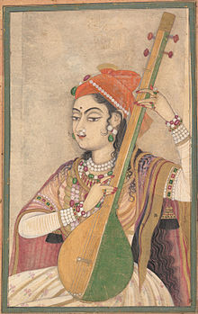
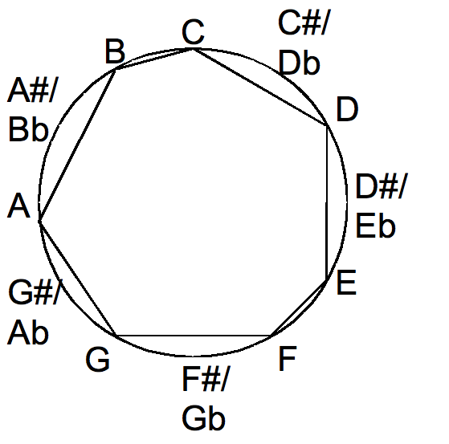
Mapping (or not) to the chromatic scale
Diatonic=8 tones
Chromatic=12 tones
Pentatonic=5 tones
Lady playing tanpura, c. 1735

Slide 7
MIDI vis-à-vis Notation
Enharmonic accuracy hard to guarantee when input is MIDI-based
Inherent non-alignment of key numbers vis-à-vis note names
One more bit-based MIDI extension: Hewlett’s MIDIPlus
See https://patents.google.com/patent/US5675100A/en?inventor=Hewlett+Walter+B.&oq=Hewlett+Walter+B.

Slide 8
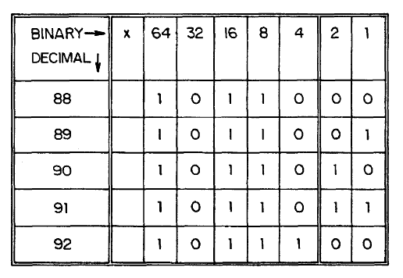
Hewlett’s MIDI Plus for accurate tonal notation (How to make MIDI enharmonically accurate)
Method
Reassign two bits from velocity byte
US Patent #5675100 (1996)
http://www.google.com/patents?id=6RclAAAAEBAJ&pg=PA2&source=gbs_selected_pages&cad=4#v=onepage&q&f=false

Slide 9
Method for enharmonic accuracy
Complements Base-40 music arithmetic (8th week)
Key number = 90
Note name depends on context
Captured bit specifies name:
00 not known
01 Gb
10 F#
11 Ex (E##)
Pitch names are contextual
F#/Gb/E##

Slide 10
MIDI Plus (How to make MIDI enharmonically accurate)
Method
Reassign two bits from velocity byte
US Patent #5675100 (1996)
http://www.google.com/patents?id=6RclAAAAEBAJ&pg=PA2&source=gbs_selected_pages&cad=4#v=onepage&q&f=false

Slide 11
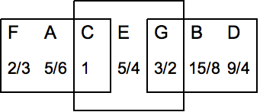
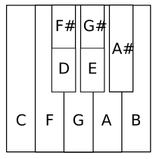
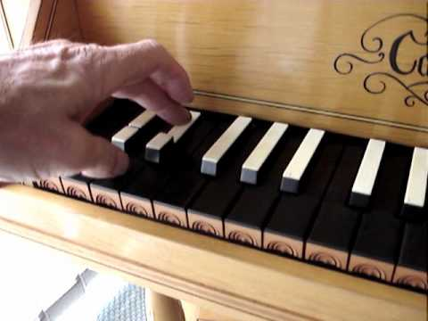
Non-equal temperament
Arbitrary 8ve arrangements
(“short octaves”, split keys)
Baroque tunings
“Just” intonation
Meantone
Werckmeister III

Slide 12
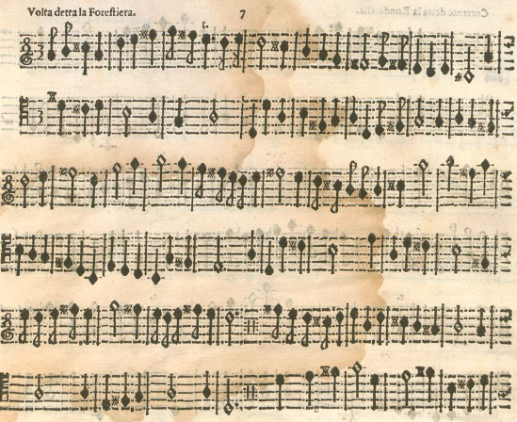
Vicentino’s enharmonic harpsichord (pitch equivalents in cents)
Music for enharmonic harpsichord (from c. 1550) by Martino Pesenti (c. 1650)

Slide 13
Roland digital harpsichord series (1988--)
Three modes
Equal-tempered
Meantone
Werckmeister III
Two acoustic contexts
Room
Hall
Two “instruments”
Organ
Harpsichord
Five “stops”
Harpsichord 1-manual
Harpsichord 2-manual
Flemish
Lute
…
https://www.youtube.com/watch?v=zZSlHVifRps

Slide 14
MIDI in use: Historical vs digital harpsichords
Original 16th-century instrument: National Music Museum, Vermilion, SD
https://www.youtube.com/watch?v=aq9iwjyq6u0
Alteration of tuning, temperament
https://www.youtube.com/watch?v=W2gOI1p_0iM [Vallotti tuning, English Renaissance music]
Split keys, Renaissance harpsichords:
https://www.youtube.com/watch?v=D0OveRacKH0

