Slide 1
MIDI and extended pitches
Tuning and Temperament

Slide 2
“Pitch”: Notated pitch relative to key
Absolute key number
36 etc.
48 C 8ve below Middle C
60 Middle C
72 C 8ve above Middle C
84 etc.
Absolute pitch = “90”
Pitch names (tonal music) are contextual
F#/Gb/E##

Slide 3
NotaMIDI (Kjell Nordli; Oslo, c1987)
Employed meta-events for extended info
Emphasized elements of notation
Time signature
Key signature
Clef-sign
Crescendo, diminuendo
Accent
Slur
Enharmonic pitch
Tempo words (Allegro, Adagio, et al.)

Slide 4
Expressive MIDI (NG, Boyle, et al., Leeds, 1988)
Based on system-exclusive messages
e.g. Data byte 1 0XXY₁Y₂Y₃Y₄Y₅
With look-up table (from early Finale)

Slide 5
MIDI vis-à-vis duration, articulation
Durations

Slide 6
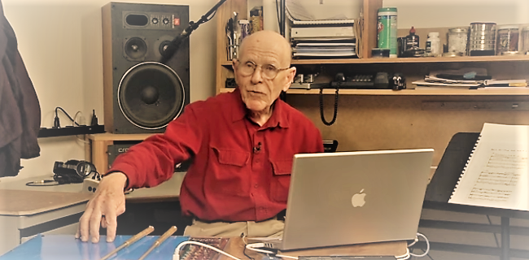
MIDI: Tuning, temperament, expression
Max Mathews, CCRMA: Radio Baton (emphasized expression—tempo, dynamics)
https://www.youtube.com/watch?v=3ZOzUVD4oLg

Slide 7
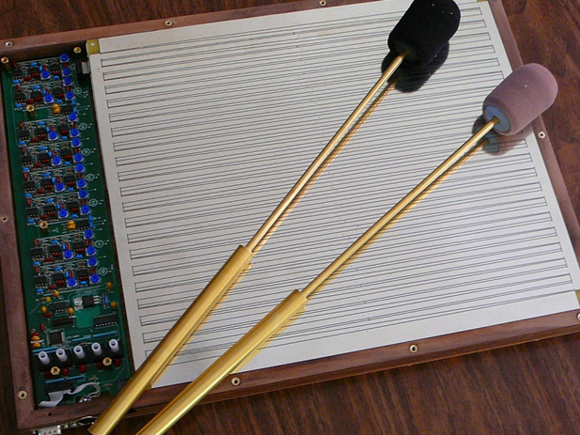
Augmented MIDI (M. Mathews, W. Hewlett)
Aim: expressive control
For accents
For articulations
Method: bit-repurposing
Bits from Note-On command OR
Bits from Velocity byte

Slide 8
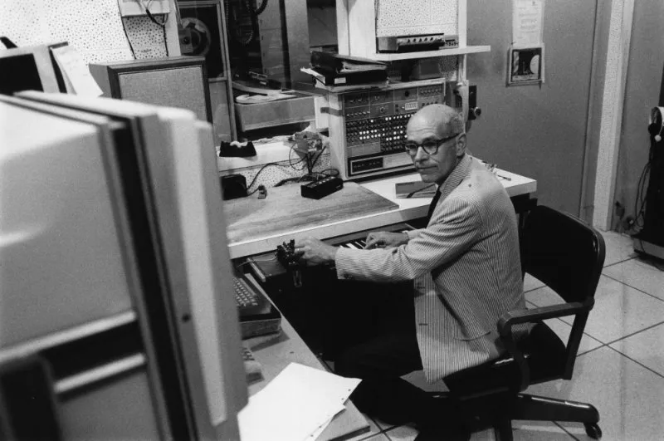
Pitch and timbre: Music V and CSound
Approaches that define sounds
Music V: Max Mathews (Bell Labs, 1968)
Csound: Barry Vercoe (Princeton, 1969; MIT)
score
scot
Strengths:
decimal system using cents (frequency)
Instruments can be arbitrary (scot)
Arbitrary objects can be encoded (pling command)
Music N history: https://120years.net/wordpress/music-n-max-mathews-usa-1957/
Tutorial: https://www.youtube.com/watch?v=rkBIUrJoJ3Y

Slide 9
Radio-drum/baton file (c1988)

Slide 10
MIDI vis-à-vis Notation
Enharmonic accuracy hard to guarantee when input is MIDI-based
Inherent non-alignment of key numbers vis-à-vis note names
One more bit-based MIDI extension: Walter Hewlett’s MIDIPlus
See https://patents.google.com/patent/US5675100A/en?inventor=Hewlett+Walter+B.&oq=Hewlett+Walter+B.

Slide 11
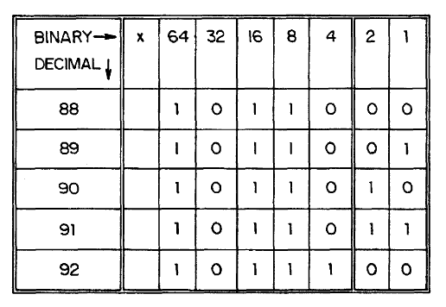
MIDI Plus (Walter Hewlett) (How to make MIDI enharmonically accurate)
Method
Reassign two bits from velocity byte
US Patent #5675100 (1996)
http://www.google.com/patents?id=6RclAAAAEBAJ&pg=PA2&source=gbs_selected_pages&cad=4#v=onepage&q&f=false

Slide 12
Method for enharmonic accuracy
Complements Base-40 music arithmetic (8th week)
Key number = 90
Note name depends on context
Captured bit specifies name:
00 not known
01 Gb
10 F#
11 Ex (E##)
Pitch names are contextual
F#/Gb/E##

Slide 13
Proposed extensions (never adopted)

Slide 14
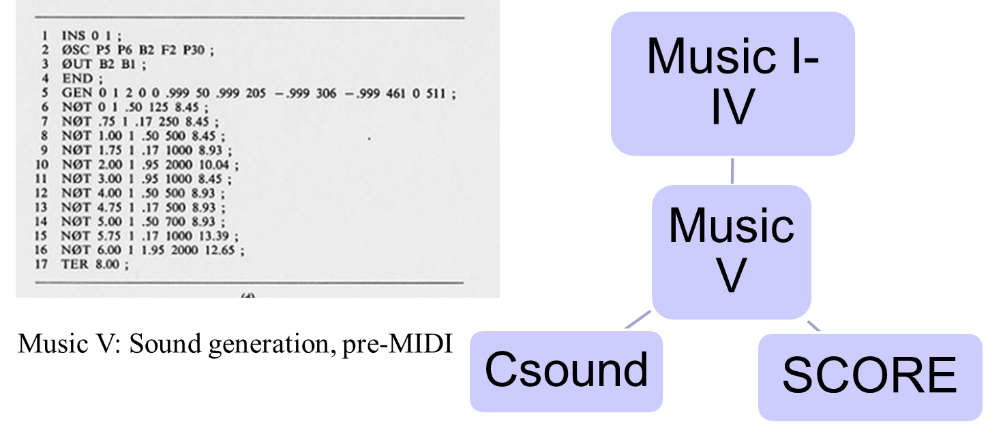
Mathews’ influence via Music V
[Mathews: Owed a debt to Pierre Boulez’s wish for similar control for tapes]

Slide 15
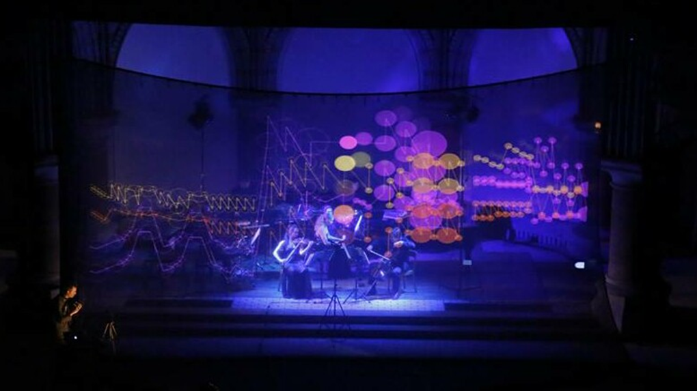
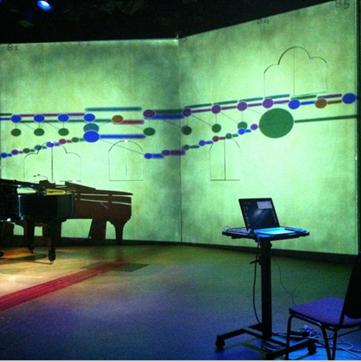
Controller legacies: Malinowski’s “cranker”
Radio Drum file: MIDI files with extra “conducting” track
Mathews, Beethoven’s Fifth, Malinowski (CCRMA, c1995)
Malinowski’s cranker for live performances (Hamburg, 2014 et al.)

Slide 16
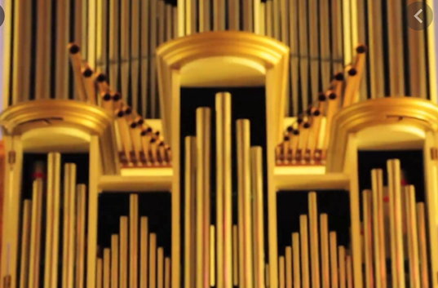
Don Knuth: Fantasia Apocalyptica (2018)

Slide 17
Shortcomings: tuning, Temperament
Pitch
Diatonic scale
Non-Western
Non-equally tempered
Interpretation of accidentals (inflections)
Blues scale
Modes vs. chromatic scale

Slide 18
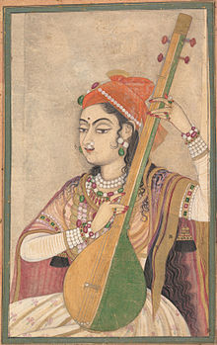
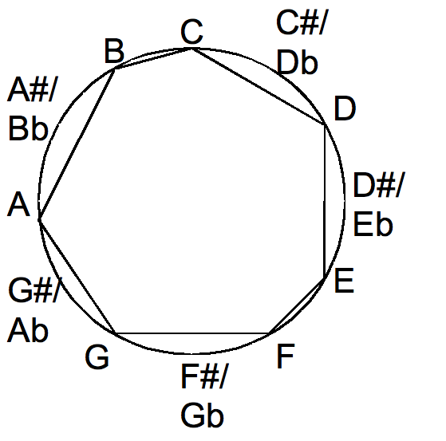
Mapping (or not) to the chromatic scale
Diatonic=8 tones
Chromatic=12 tones
Pentatonic=5 tones
Lady playing tanpura, c. 1735

Slide 19
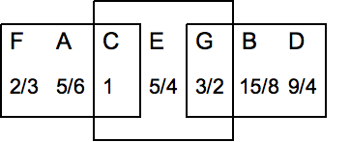
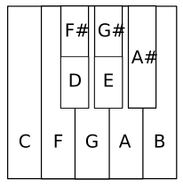
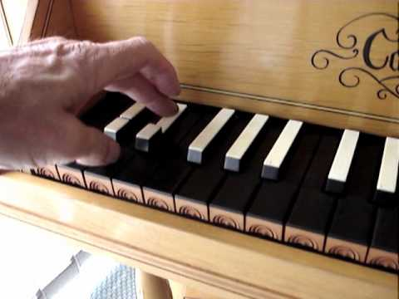
Non-equal temperament
Arbitrary 8ve arrangements
(“short octaves”, split keys)
Baroque tunings (18th century)
“Just” intonation
Meantone
Werckmeister III

Slide 20
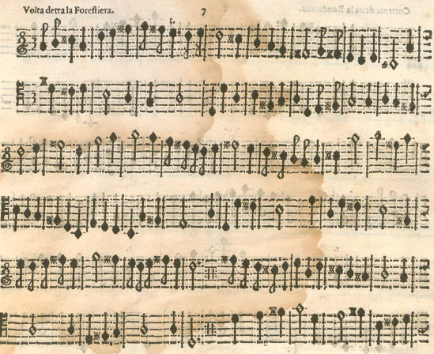
Vicentino’s enharmonic harpsichord (pitch equivalents in cents)
Music for enharmonic harpsichord (from c. 1550) here by Martino Pesenti (c. 1650)

Slide 21
Roland digital harpsichord series (1988--)
Three modes
Equal-tempered
Meantone
Werckmeister III
Two acoustic contexts
Room
Hall
Two “instruments”
Organ
Harpsichord
Five “stops”
Harpsichord 1-manual
Harpsichord 2-manual
Flemish
Lute
…
https://www.youtube.com/watch?v=zZSlHVifRps

Slide 22
MIDI in use: Historical vs digital harpsichords
Original 16th-century instrument: National Music Museum, Vermilion, SD
https://www.youtube.com/watch?v=aq9iwjyq6u0
Alteration of tuning, temperament
https://www.youtube.com/watch?v=W2gOI1p_0iM [Vallotti tuning, English Renaissance music]
Split keys, Renaissance harpsichords:
https://www.youtube.com/watch?v=D0OveRacKH0

