Slide 1
Optical Music Recognition and Data Import/Export
Music 253/ CS 275A
Eleanor Selfridge-Field

Slide 2
Optical recognition for text
Reliable to roughly 96-99% for Roman alphabet
Good when
Content is even and regular
Scanning is carefully fed
Less good when
Text is uneven or irregular
Scanning is sloppy
Rarely useful for
Non-Roman texts (Cyrillic, Hindi, Mandarin, et al.)
Handwriting

Slide 3
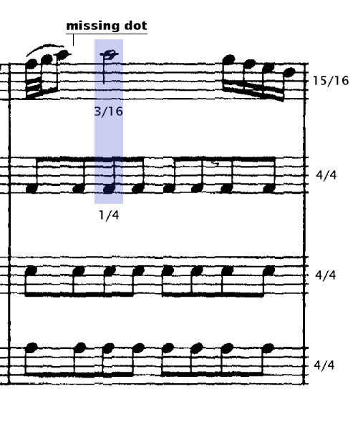
Optical Music Recognition (OMR)
History of efforts from c. 1968
CCARH survey in 1993-4: 37 projects, 7 responses
Why is optical recognition difficult?
Semantic meaning of many objects depends on graphical context more than shape
Sources and their legibility:
Manuscripts: very irregular
Out-of-copyright prints: images often deteriorated
In-copyright prints: not legal to copy
Errors in source
Biggest problems for OMR developers
Superimposition of objects in 2D image
Constraints imposed by output formats

Slide 4
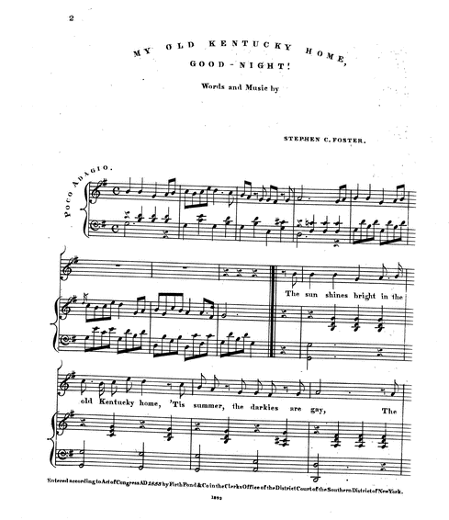
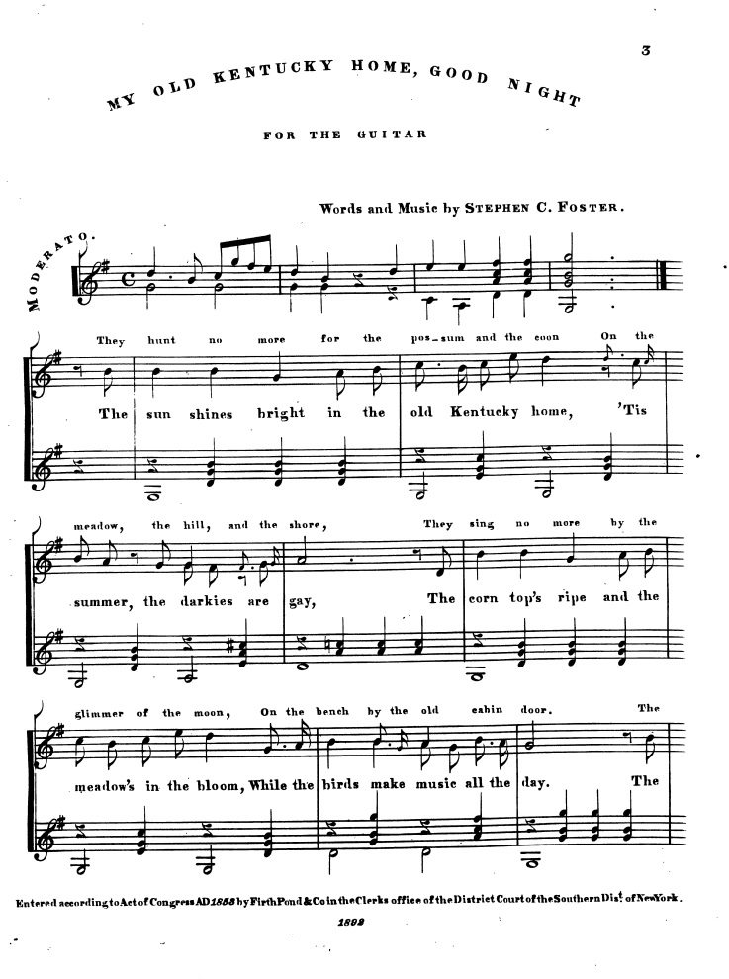
Basic problems in optical data acquisition
Image is crooked
Elements of layout unconventional

Slide 5
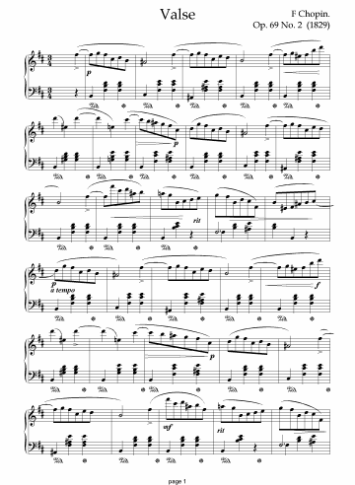
How does OMR work?
Separation of lines and other matter
Isolation of objects
Recognition of objects
Export to a format for
storage
printing
sound
data interchange
Captured: notes, rests
Missed: slurs, pedal marks

Slide 6
Why is OMR difficult?
Problems of image quality:
Ideally
Staff lines are straight
Spacing is uniform
The scanned material is clean (unspotted)
Slurs are symmetrical
Beams are parallel
All lines are unbroken
Reality is different!
Problems of graphical context
Unread symbols affect interpretation of pitch
Key signatures
Octave alterations  
Symbols affect interpretation of duration
Meter signatures
Tempo indicators
Fermatas 
Symbols relating to dynamics or technique
Dynamics marks  ▪ 
Repetition of note-groups , of sections  
Instrumental technique ○  

Slide 7
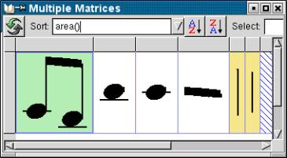
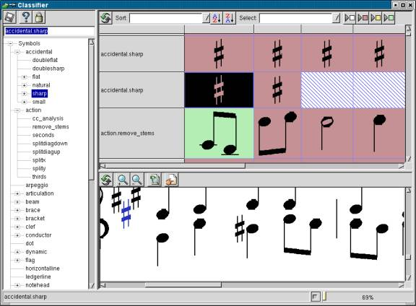
Other difficulties
Multiple configurations for same objects
Methods of evaluation and control
Musical accuracy?
Handicaps for post-processing
Controls for input quality
Comparison of output formats
Weighing speed against accuracy and usability
 | Input | Capture format | Post-Processing
Carter | 00:20 | SCORE | 9:20
CCARH | 2:30 + 7:05 | MuseData | 00:15

Slide 8
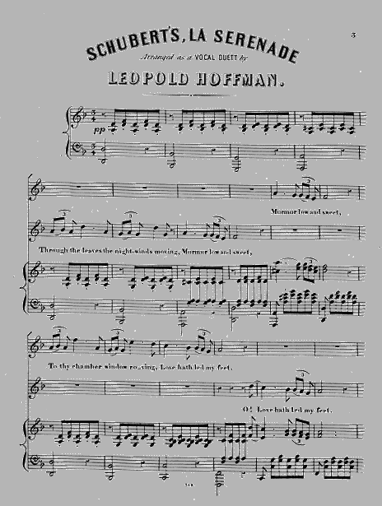
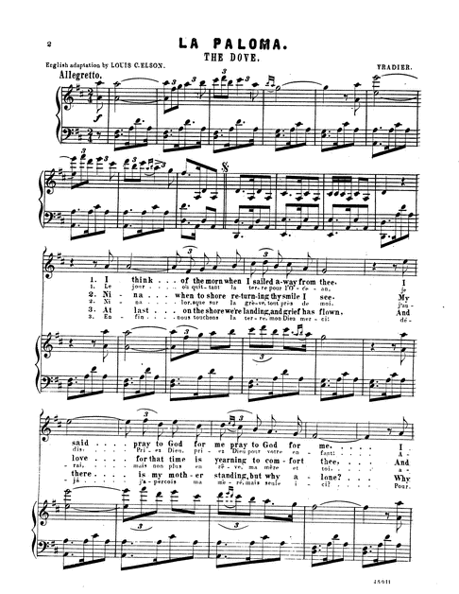
Samples from Library of Congress site
Random material from loc.gov

Slide 9
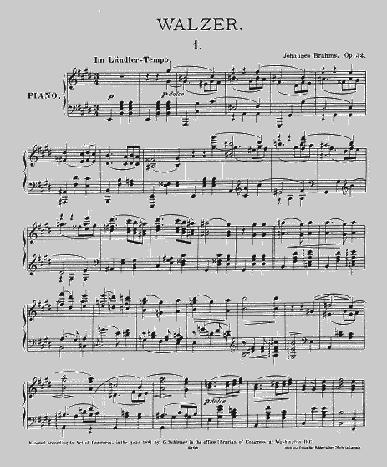
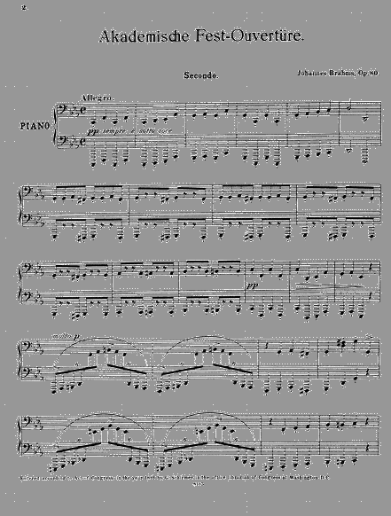
Samples 2: More random material from loc.gov

Slide 10
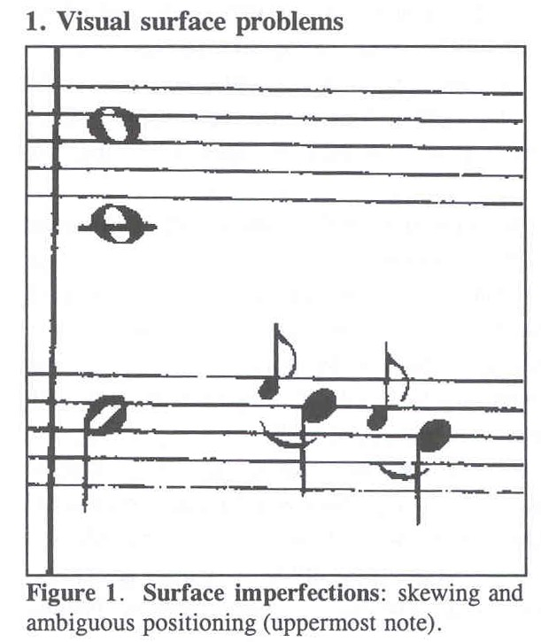
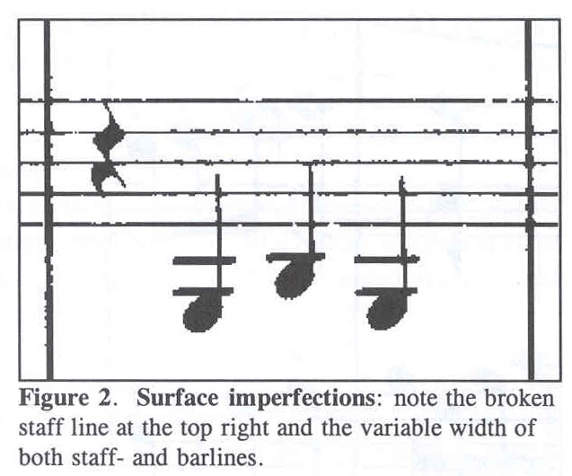
Close-up views of conventionally typeset music
Surface imperfections
Surface imperfections

Slide 11
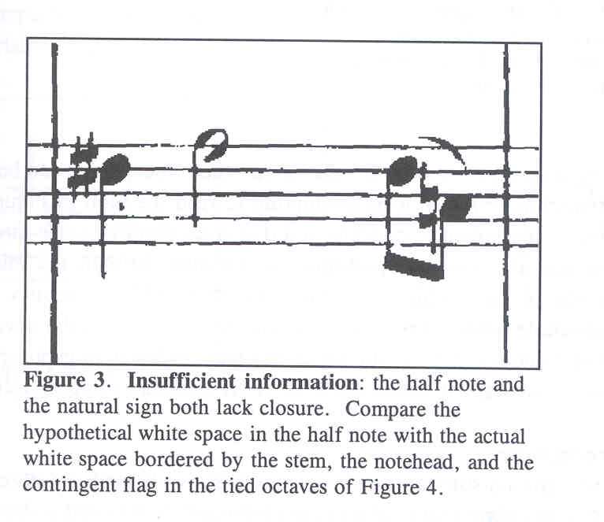
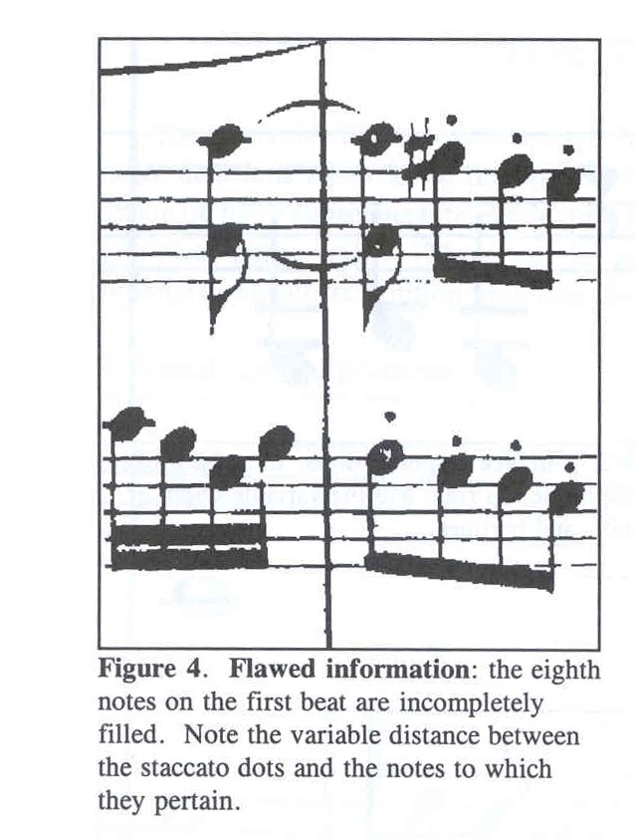
Close-up views (2)
Missing contextual information
Graphic imperfections

Slide 12
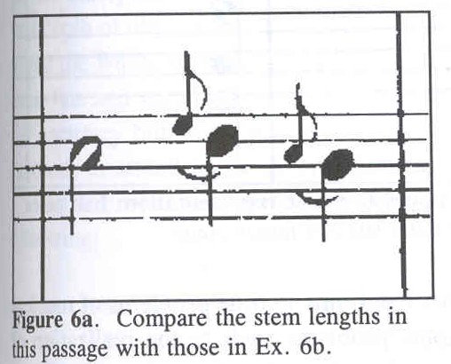
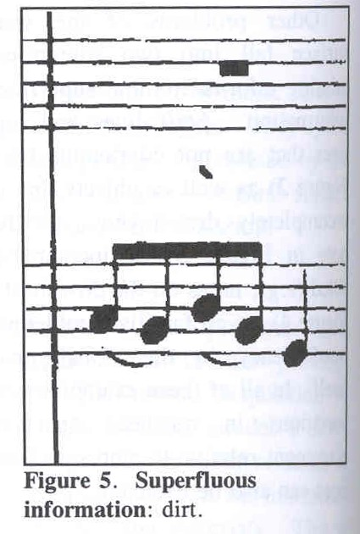
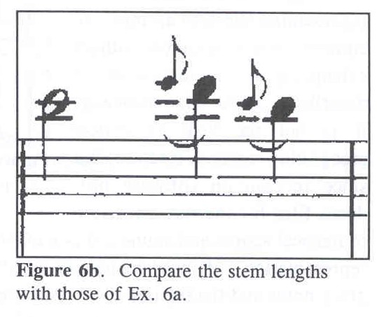
Close-up views (3)
Variable appearance of equivalent objects
Dirt

Slide 13
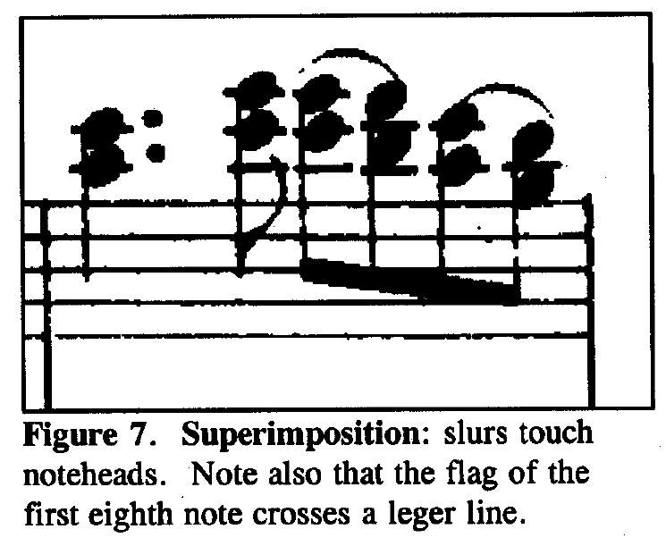
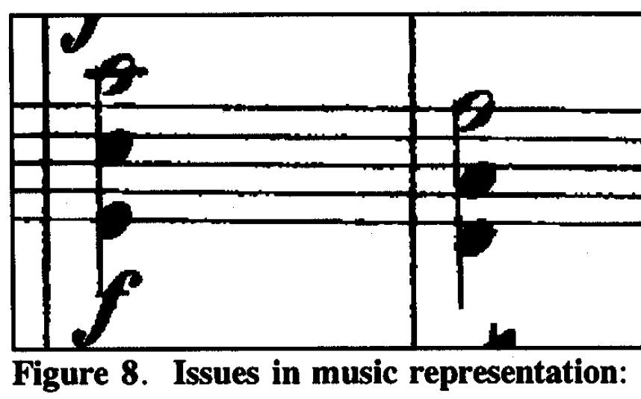
Close-up views (4)
Touching objects
Unconventional presentations

Slide 14
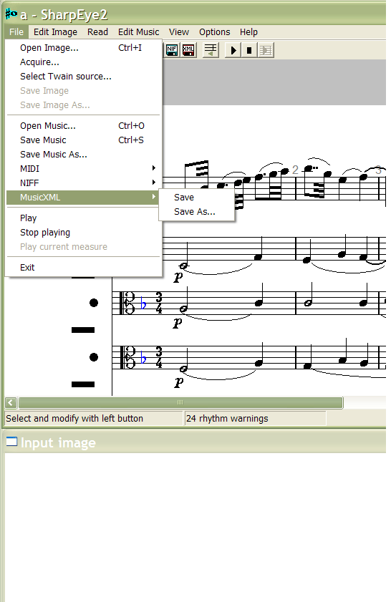
SharpEye: File operations
Comes from Shetland Islands
Source code available
Exports to MusicXML
Four-step process
Capture a page image
View the auto-image
Correct the image
Save/export the result
Vis-à-vis MuseData:
SE: score-based
MD: part-based

Slide 15
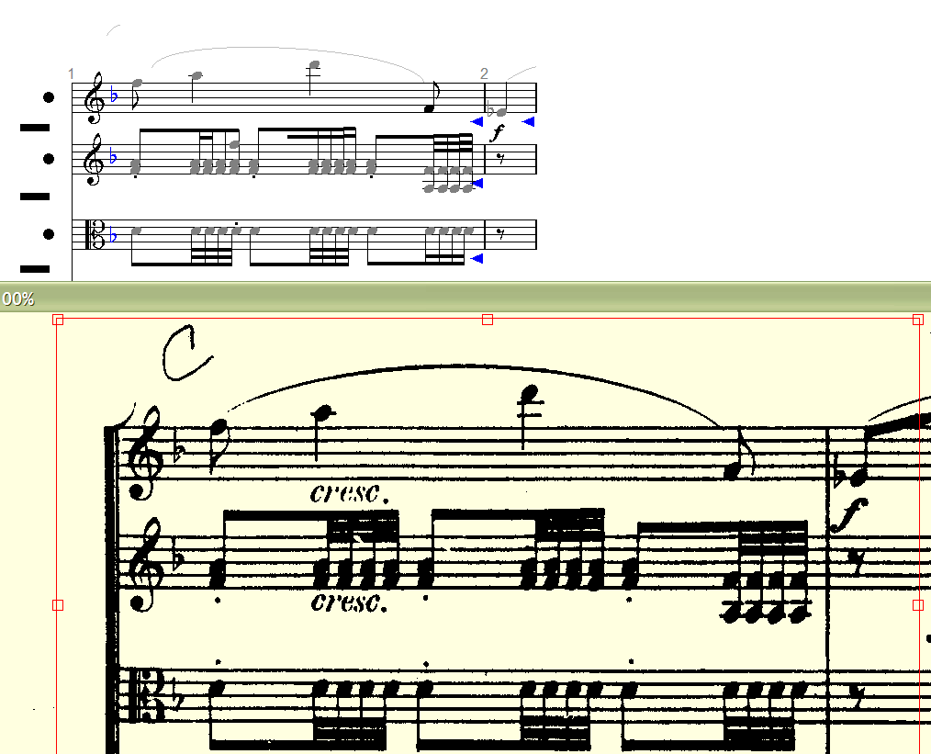
SharpEye: Raw Capture

Slide 16
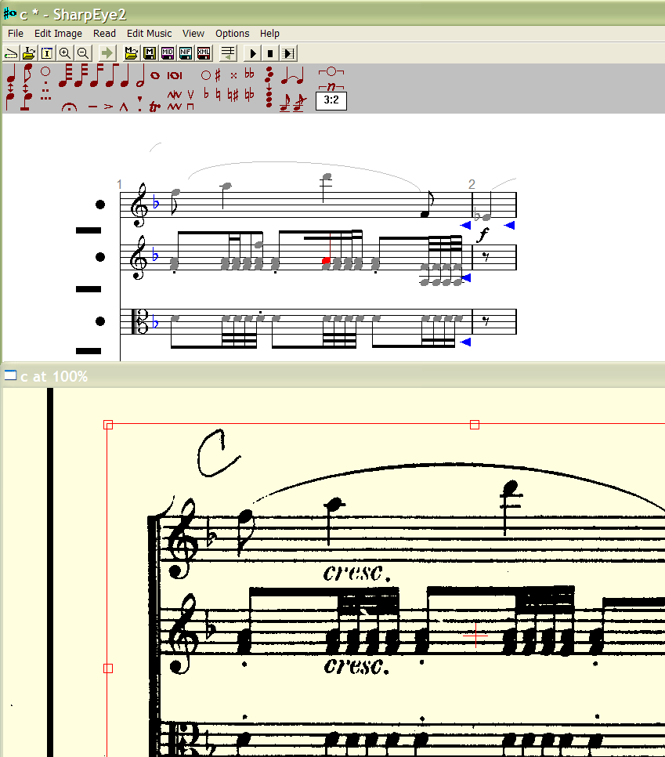
SharpEye: Correcting the interpretation
Edit mode:
Captured image below
Interpreted image above
Live object in red
Available symbols in red
What SharpEye thought it saw
Step 1: Selection a portion the score to edit
Step 1: Selection a portion the score to edit
What SharpEye scanned

Slide 17
OTR benefits from side-by-side comparison
Deutsche Textarchiv: Max Planck, Readings on Thermodynamics (1897)

Slide 18
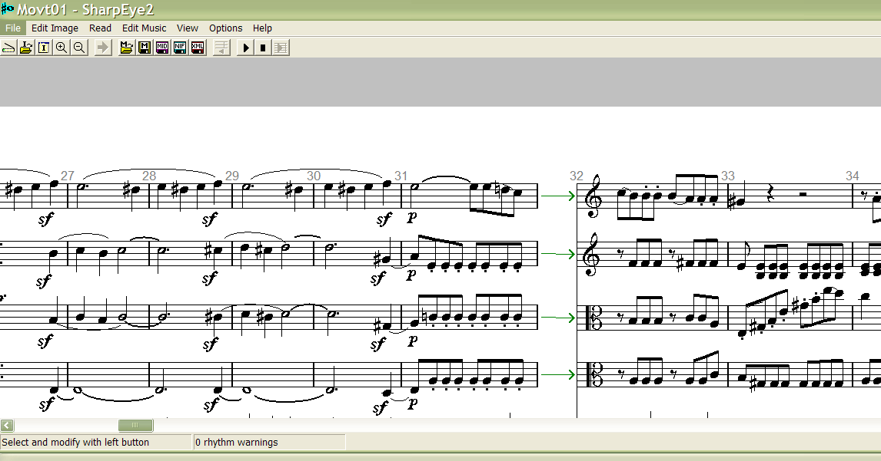
SharpEye: Scroll view

Slide 19
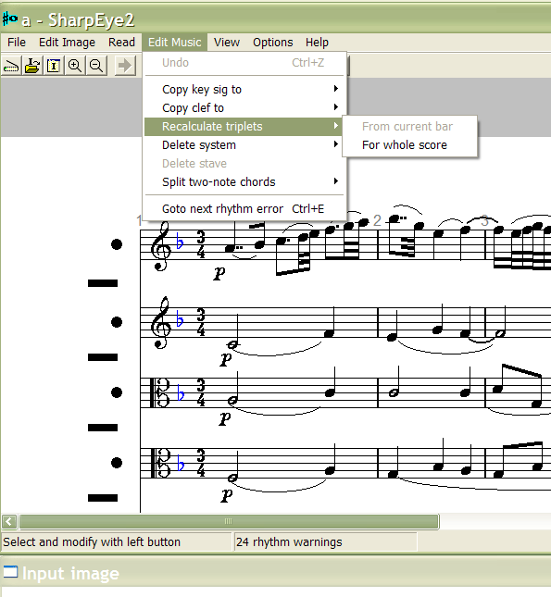
SharpEye: System edits

Slide 20
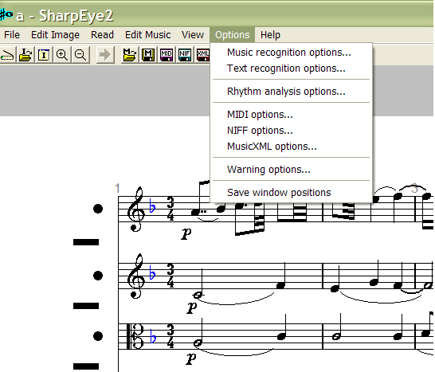
SharpEye: Data-interchange options

Slide 21
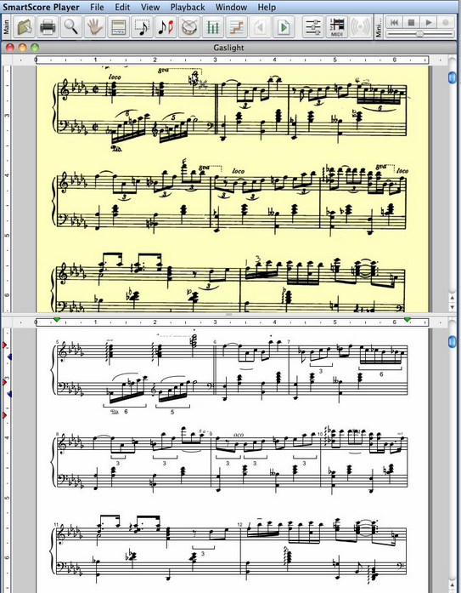
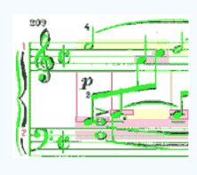
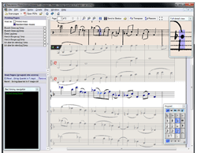
Other OMR Software
Capella-scan: http://www.capella.de/us/index.cfm/products/capella-scan/info-capella-scan/ [capella]
Neuratron PhotoScore: http://www.neuratron.com/photoscore.htm [Sibelius]
SmartScore: http://www.musitek.com/
CapellaScan
PhotoScore
SmartScore

Slide 22
Important questions about OMR software
http://www.wikicfp.com/cfp/servlet/event.showcfp?eventid=11836http://www.wikicfp.com/cfp/servlet/event.showcfp?eventid=1183633
What output formats are available?
MIDI-level features only?
Graphical position?
Markup?
New forum: WoRMShttp://www.wikicfp.com/cfp/servlet/event.showcfp?eventid=118363—http://www.wikicfp.com/cfp/servlet/event.showcfp?eventid=118363
Music Reading Systems, incl. OMR
Mus 253/CS 275A
2016 Eleanor Selfridge-Field
20

