Slide 1
From Silent Film to YouTube: Musical Identity, Music Copyright, and Film Music
Eleanor Selfridge-Field
CCARH, Stanford University
esfield@stanford.edu

Slide 2
Overview
Musical ontologies
Fixed form in a digital environment
Using copyrighted works
Film music as intellectual property
Cases and claims

Slide 3
Musical Ontologies

Slide 4
Types of digitization
Sound content (audio, MIDI)
Graphical content (scores)
Symbolic data (various)
Sound
“Logical work”
Notation

Slide 5
Unique features of each domain
Sound
Sound domain
Timbre
Tempo
Graphics domain
Layout
Gestural information
Logical domain
accent
If film, synchronization domain
-time values for coordinating music with video
“Logical work”
Notation

Slide 6
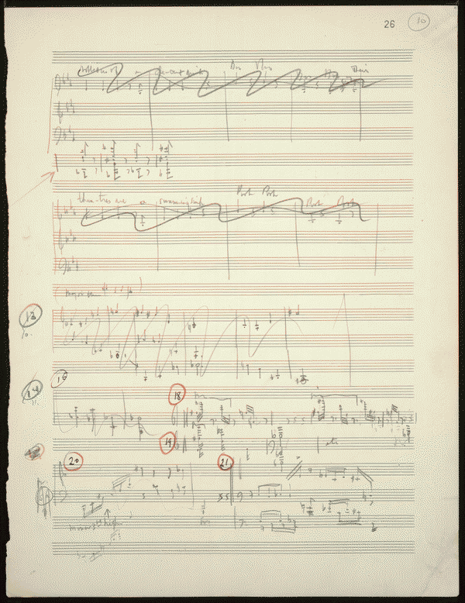
Practical aspects of digitalization
Time: Operas and oratorios (2-/3-hour works) take about 6 months to encode, proofread, lay out, and print.
Allowable uses: safest sources are
Out-of-copyright material
New editions
Source material: scarce
Copland: Of Mice and Men

Slide 7
Fixed Form in a Digital Environment

Slide 8
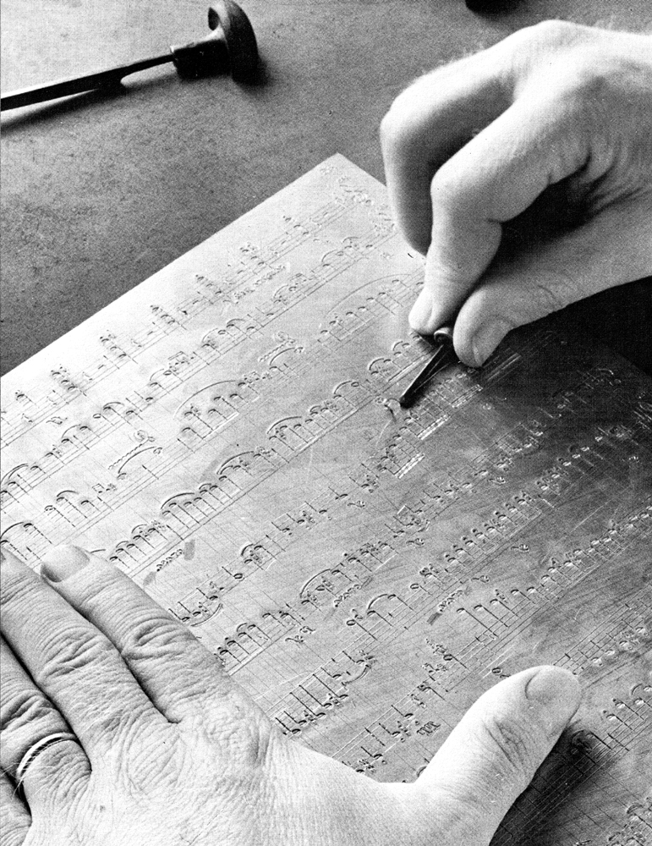
(Musical) Copyright concepts
1909: US Copyright Act adopted
Provides protection based on concept of fixed form
Grew out of legacy control of the dissemination of printed material made from printing plates
Belonged in 16th century to printers’ guilds
Rights drift, by assignment, to publishers
Analogues to print receive coverage
Piano rolls, recordings, and films
G. Henle Verlag

Slide 9
Copyright Aims
What does copyright promote?
Creativity
What does copyright protect?
Right to reproduce work
What does copyright require?
A fixed registered instantiation of the work

Slide 10
Data varies across domains
Entity: the US
Identity #1:
The atmospheric nitrogen map of the US
Identity #2:
The ground nitrogen map of the US

Slide 11
The Great web of Content and its Rights
The Protected Film
Media used in distribution
Publicaton
Recording
Distribution
Radio (from 1909)
Sheet music
Piano rolls
Recordings
…..
Synchronization rights
(may belong to music publisher)

Slide 12
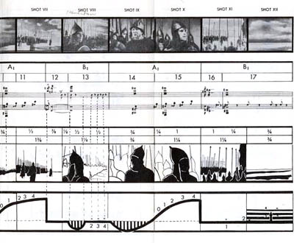
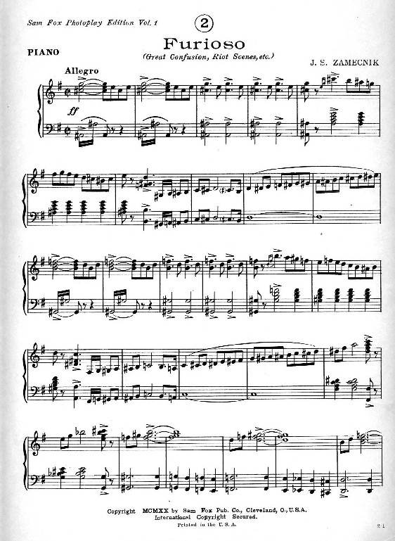
New informational content
Sound (moving)
Images (moving)
Synchronization information

Slide 13
Film as a container
Sound information
Graphical information
Symbolic content information
Container information (Smiraglia et al.)

Slide 14
Art of the Container
Music liberates time.
Container freezes time.
Art of the performance.
Art of the container
Photo © 2002 John Storey. Permission pending.
(Sarah Hughes, 2002 Olympics)

Slide 15
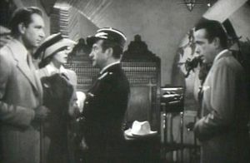
Synchronization as container art
Casablanca (1942)
Max Steiner, Warner Bros.
With songs by M.K. Jerome (d. 1977) and Jack Scholl (1988) as well as “Die Wacht am Rhein”; The Marseilles; music by I. Jones, 1924, and many others
“As time goes by,” Herman Hupfeld, 1931 (#1)
Hollywood polyphony (#2)

Slide 16
Using Copyrighted Works

Slide 17
Lack of Clarification
Case law (US) only occasionally touches film music
Film music is normally the property of the film producer

Slide 18
Duration of Copyright (US)
Print legislation models to be observed
Duration pre-1998 (excluding many complexities)
1923-49: 28 plus max 28 years = 56 years (now 95 years)
1950-63: 28 plus 67 years = 95 years
1964-77: renewal automatic; thus 95 years
Pre-1978, never published: expired in 2002
1978 to present: expires in 2047

Slide 19
Factors complicating Duration
Multiple authors
Neighboring rights (multiple countries involved)
Mixed material
Transfer of rights

Slide 20
YouTube and copyright
How not to infringe
…It is illegal even if
You taped it from a broadcast
You only used a little bit
You credited the creator
You edited your video
Do something completely original
Use only your own creations
If you do not have the owner’s permission, don’t post it….

Slide 21
YouTube holdings statistics (2/20/09)
Studios represented
Film music composers represented

Slide 22
Film Music as Intellectual Property

Slide 23
When/How was the music composed?
Commissioned by film producer (work made for hire)
Previously extant (newly arranged)
Synthesized (or electro-acoustic)
Retrospective (esp. silent films)
Pastiche of previously existed works

Slide 24
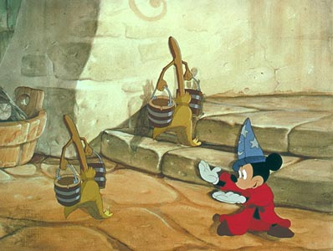
Previously extant/public domain music
“Out-of-Copyright” Music
Many Disney cartoons, e.g.
Fantasia (1940) credits
J.S. Bach (d. 1750, Germany)
Tchaikovsky (d. 1893, Russia)
Paul Dukas (d. 1935, France)
Igor Stravinsky (d. 1971, USA);
Rite of Spring 1913 (full score, Paris 1921)
L. v Beethoven (d. 1827, Austria)
Ponchielli (d. 1886, Italy)
Mussourgsky (d. 1881, Russia)
Schubert (d. 1828, Austria)
The “Sorcercer’s Apprentice” scene (Dukas)

Slide 25
Previously composed “Film” Music
In-copyright music (not always credited)
Other Disney cartoons
Bambi (1942)
“Love is a song that never ends ” [by Frank Churchill ; d. 1942] and 12 other songs” © Wonderland Music Co. 1953/1978
Additional works by others found in later revised versions of film
Churchill not credited for music in 25 other films for which he wrote music; see posthumous credits in ASCAP database (300 songs credited to him)
Bambi history:
US releases, 1942 and after
Elsewhere, 45 releases through 1987

Slide 26
Electro-acoustic film music
An early film-music generator
…As used in Hitchcock’s
The Birds (1963)
Oskar Sala’s Trautonium
Bernard Hermann a customary collaborator

Slide 27
Electronically enhanced film music
Synthetic Voices
As in Farinelli
(Belgium, 1994)
Simulation of castrato achieved by blending male countertenor and female voices
Derek Lee Ragin
Ewa Małas-Godlewska
“Lascia ch’io pianga” from Handel’s Rinaldo (1711)

Slide 28
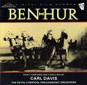
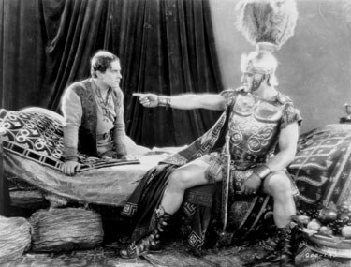
Retrospective FiLM music
Carl Davis: Ben Hur
Silent film (1925)
Score by William Axt (d. 1959), 1931
(recent realization by Gillian Anderson)
Score by Miklos Rozsa (d. 1995), 1959
Score by Carl Davis, 1987

Slide 29
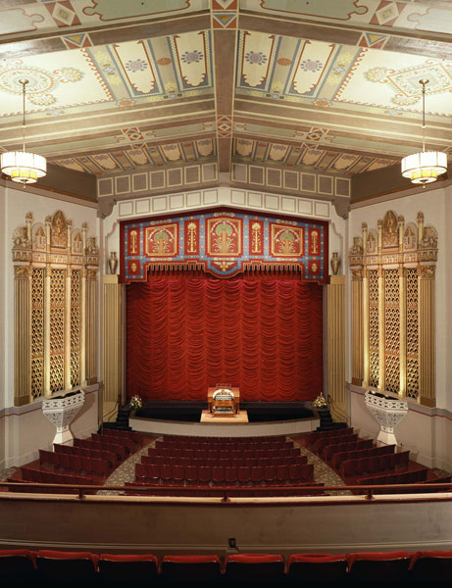
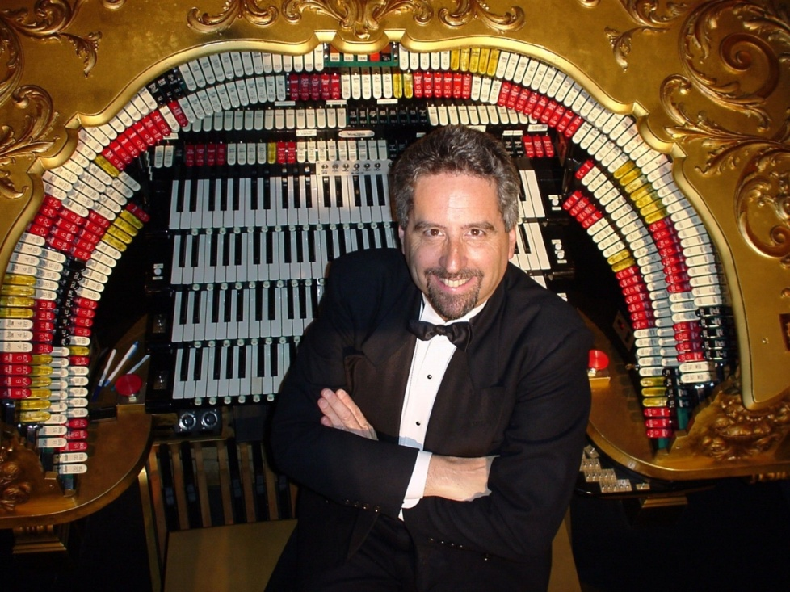
Live music realization for silent films
Stanford Theater Foundation
Improvised organ music from cue sheets: Dennis James et al.

Slide 30
Cases and claims

Slide 31
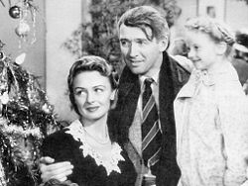
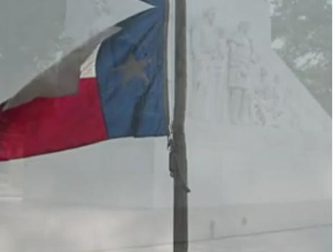
Derivative work claim
Rights Recapture
It’s a Wonderful Life (1946)
Frank Capra (d. 1991), producer
RKO-Liberty studio
Music by Dimitri Tiomkin (d. 1979), except “Buffalo Girls”
Copyright not renewed after 28 years
1974-1993: in public domain
1993 claim (rested on 1991 decision by Supreme Court)
Claimed by Republic Pictures because the underlying story was still protected.
Rights now held by Paramount
The Alamo (1960)

Slide 32
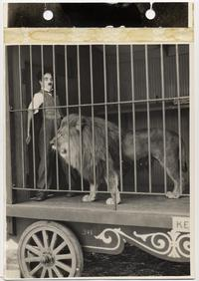
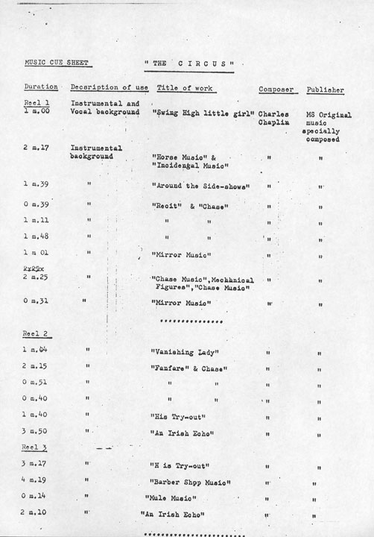
Retrospective music plus transfer
Film (1928)/silent
New score—late Sixties
The work can only be screened with the new score.
Rights = $1800/Eastman House

Slide 33
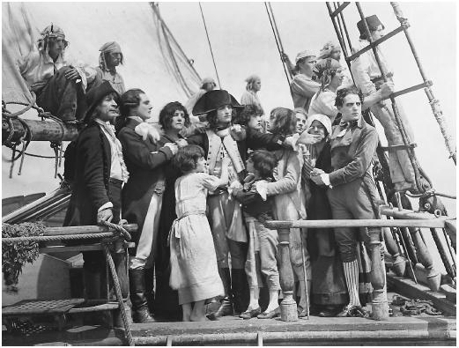
Forced choice of music
Napoleon (1927)
Original production: Paris
Music by Alfred Honegger (d. 1955)
1981 restoration of original
UK: new music by Carl Davis
US: new music by Francis Ford and Carmine Coppola (d. 1991)
Only the Coppola version can be screened in the US.

Slide 34
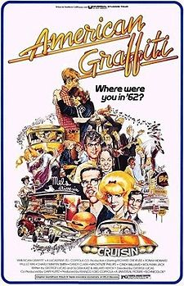
Pastiche sound tracks
American Graffiti (1973) Lucasfilm
55 pre-existing numbers:
“I only have eyes for you” (Flamingos, 1959)
“Why do fools fall in love?” Frankie Lymon (1956)
“The Great Pretender” (Platters, 1959)
Cost of all rights: $80,000
Musical supervision by Karin Green
Excluded Elvis Presley
Later excluded: “She’s so fine” (Chiffons, 1964; successfully sued Beatles for “My sweet Lord” melody)

Slide 35
Fixed FORM VS Fluid Content
Autograph MS
Copyists
Composer
Sources
Editor(s)
“Music consists only of sound…but sound is its least stable element.” Margaret Bent (1992)
Published edition
Edition
Performers
Recording
Film music
Broadcast
DVD of Film
Ontological problem: What is a musical work?

Slide 36
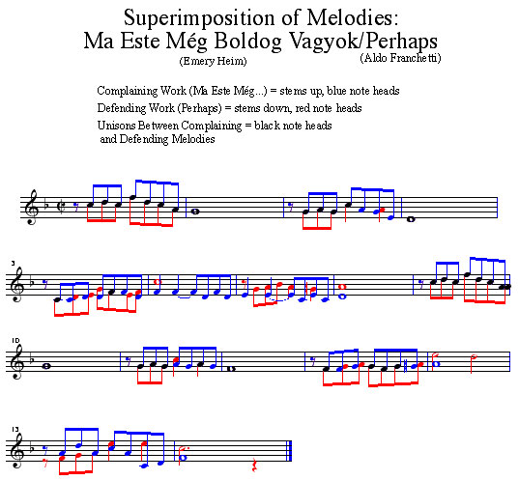
Colliding Claims
Unnamed, Undated (PBS)
Unnamed (1996)
Music: Composers A and B
Music: Composer X
Composer(s) living
Documentary film
?
Commissioned score
Commercial film (similar subject)
Heim vs. Universal Pictures (1946)
Dvorak: Humoresque (1894)
Commissioned score

