Slide 1
Harmonic Models
CS 275B/Music 254

Slide 2
General questions
Can harmony be separated from pitch and rhythm?
Should harmony be computed top-down or bottom up?
How should harmonic change be segmented?
How can harmonic information best be communicated?

Slide 3
Krumhansl on Rhythm and Pitch Organization
Rhythmic phenomena
Psychological Bulletin (2000). 126/1, 159-179.
Pitch phenomena
Periodic pulse
Grouping
Objective rhythmicization
Ratios of durations
Patterns of duration (rather than absolute values) of primary psych importance (motoric involvement)
Discreet frequencies
Melodic intervals
Consonance, dissonance
Pitch patterns
Bottom-up approach

Slide 4
Krumhansl (2): Pitch aspects of harmony
Categorical perception of pitch (intervallic sizes)
Tonal hierarchies
Key estimation
Virtual pitch (missing fundamental)
Transposition (not always recognized)
Modulatory distance (circle-of-fifths)
Large-scale musical form
Conclusion: musical patterns organized into hierarchies of events

Slide 5
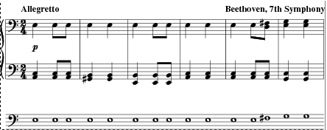
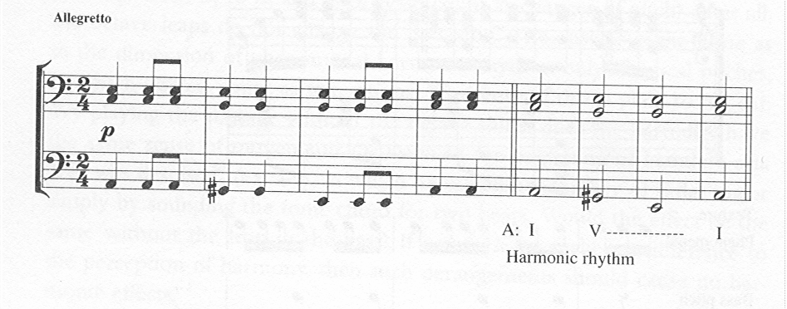
Melodic change vs. Harmonic change
Same melody,
changing harmony

Slide 6
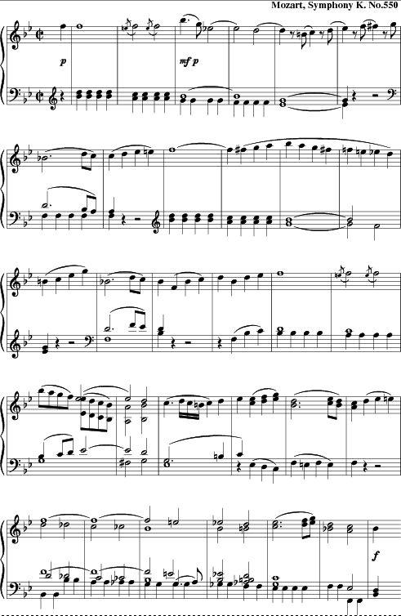
Dynamic properties of structure
In regular circumstances
  How many times is the theme (re)stated?
  How many times is the melody the same?
  How many times is the harmony the same?

Slide 7
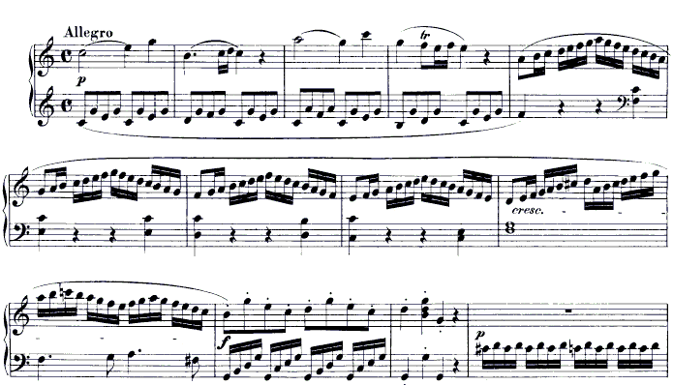
Hugo Riemann (Riemann-esque analysis)
I V I IV I V V7 I

Slide 8
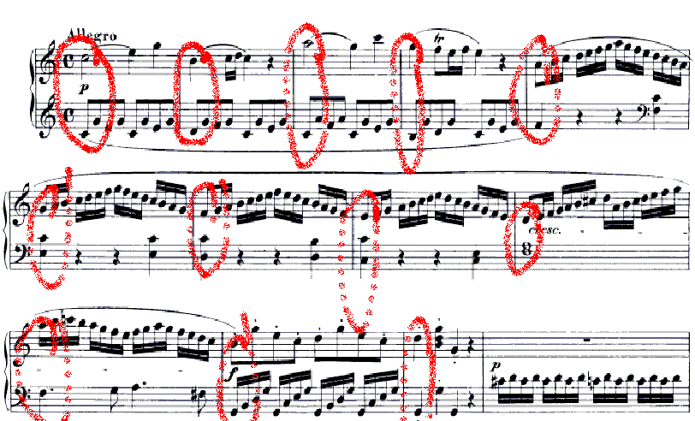
Metrical reductions

Slide 9
Harmonic evaluation
Musical texture:
  interval of assessment
  Harmonic bald spots
  Thematic neutrality

Slide 10
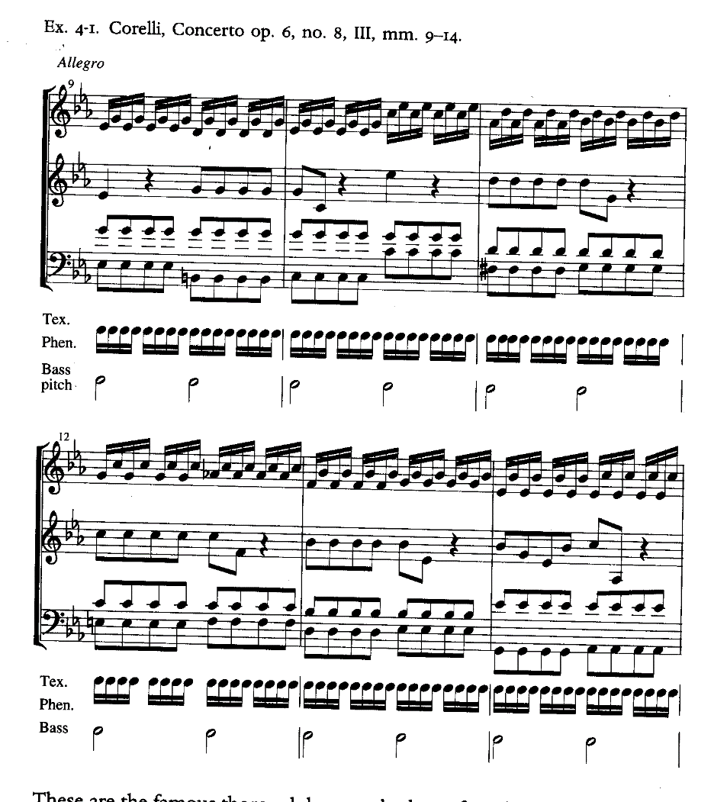
Joseph Swain: Harmonic Rhythm (1998)
Six levels of harmonic rhythm
  Phenomenal rhythm
  Bass-pitch rhythm
  Root analysis
  Within-key analysis
  Density
  Harmonic function
  Interpretation

Slide 11
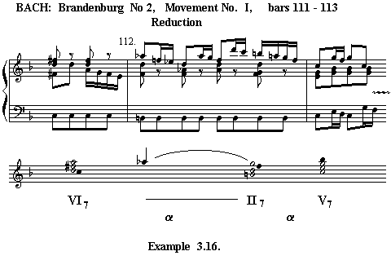
Schenker (Schenkerian analysis)
Foreground/
background

Slide 12
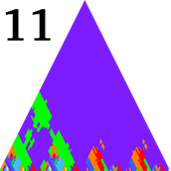
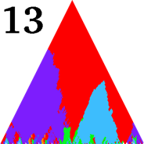
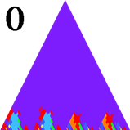
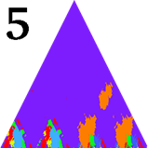
Evaluation and detection (Sapp)
Riemannesque analysis: root-based chord analysis
  kern > eval > new spine > gmn
  chord quality tool (Sapp)
Visualization of chord root/quality > key (Sapp)
Pattern violations (#13)
Schubert: Piano Variations D 576

Slide 13
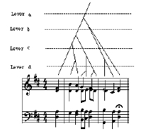
Lerdahl (Gestalt readings)
Lerdahl & Jackendoff:
Generative Theory of Tonal Music (MIT, 1983)
Grammatical structures
  Grouping structures
    Motives, phrases
  Metrical structures
    Strong, weak beats
  Time-span reductions
    Tree structures
  Prolongational reductions
    Psychological awareness
Bach chorale

Slide 14
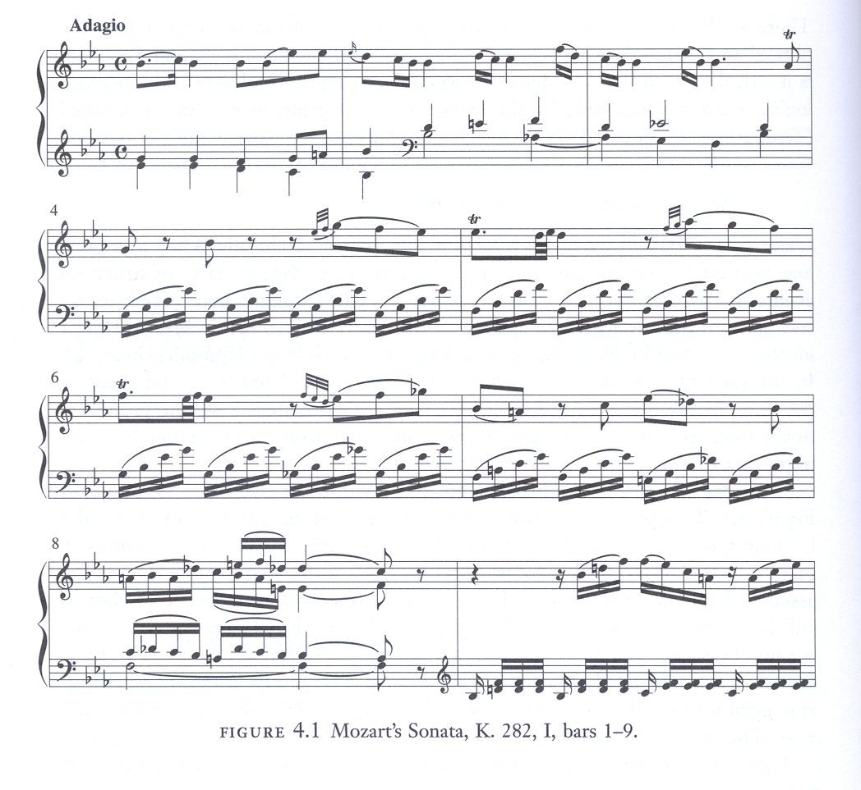
Lerdahl: Tonal Pitch Space (2001)
GTTM rules
Well-formedness rules (structure)
Preference rules (listener-based)
Transformational rules (grouping,
deceptive situations)
Preference rules
  Harmonic tension
  Melodic attraction
  Attraction, expression

Slide 15
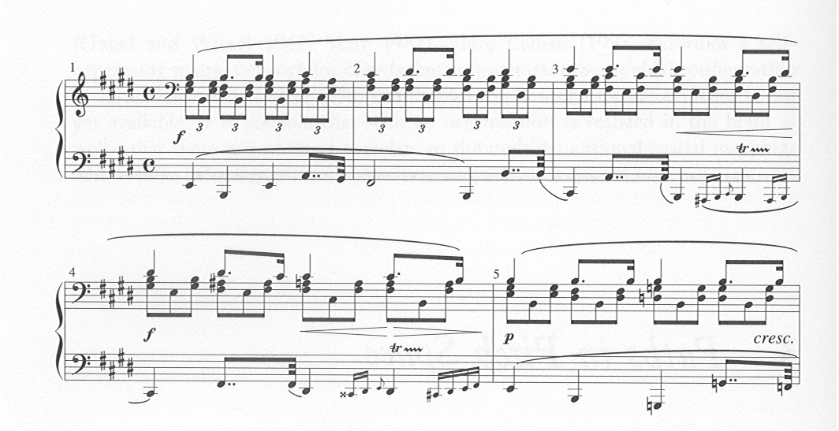
Lerdahl: Tonal Pitch Space (2001)
Riemannian functions
Octatonic vs hexatonic spaces
Chromatic spaces
Whole-tone spaces
Metrical attractions
Psycho-acoustical factors

Slide 16
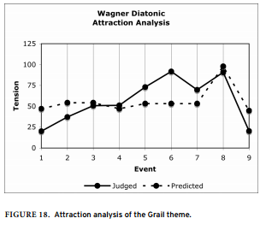
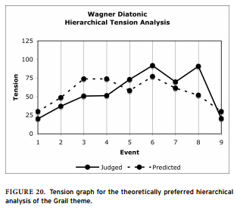
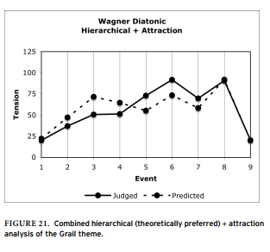
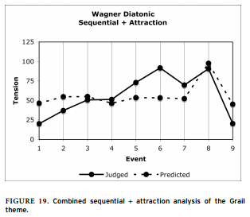
Lerdahl, Krumhansl (2007), 1
“Modelling Tonal Tension,” Music Perception 24, 329-366 (2007)
Attraction
Tension
Combo attraction
Combo hierarchical
Principles: Prolongational structure, pitch-space model, surface-tension model, attraction model--
Experimental results

Slide 17
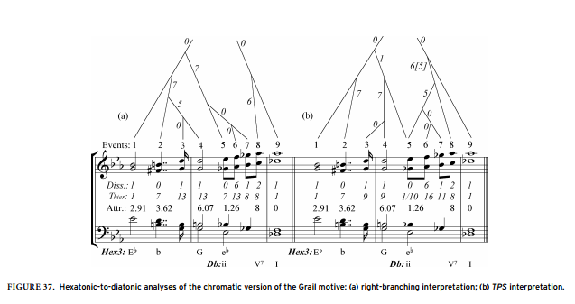
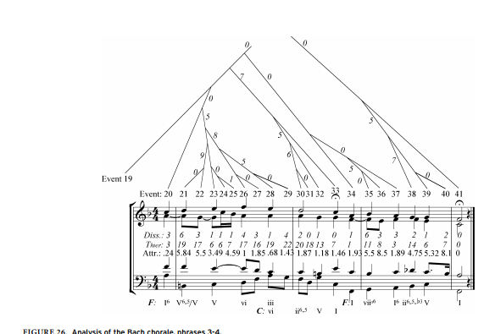
Lerdahl, Krumhansl (2007), 2
Bach chorale
Wagner “Grail” motif.

Slide 18
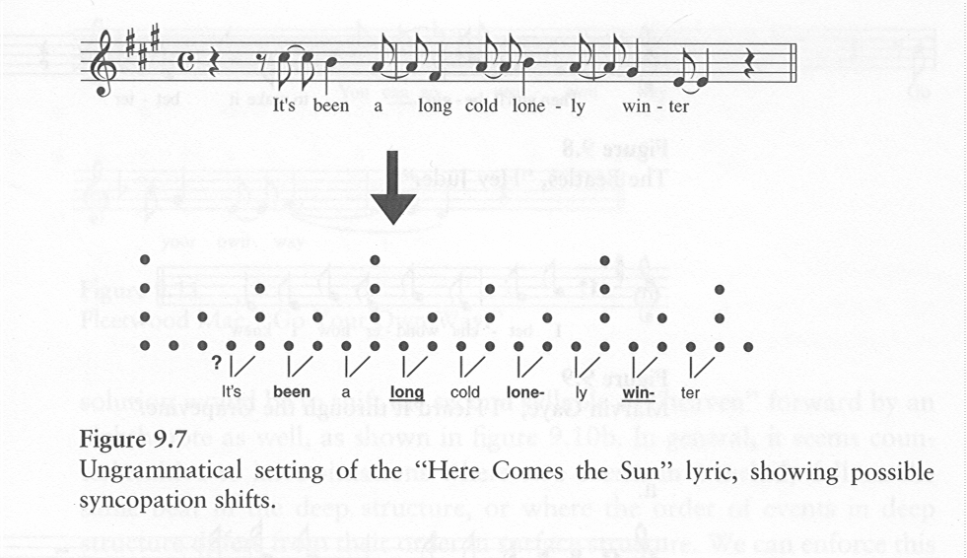
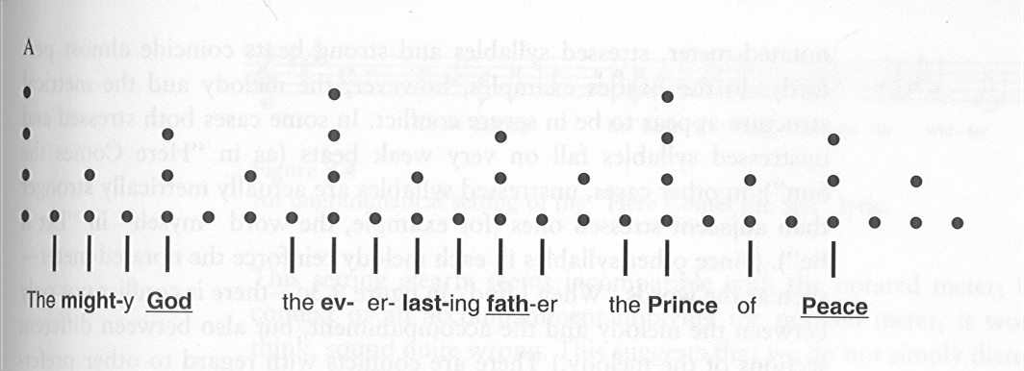
Temperley 2003, 1
Music Cognition:
The Cognition of Basic Musical Structures (2003)
Areas covered:
Metrical structure
Phrase structure
Melodic phrase structure
Contrapuntal structure
Harmonic structure
Key structure

Slide 19
Temperley 2003, 2
Repertories and perspectives
  Ambiguity
  Rock
  African music
  Generative processes
  Non-metrical music
  Arbitrariness
  Method: mainly based on GTTM (Lerdahl…) and extensions to it
  Software: (Melisma): mainly written Daniel Sleator
  [cf on KernScores]

Slide 20
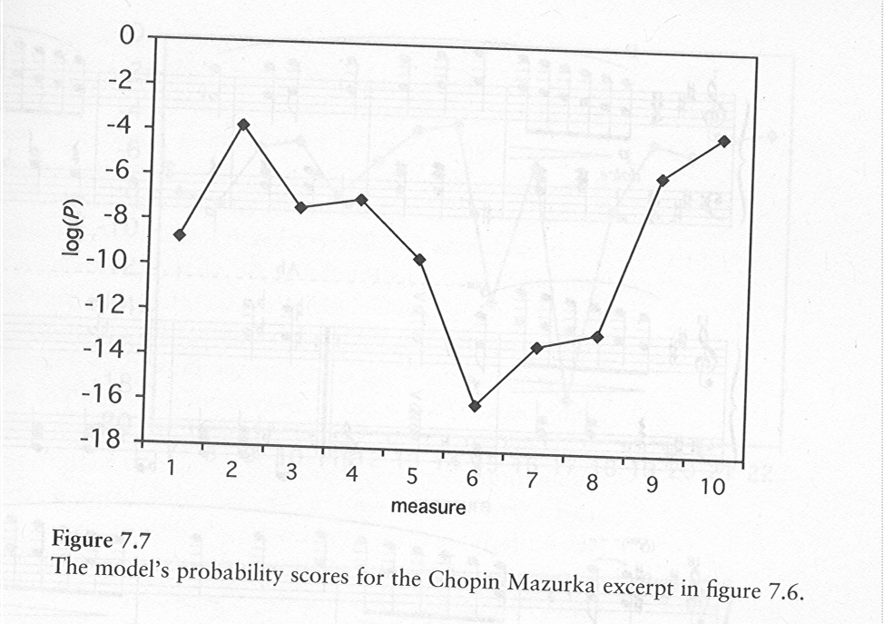
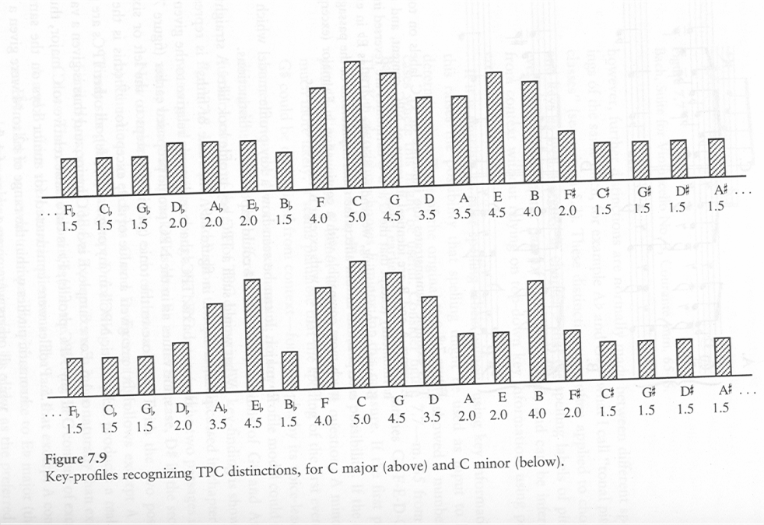
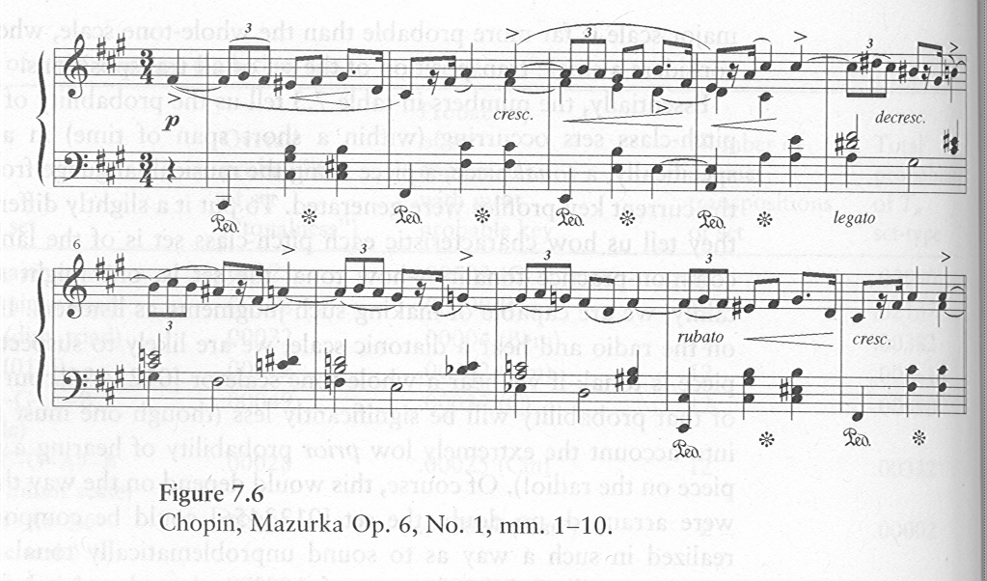
Temperley (3)
Music and Probability (2006)

Slide 21
Harmonic generation
Generation of harmony from melody
Kemal Ebcioglu (SUNY Buffalo, 1986; IBM)
rule (“expert”) systems
(100 for thesis,
300 in post-thesis work)
Generation of entire chorales
David Cope (UC Santa Cruz, 2005)
augmented transition network

Slide 22
Izmirli: Acoustics vs. Circle of Fifths

Slide 23
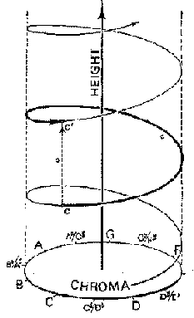
Geometrical models of tonality (2000-2010)
18th century
  Heinichen
  Euler
19th century
  Riemann
20th century
  Shepard (SU)
  Krumhansl (SU, Cornell)
  Lerdahl (Columbia)
  Chew (SU, MIT, London)
  Purwins (Berlin, Barcelona)
  Sapp (SU)

Slide 24
Toroidal models of tonality
G. Weber key chart

Slide 25
Krumhansl:
Cognitive Foundations of Musical Pitch (1990)
Hendrik Purwins
Stephen Malinowski
Weber

Slide 26
Well Tempered Clavier (Purwins)
Harmonic usage profiles of individual preludes and fugues from JS Bach’s WTC (1722)

