Slide 1
Musical Similarity: More perspectives and compound techniques
CS 275B/Music 254

Slide 2
Musical similarity
Similarity studies in general
Reductionist approaches
Social cognition
Timbral confounds
Affective similarity
Cognitive distance metrics
Compound search techniques

Slide 3
Cognitive distance metric (1)
1. Basic Pitch-Accent Structure |  |  |  |  | Range = 0-4
A. | If meter matches target |  |  |  | Max = 1.00
 |  | and |  | If subunit (e.g. quarter note) is the same | Score = 1.00
 |  | or |  | If subunit is different (e.g., 4/8 vs. 2/4) | Score = 0.50
 | Else |  |  |  | Score = 0.00
B. Percentage of matched pitches on primary beats* |  |  |  |  | Max = 2.00
 | If matching number of scale degrees=100% |  |  |  | Score = 2.00
 |  |  | or | If matching number of scale degrees =>90% | Score = 1.33
 |  |  | or | If matched number of notes/unit =>80% Score=0.67 | Score = 0.67
 | Else |  |  |  | Score = 0.00
C. Percentage of matched pitches on secondary beats |  |  |  |  | Max = 1.00
 | If matching number of scale degrees=100% |  |  |  | Score = 1.00
 |  | or |  | If matching number of scale degrees=>90% | Score = 0.67
 |  | or |  | If matched number of notes/unit =>80% Score=0.33 | Score = 0.33
 | Else |  |  |  | Score = 0.00

Slide 4
Cognitive distance metric (2)
II. Basic Harmonic-Accent Structure |  |  |  |  |  | Range = 0-6
A. Mode of work (major, minor, other) |  |  |  |  |  | Max = 1.00
 | If modes match |  |  |  |  | Score = 1.00
 | Else |  |  |  |  | Score = 0.00
B. Percentage of matched chords on downbeat** |  |  |  |  |  | Max = 2.50
 | If unambiguous matches on primary beats =>90% |  |  |  |  | Score = 2.50
 |  | or |  |  | If unambiguous matches on primary beats =>80% | Score = 2.00
 |  | or |  |  | If unambiguous matches on primary beat =>70% | Score = 1.50
 | Else |  |  |  |  | Score = 0.00
C. Percentage of matched chords on secondary beats** |  |  |  |  |  | Max = 2.00
 | If unambiguous matches =>90% |  |  |  |  | Score = 2.00
 |  |  | or | If unambiguous matches =>80% |  | Score = 1.50
 |  |  | or | If unambiguous matches =>70% |  | Score = 1.00
 | Else |  |  |  |  | Score = 0.00
D. Percentage of matched chords on tertiary beats |  |  |  |  |  | Max = 0.50
 | If unambiguous matches =>90% |  |  |  |  | Score = 0.50
 | Else |  |  |  |  | Score = 0.0

Slide 5
Cognitive distance metric (3)
Example | Pitch-Accent score |  | Harmonic-Accent score |  | Total score (additive)
 | Raw | Ranked | Raw | Ranked | Raw | Ranked
2a | 3.67 | 2 | 5.5 | 3 | 9.17 | 2
2b | 3.67 | 2 | 5.0 | 4 | 8.67 | 3
2c | 2.67 | 6 | 6.0 | 1 | 8.67 | 3
2d | 1.17 | 9 | 4.5 | 5 | 6.67 | 8
2e | 2.67 | 6 | 4.0 | 9 | 6.67 | 8
2f | 2.33 | 8 | 4.5 | 5 | 6.83 | 7
2g | 1.00 | 10 | 2.0 | 11 | 3.00 | 11
2h | 3.50 | 4 | 4.5 | 5 | 8.00 | 6
2i | 4.00 | 1 | 4.5 | 5 | 8.50 | 5
2j | 1.00 | 10 | 4.0 | 9 | 5.00 | 10
2k | 3.33 | 5 | 6.0 | 1 | 9.33 | 1

Slide 6
Evaluating search viability and efficiency
Krumhansl, 2000 [theory/experiment]
Sapp, Liu, Selfridge-Field, 2004 [practical]
“Search effectiveness measures for symbolic music queries in very large databases” ISMIR 2004:
http://ismir2004.ismir.net/proceedings/p051-page-266-paper135.pdf

Slide 7
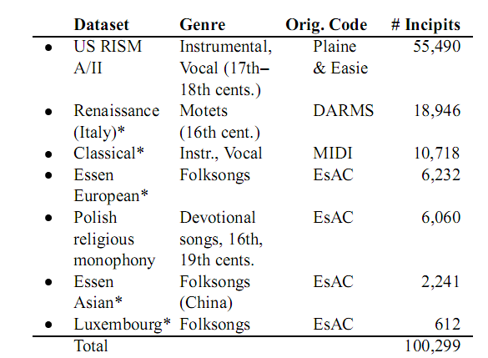
Sapp, Liu, Selfridge-Field (ISMIR 2004)
Search Effectiveness (1)
Data

Slide 8
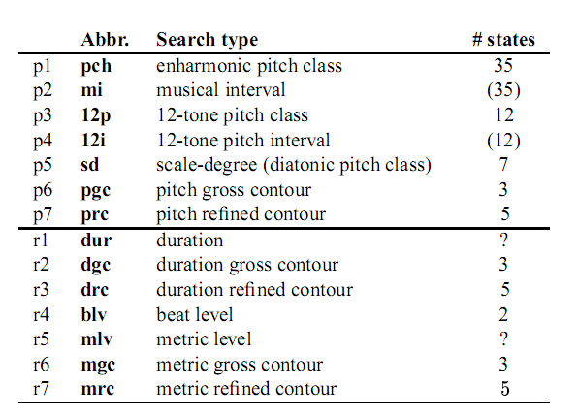
Search Effectiveness (2)
Pitch features
Meter features

Slide 9
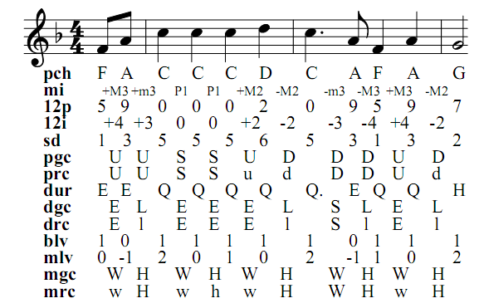
Search Effectivesness (3)
Sample search
Coupled
search

Slide 10
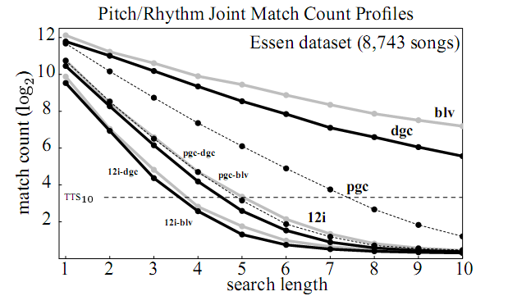
Results

Slide 11
Sapp, Liu, Selfridge-Field (ISMIR 2004)
Search Effectiveness (1)
Data

Slide 12
Stats from 2004 study
Repertory | Repeated pitch intervals | Up intervals | Down intervals | Symbols/theme | Total incipits
15-16th cent/Latin | 29,916 | 66,026 | 67,151 |  | 18,947
15th-16th cent/Polish | 57,006 | 130,030 | 157117 |  | 6016
17-18th cent/US RISM | 110,478 | 344,621 | 399,079 |  | 55,491
18th-19 cent/classical | 19,241 | 80,166 | 86,430 |  | 10,722
Essen Europe | 43,581 | 53,033 | 58,815 |  | 6,232
Essen Asia | 16,441 | 54,577 | 65,684 |  | 2,240
Luxembourg | 4,355 | 9,720 | 11,927 |  | 612
 | 281,018 | 738,173 | 846,203 |  | 100,260

Slide 13
Normalized pitch usage by repertory

Slide 14
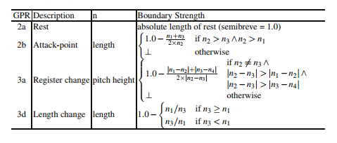
Form: Boundary strength
Markus Pearce, Daniel Müllensiefen, Geraint Wiggins (Goldsmith): et al: “Melodic Grouping in Music Information Retrieval”
After Frankland and Cohen (2004)

Slide 15
Binary (?) melodic segmentation
Melodic segmentation (binary~)
Pearce’s “ground truth” tests using Essen ERK data with binary segmentation(s)
Marcus T. Pearce, Daniel Müllensiefen, and Geraint A. Wiggins,
“Melodic Grouping and Music Information Retrieval” (2010)
[same], “A Comparison of Statistical and Rule-Based Models and Melodic Segmentation”, ISMIR (2008).
Pearce results (Springer Verlag, 2010)
GPR2a preference rules work
Temperley 2001 also useful
Synthesis of Grouper, LBDM, GPR2a, and Thom better that any one individually
Unsupervised learned performed better than any statistical method

Slide 16
Pearce et al software and articles
Idyom software:
https://code.soundsoftware.ac.uk/projects/idyom-project
Perceptual segmentation of melodies:
http://www.doc.gold.ac.uk/~mas03dm/papers/icmpc08_PearceMullensiefenWiggins.pdf
Expectation in audio boundaries:
http://www.ncbi.nlm.nih.gov/pubmed/21180358

