Slide 1
Melodic Search:
Strategies and Formats
CS 275B/Music 254

Slide 2
On melody
What is a theme?
What is an incipit?
Are all themes incipits?
Can you tell the key from a melody?
Can you tell whether something you hear begins at the beginning?
Is melody one-dimensional?
How can we isolate a melody algorithmically?

Slide 3
On melody
What is a theme? Significant content that identifies a piece
What is an incipit? Opening phrase
Are all themes incipits? No
Can you tell the key from a melody? Sometimes
Can you tell whether something you hear begins at the beginning? ??
Is melody one-dimensional?
How can we isolate a melody algorithmically?

Slide 4
Imported search strategies

Slide 5
Imported search strategies
Probability ranking
Sorting, clustering, categorization
String matching, edit distance
N-grams
Dynamic programming
Pattern detection

Slide 6
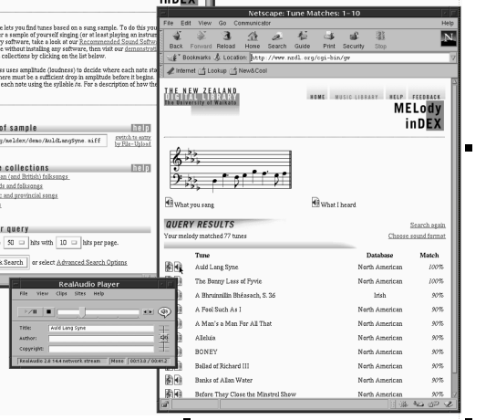
Probability ranking
“Query-by-humming”: work of Lloyd Smith et al, c. 1995.
Example: MELDEX

Slide 7
Melodic sorting (incipits)
[Ranking??]
Examples from RISM
John Howard, "Strategies for sorting melodic incipits," CM 11 (1998).

Slide 8
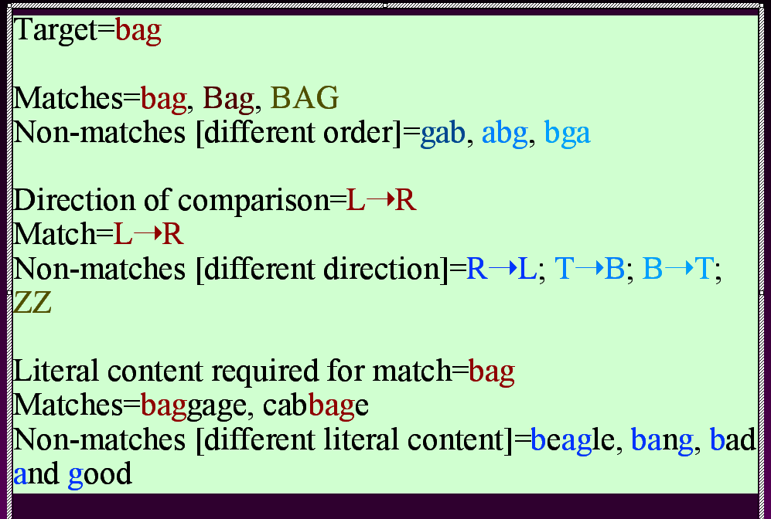
Edit distance: text
1. Item-by-item comparison
2. Penalties for
  substitutions
  insertions
  deletions
Bag
Bat
Cat
Catch

Slide 9
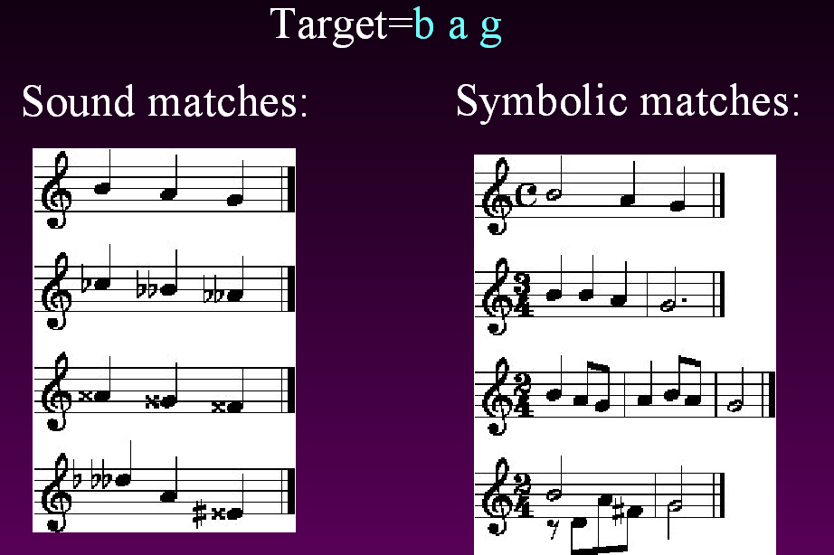
Edit distance (music)
Ambiguities
-iteration (accent invariant)
-polyphonic involvement
-decoration (accent invariant)

Slide 10

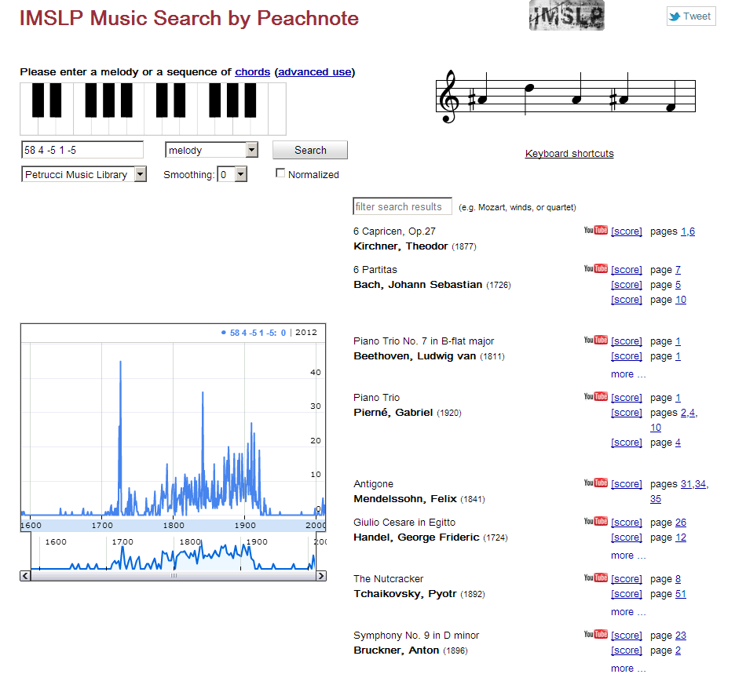
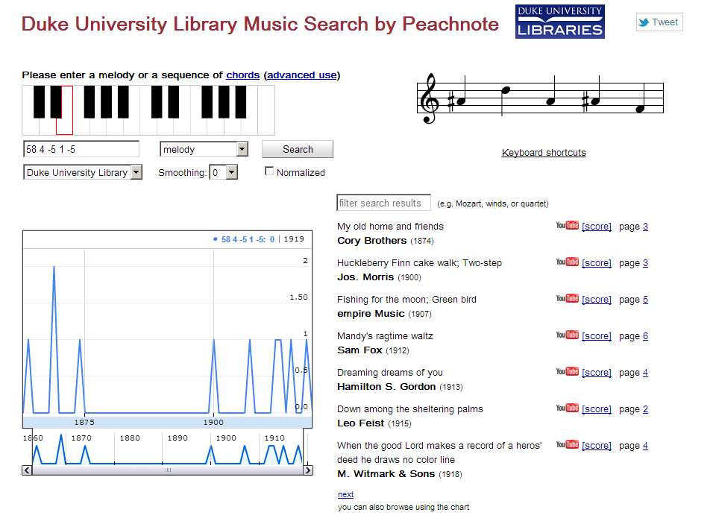
N-grams
Method
Pick a string length
Seek all its permutations
Beethoven: Archduke Trio

Slide 11
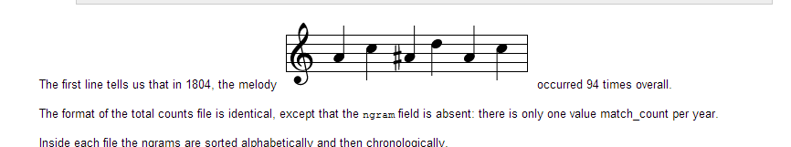
N-grams
Music n-gram viewer
http://www.peachnote.com/datasets.html

Slide 12
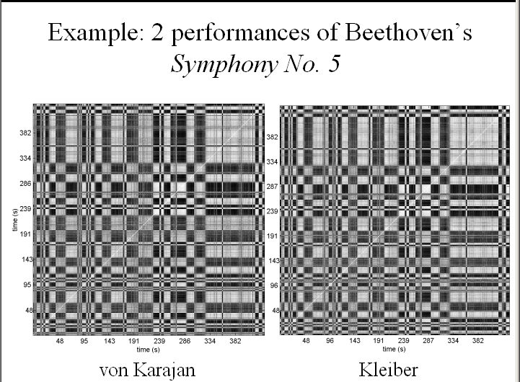
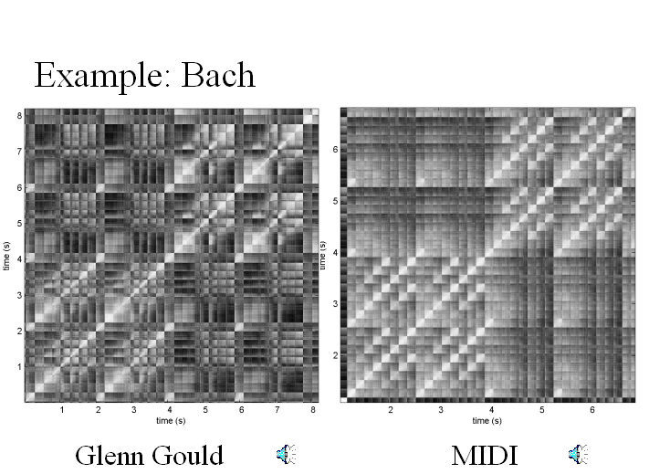
Dynamic programming
Examples: Jonathan Foote
Performance-based
self-similarity matrices
Rhythmic similarity

Slide 13
Pattern detection

Slide 14
Pattern detection
Settings of the word "Liebe"
Nettheim: MuSearch (SCORE)
Pattern realms
Lyrics
Pitch
Duration
Phrase structure

Slide 15
Vulnerabilities
Query
Target (scale degree): 32123
Pitch (scale-degree) matching without rhythmic, metric invariance

Slide 16
Vulnerabilities
Query
Target: 3331
Pattern-matching without:
Rests
Register considerations
Repeated notes

Slide 17
Themefinder
A search application for melodic data

Slide 18
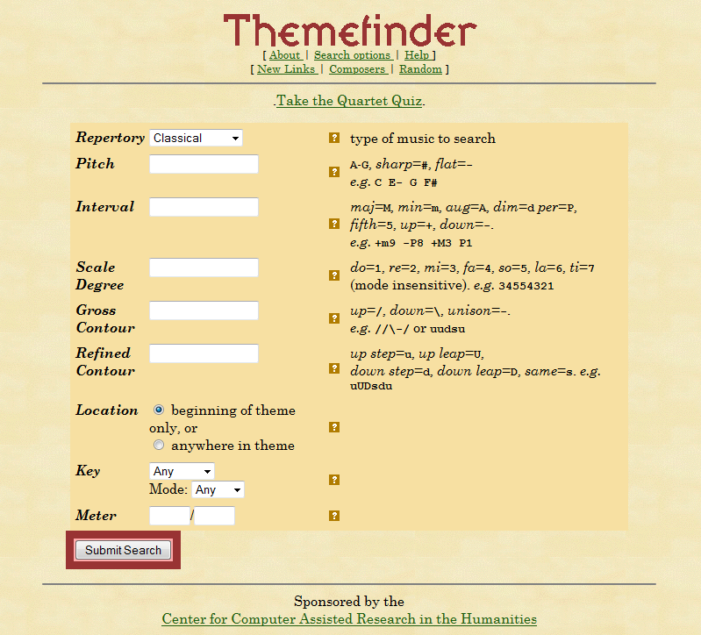
Themefinder
Classical = themes
Folk = incipits
Renaissance = incipits

Slide 19
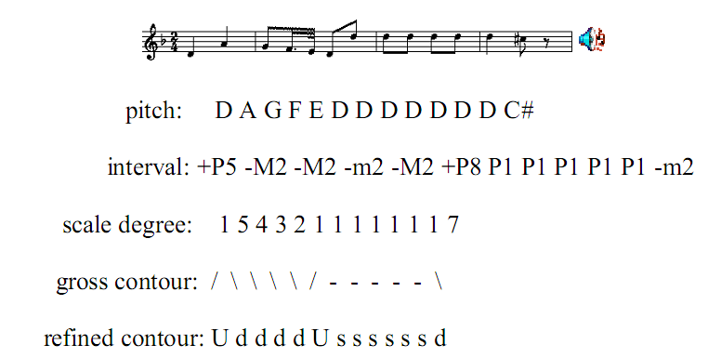
Search examples
…in decreasing order of precision
http://www.themefinder.org

Slide 20
Thought for the day
“The dictionary describes melody as a series of notes strung together in a meaningful sequence.”
Source: U.S. Patent application 20060254411 (Nov. 16, 2006)

