Slide 1
Codes for data archiving, interchange, and analysis: MuseData
Music 253/CS 275A
Stanford University

Slide 2
Distinguishing features
Neither time nor space is a dominant consideration
Focus is on repurposable data, interoperability
Examples
Archiving: canonical format that facilitates interoperability
Interchange: canonical format that is easily interpreted by sending and receiving systems whose formats may be unknown
Analysis: flexible format that can be modified to suit a range of needs (can sometimes be distilled from richer format)

Slide 3
Distinguishing features
Neither time nor space is a dominant consideration
Environment may be extensive; focus on interoperability
Examples
Archiving: EsAC (monophonic), MuseData (polyphonic)
Interchange: MusicXML, MEI
Analysis: Humdrum Toolkit (main format = kern)

Slide 4
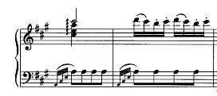
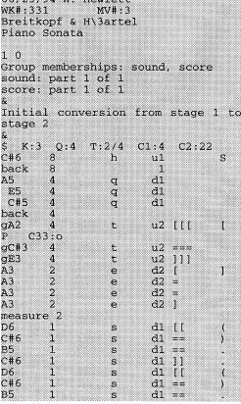
MuseData: Turkish march
chord
Print suggestions
Sound suggestions
Print
suggestion

Slide 5
MuseData network models
MuseData
Analytical apps
Notation apps
Sound apps
Classical music focus
MIDI only
Full encodings

Slide 6
Comparison of models
MuseData
Analytical apps
Notation apps
Sound apps

Slide 7
MuseData encodings (2012)
c. 1250 works

Slide 8
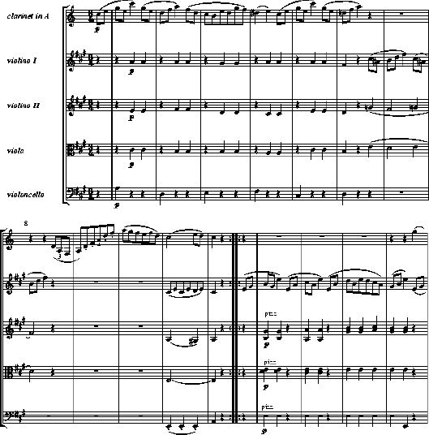
Part/score orientation in MuseData
1. Encode voice by voice for full movement
2. Add lyrics, other refinements
3. Repeat until all movements are encode
4. Assemble score

Slide 9
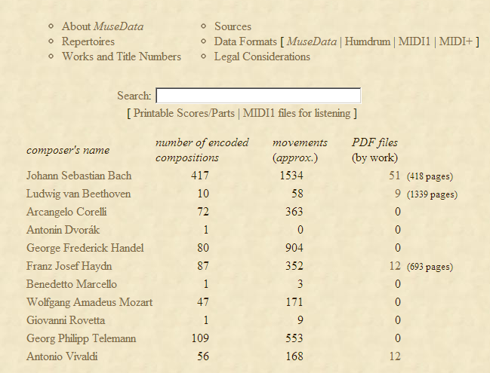
MuseData: encoding
Two-step process
MIDI-level data
Non-sounding data
Serial processes
Storage formats
Stage 1 (pitch, duration)
Stage 2 (stems, lyrics, etc)
Internal format (notation)

Slide 10
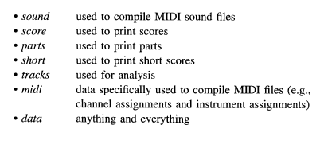
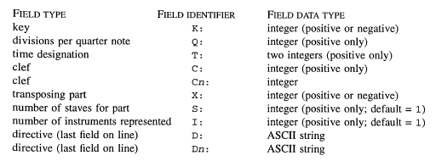
MuseData: instantiations
Input keys

Slide 11
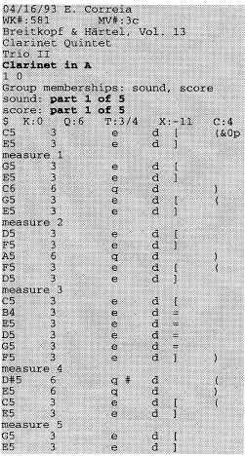
MuseData: Conventional input files
Input data (Stage 1)
Enhanced data
(Stage 2)
Mozart trio: V1

Slide 12
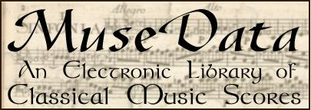
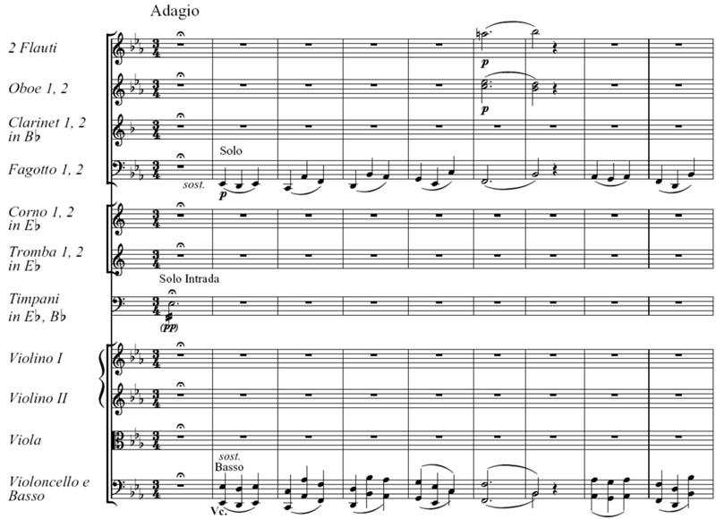
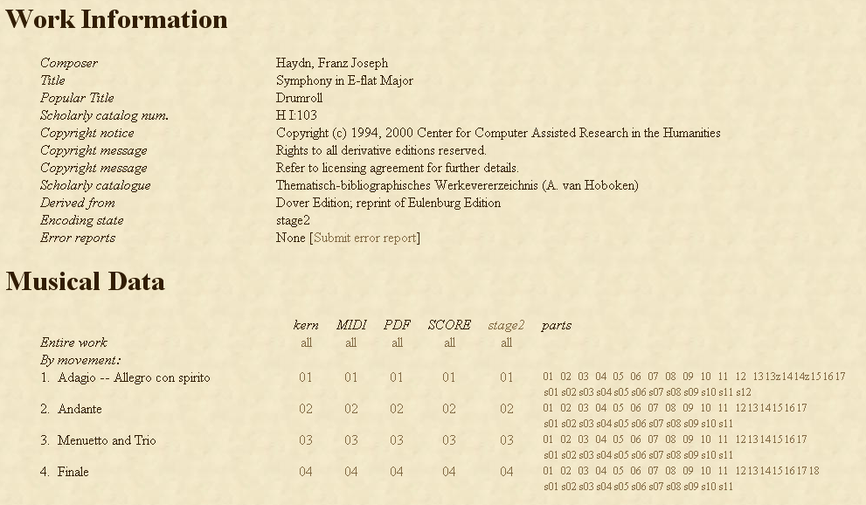
Encoding in multiple domains: Actualities
musedata.org

Slide 13
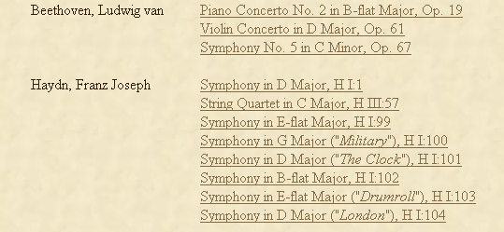
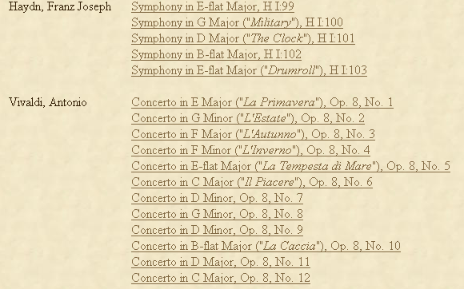
Encoding in multiple domains: samples
From MIDI file list
From PDF list

